Slide 1

Luella Tracy Henderson
NetWork-211
Professor McCracken
02/25/2023

Slide 2

Introduction
In this PowerPoint, I will go over the following:
Setting up Azure
Virtual Machine Instances
Virtual Private Cloud
Azure VM Security
Cloud Storage
Cloud Monitoring

Slide 3


Module 1
In module 1, we prepared by setting up Azure Machine Learning, the process for doing this involved creating an account using our DeVry student emails, shortly then I followed the remainder of the directions given to make sure the set-up was successful.
https://lms.devry.edu/lms/content/1650/65273/NETW211/*NETW211%20CP%20Guide%20Module%201_Oct%202021%20(1).pdf

Slide 4

Week 2- Virtual Machine Instances
We did a project on a virtual machine providing secure and resizable cloud computing capacity in week two.
Week 2 goes over the screenshots from the project I did use Azure Learning Studio.
Deploying a Virtual Machine in Azure, Connecting to the Virtual Machine, & Lastly, deleting the virtual machine.

Slide 5
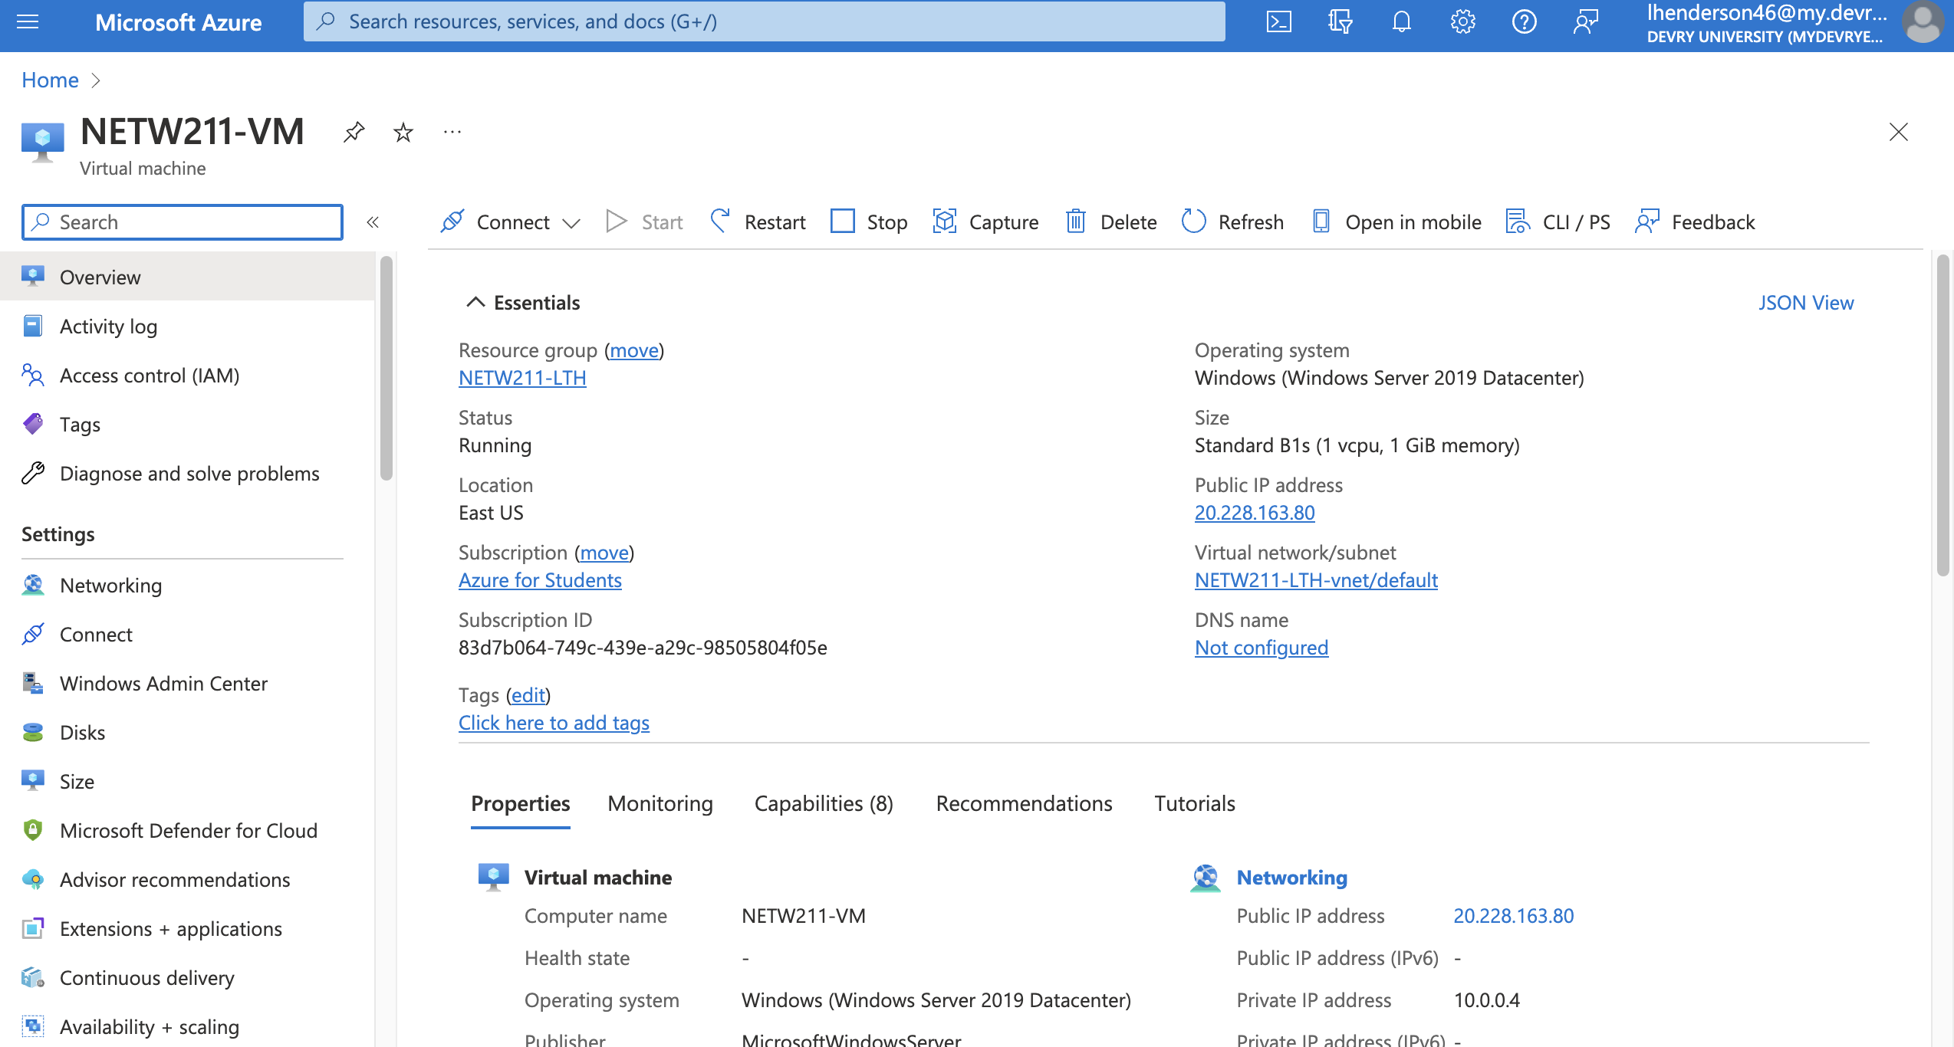
Deploying a VM in Azure
This screenshot should show the NETW211VM page with information such as the resource group name, subscription, public IP address, etc.

Slide 6
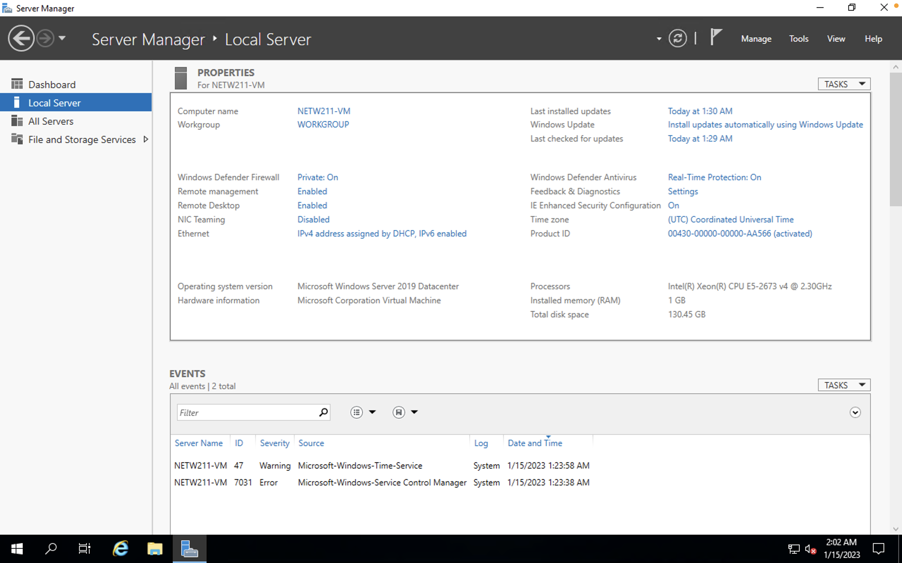
Connecting to the VM
This screenshot should show the PROPERTIES for NETW211VM page, with the computer name, operating system version, hardware information, etc.

Slide 7
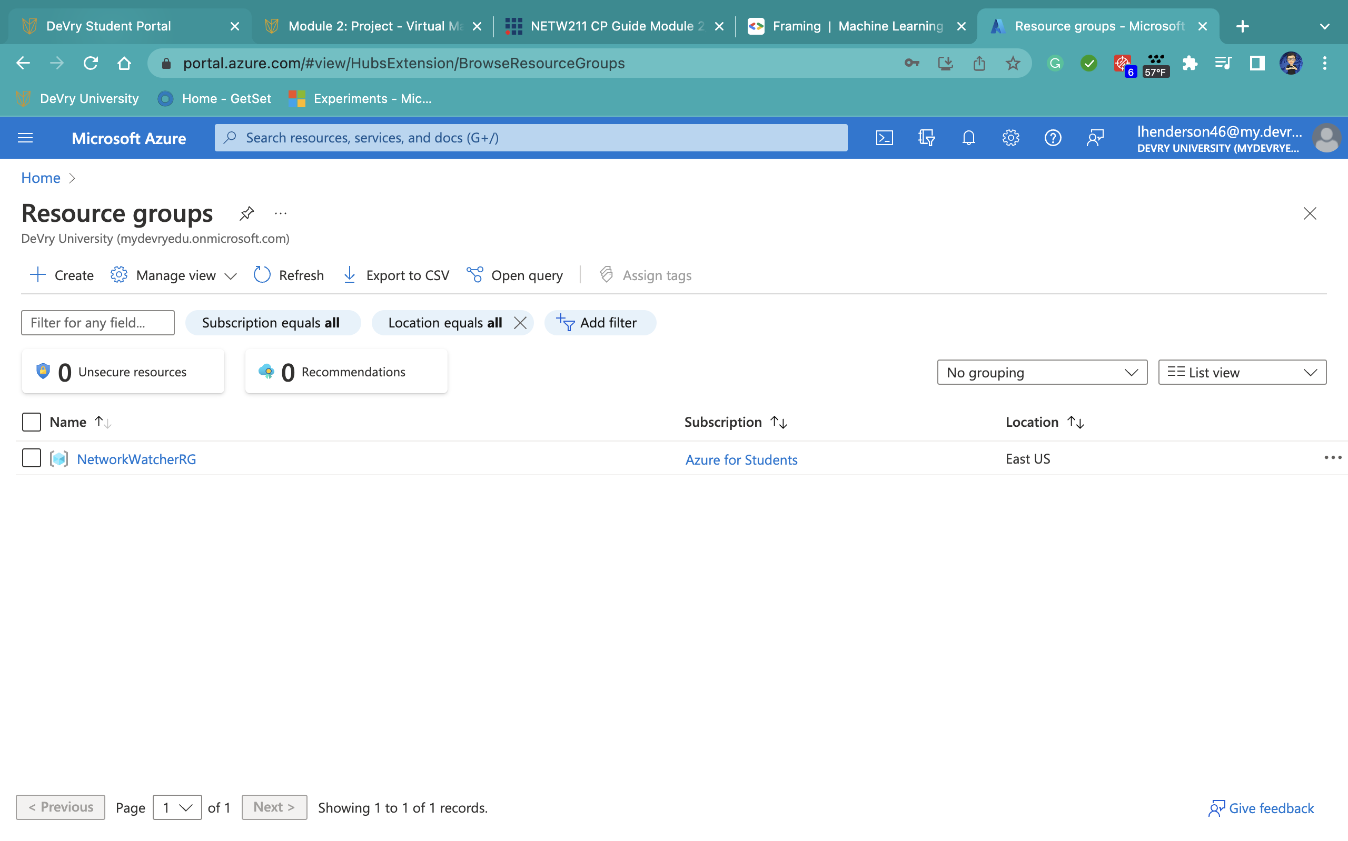
Deleting
the VM
This screenshot should show the Resource groups page, with the Azure for Students subscription selection and the “No resource groups to display” message.

Slide 8

Week 3- Virtual Private Cloud
In module 3, we explored the Virtual Network (VNet), which allows people to provision a logically isolated section of the Azure cloud and launch resources into a virtual network.
Week 3 screenshots are displays of the work using Azure.
We are deploying VMs into subnets & Verifying connectivity.

Slide 9
Creating a VNET with Two Subnets
1. With a /24 network prefix, how many usable IPv4 host addresses are there? [hint: you learned this in NETW191]
The answer here: There are 251 usable host addresses.
2. Given the answer above, why is the number of available IP addresses for Subnet0 (10.0.0.0/24) or Subnet1 (10.0.1.0/24) shown as 251? [hint: where did the missing addresses go?]
The answer here: A /24 host consists of a total of 256 IP Addresses; since it’s a class C network, 5 IPS are reserved for azure protocol conformance.
References (here are two examples to get your research started):
1. IP Subnet Calculator, https://www.calculator.net/ip-subnet-calculator.html
2. Azure Virtual Network frequently asked questions, https://docs.microsoft.com/en-us/azure/virtual-network/virtual-networks-faq
3. https://www.freecodecamp.org/news/subnet-cheat-sheet-24-subnet-mask-30-26-27-29-and-other-ip-address-cidr-network-references/

Slide 10
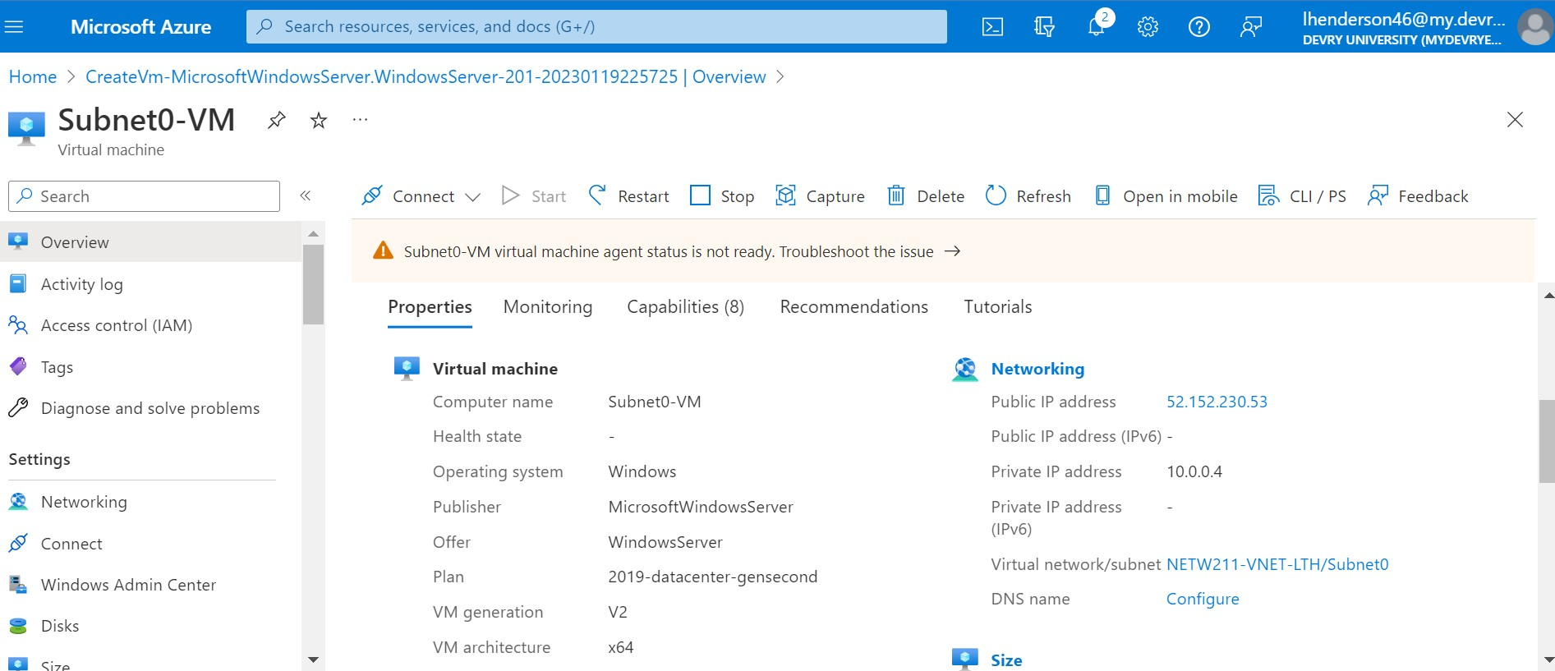
Deploying VMs into Subnets
This screenshot should show the Properties section of the Subnet0-VM page, showing the networking and size information of the VM.

Slide 11
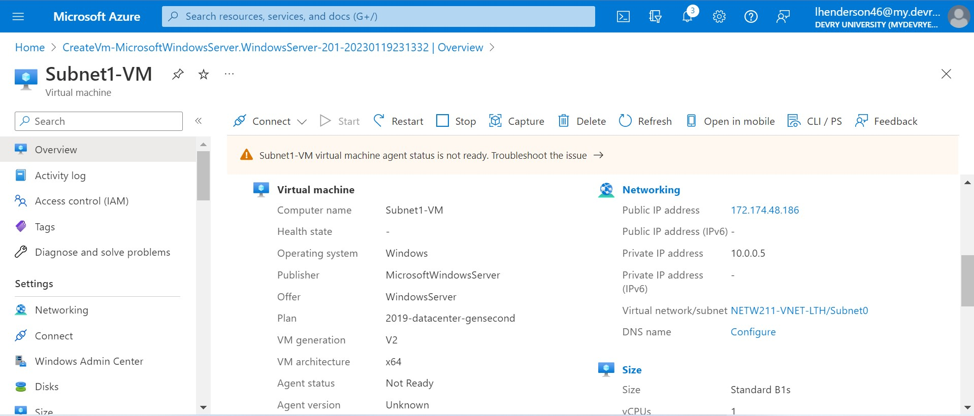
Deploying VMs into Subnets cont’d
This screenshot should show the Properties section of the Subnet1-VM page, showing the networking and size information of the VM.

Slide 12
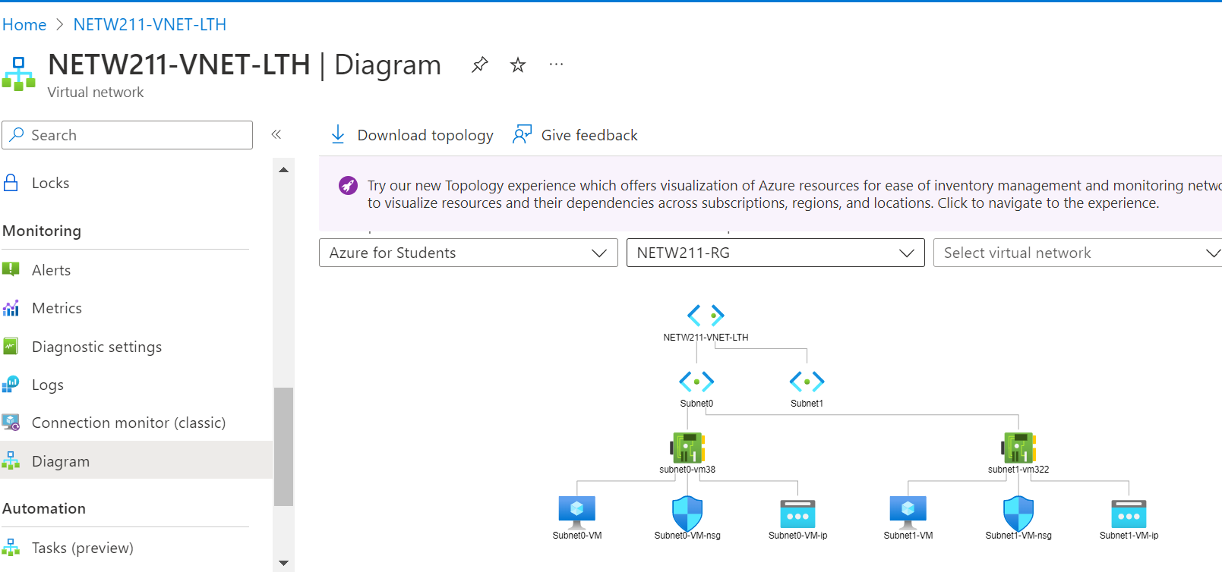
Deploying VMs into Subnets cont’d
This screenshot should show the topology diagram of your VNet (NETW211-VNet-Your Initials) with two subnets (Subnet0 and Subnet1) and one VM in each subnet (Subnet0-VM and Subnet1-VM).

Slide 13
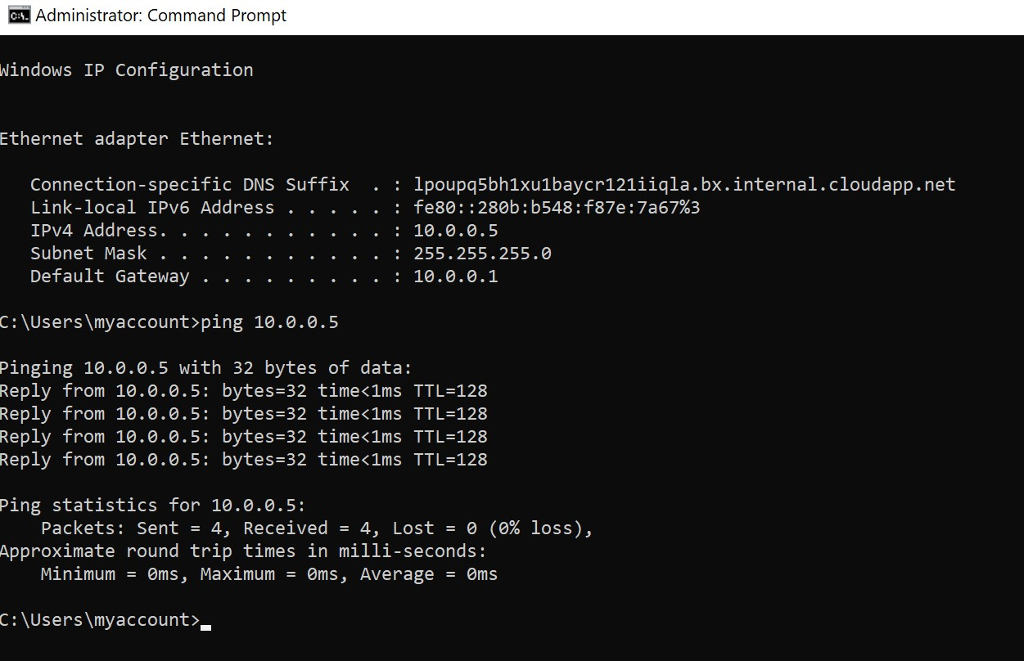
Verifying Connectivity between VMs
This screenshot should show the ipconfig and ping x.x.x.x results in the command prompt window, including the Subnet0-VM – x.x.x.x – Romote Desktop Connection window title.

Slide 14
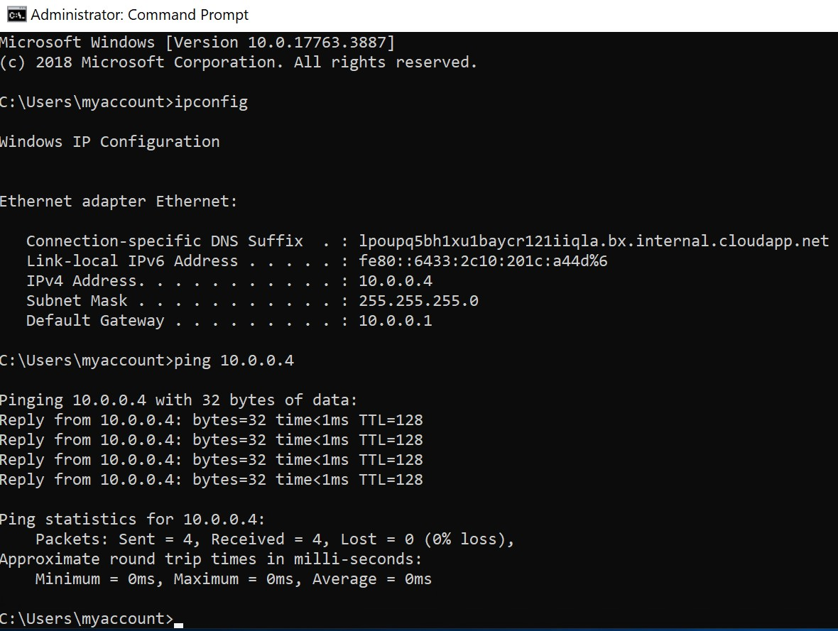
Verifying Connectivity between VMs
cont’d
This screenshot should show the ipconfig and ping x.x.x.x results in the command prompt window, including the Subnet1-VM – x.x.x.x – Romote Desktop Connection window title.

Slide 15

Week 4- Azure Virtual Machine Security
In week 4, I learned how to securely connect to an Azure VM via SSH and control inbound and outbound traffic by configuring a network security group (NSG).
The next few slides go over launching the VM, connecting to the VM via SSH, & configuring an NSG.

Slide 16
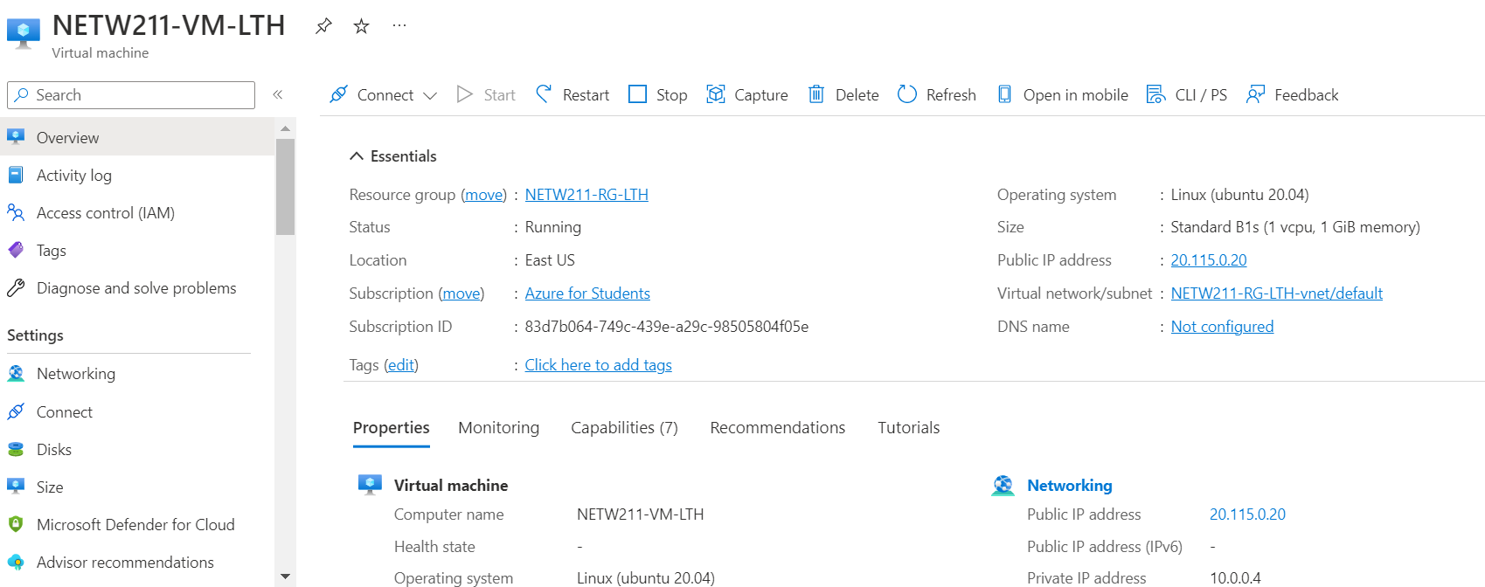
Launching a VM
This screenshot should show the NETW211-VM-Your Initials page, with information such as the resource group name, subscription, public IP address, etc.

Slide 17
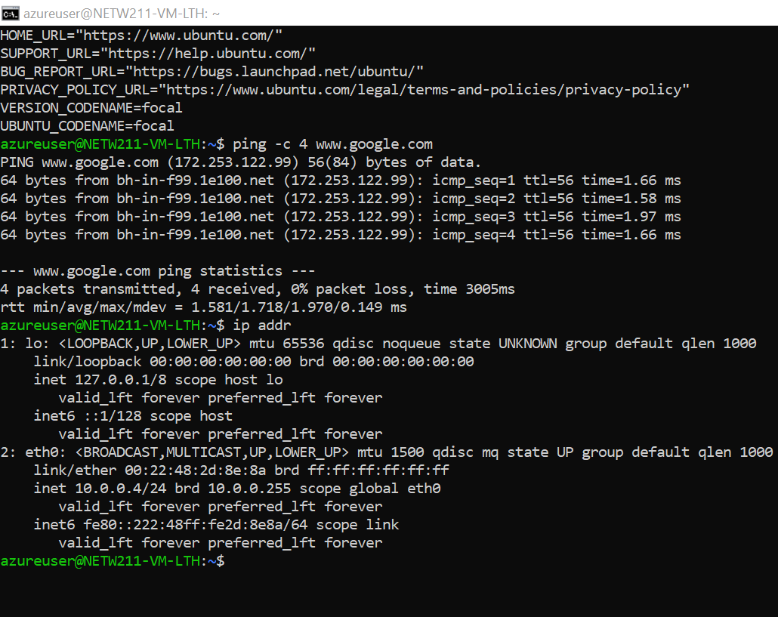
Connecting to the VM
via SSH
This screenshot should show the azureuser@NETW211-VM-Your Initials window showing the IPv4 address of the VM in the Azure cloud.

Slide 18
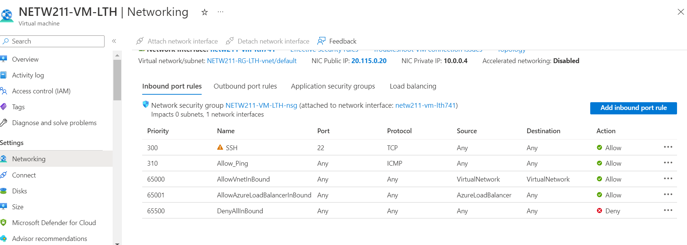
Configuring an NSG
This screenshot should show the Inbound port rules section with the newly added Allow_Ping rule.

Slide 19
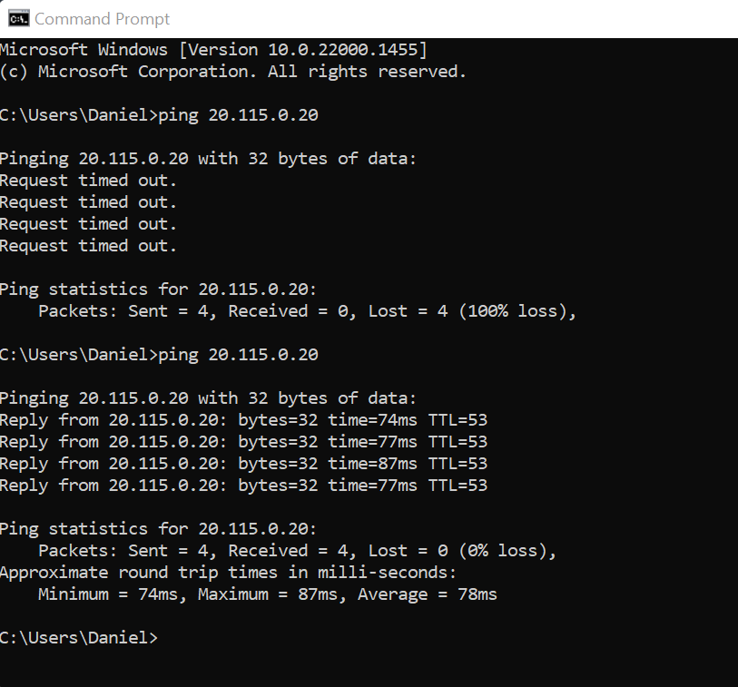
Configuring an NSG
cont’d
This screenshot should show the successful ping result from your local computer to the VM in the Azure cloud.

Slide 20

Week 5- Cloud Storage
In week 5 I learned about Azure's Blob storage and how It is an object storage used to store and protect data for use cases such as mobile applications, websites, backups, IoT devices, and big data analytics.
The following few slides go over the steps of uploading and accepting a file, creating a blob snapshot, & Enabling blob versioning.

Slide 21
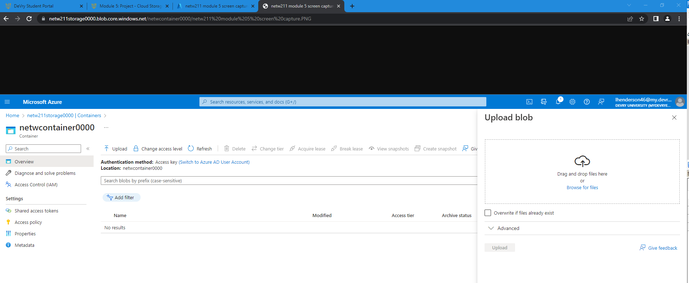
Uploading and Accessing a File
This screenshot should show the browser window with the image uploaded from your local computer and the URL on top of the window.

Slide 22
Question
What does the access tier setting do? What are the Azure blob storage access tiers?
[hint: in the Azure portal, on the Upload blob page, under Advanced, click the? circle above the Access tier box.]
Answer here: The access tier allows users to have access to options that can allow them to save blob object data in the most cost-effective manner possible. The access tier can only be allowed by block blobs.
The Azure blob storage access tiers are:
The archive tier, Cool tier, & Hot tier.
References (here are two examples to get your research started):
1. Hot, Cool, and Archive access tiers for blob data, https://docs.microsoft.com/en-us/azure/storage/blobs/access-tiers-overview
2. Azure Blob Storage Access Tiers, https://devry.percipio.com/courses/c7ef0333-8560-403f-a004-9c5c843866b0/videos/2658bbe6-ee97-438b-a376-fbb079c3b3a0
3. https://www.testpreptraining.com/tutorial/azure-blob-storage-hot-cool-and-archive-access-tiers/

Slide 23
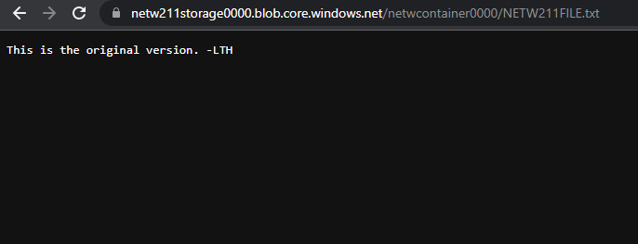
Creating Blob Snapshots
This screenshot should show the browser window with the “This is the original version. –Your Initials” message and the URL on top of the window

Slide 24
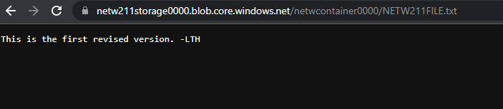
Enabling Blob Versioning
This screenshot should show the browser window with the “This is the first revised version. –Your Initials” message and the URL on top of the window.

Slide 25

Week 6- Cloud Monitoring
In week 6, I learned that Azure Monitoring is a service used to monitor Azure resources.
Some of the things learned were group and notifications, setting up alert rules, & testing alerts.

Slide 26
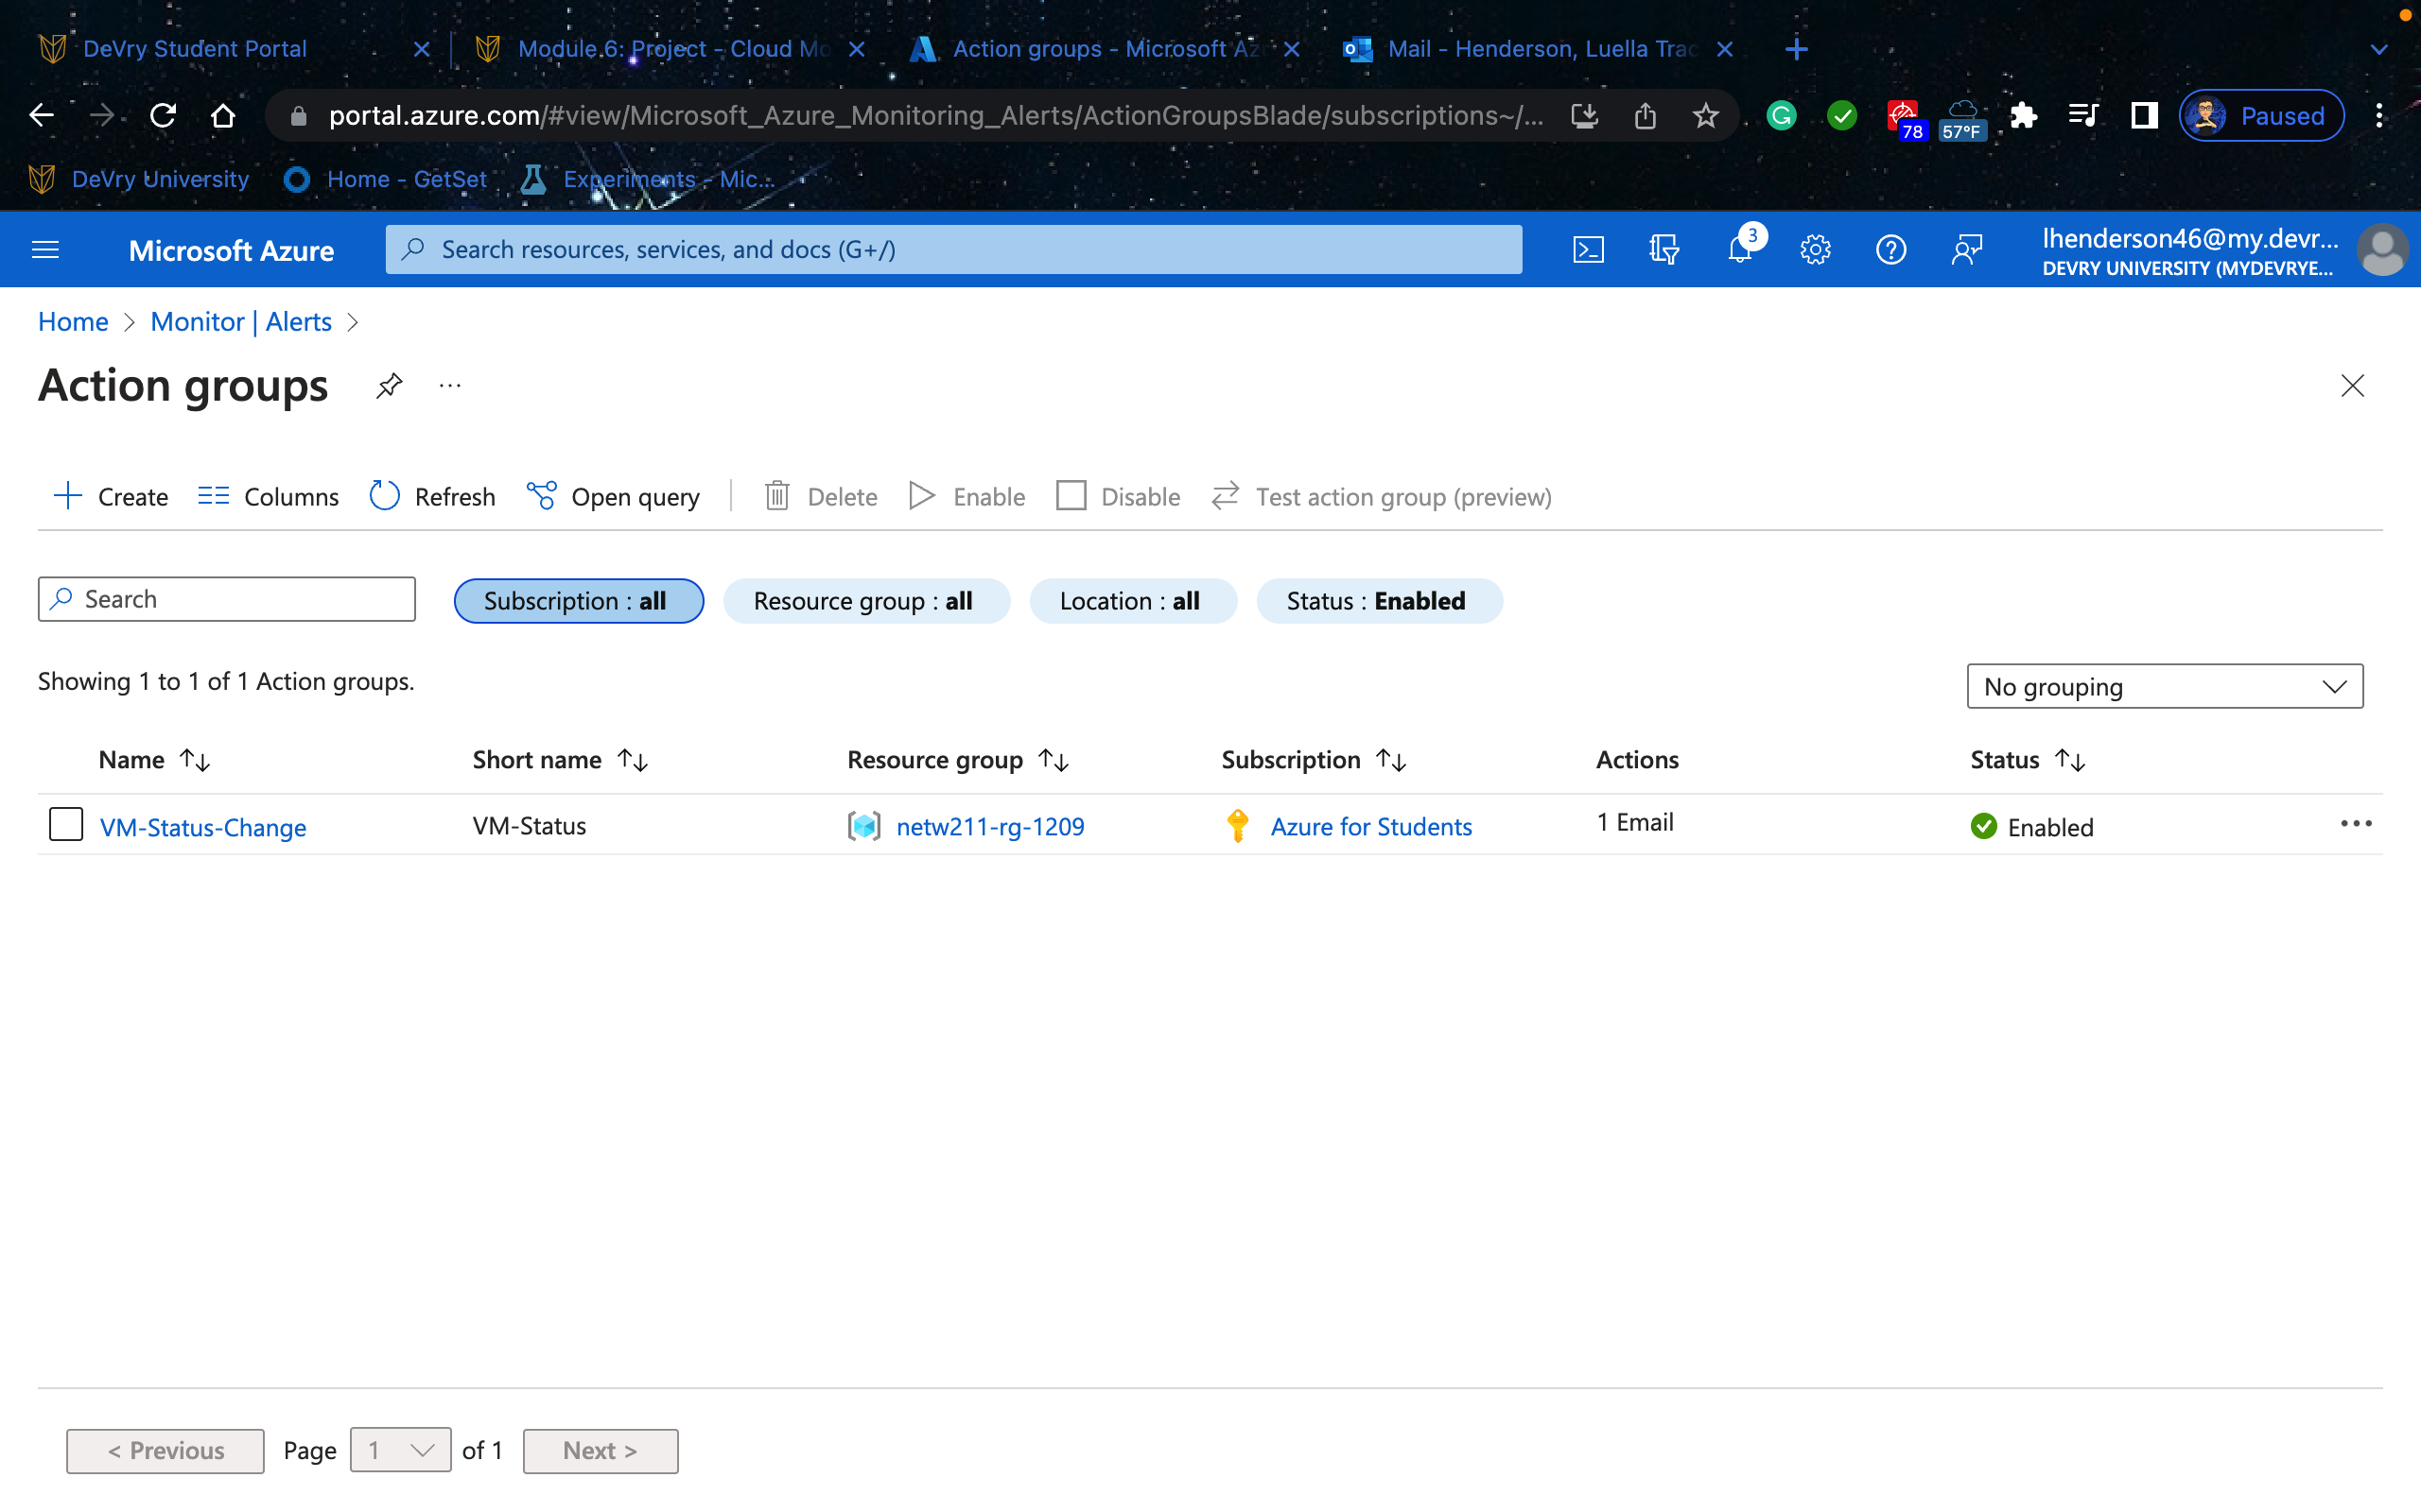
Setting up an Action Group and Notifications
This screenshot should shVM-Status-Change” action group on the
Manage actions page.

Slide 27
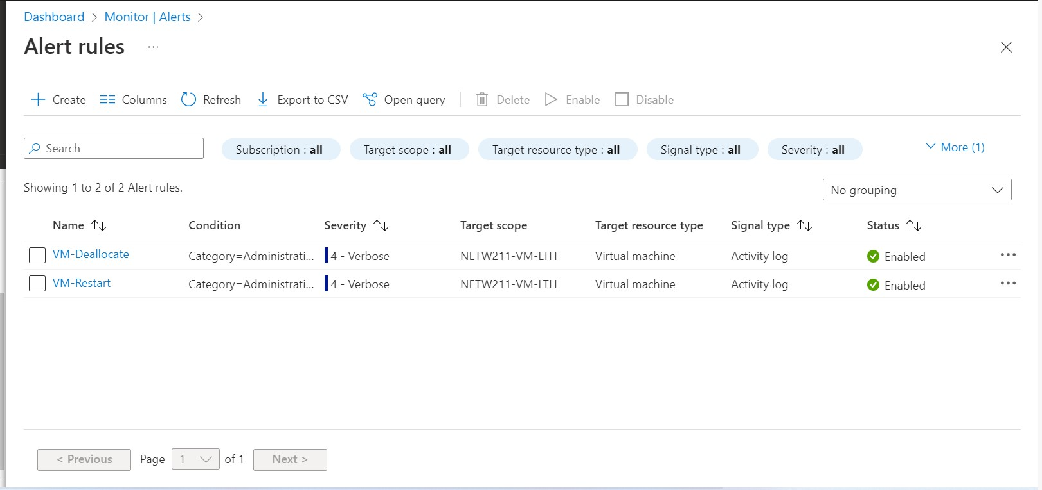
Setting up Alert Rules
This screenshot should show the Alert rules window showing the VM-Deallocate and VM- Restart rules.

Slide 28
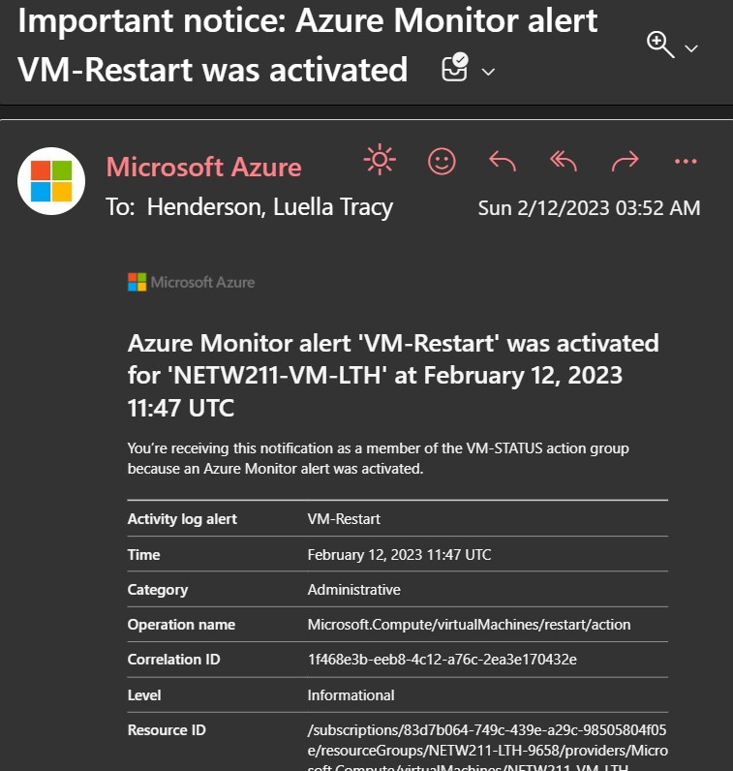
Testing Alerts
This screenshot should show the ‘VM-Restart’ was activated email message with the date and time of the alert.

Slide 29
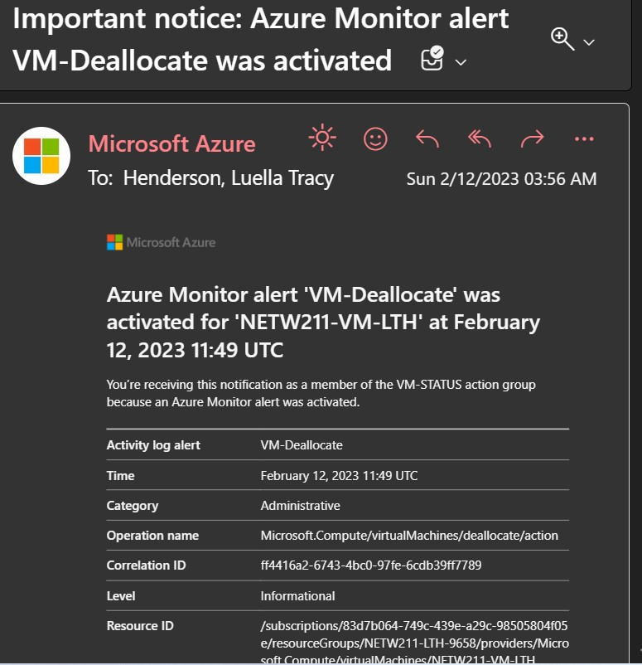
Testing Alerts cont’d
This screenshot should show the ‘VM-Deallocate’ was activated email message with the date and time of the alert.

Slide 30


Challenges
Some challenges that I faced at first were with part of module 6 as far as setting up the alert rules.
This Photo by Unknown Author is licensed under CC BY-ND

Slide 31

Career Skills
Some career skills that I have learned are:
Having better critical thinking skills
Understanding
Patience

Slide 32


References
1. Hot, Cool, and Archive access tiers for blob data, https://docs.microsoft.com/en-us/azure/storage/blobs/access-tiers-overview
2. Azure Blob Storage Access Tiers, https://devry.percipio.com/courses/c7ef0333-8560-403f-a004-9c5c843866b0/videos/2658bbe6-ee97-438b-a376-fbb079c3b3a0
3. https://www.testpreptraining.com/tutorial/azure-blob-storage-hot-cool-and-archive-access-tiers/
IP Subnet Calculator, https://www.calculator.net/ip-subnet-calculator.html
2. Azure Virtual Network frequently asked questions, https://docs.microsoft.com/en-us/azure/virtual-network/virtual-networks-faq
3. https://www.freecodecamp.org/news/subnet-cheat-sheet-24-subnet-mask-30-26-27-29-and-other-ip-address-cidr-network-references/
This Photo by Unknown Author is licensed under CC BY-SA-NC
This Photo by Unknown Author is licensed under CC BY-ND

Slide 33



Conclusion
In conclusion, this class has taught me how:
To set up Azure
Virtual Machine Instances
Virtual Private Cloud
Azure VM Security
Cloud Storage
Cloud Monitoring
This class was exciting, and I learned a lot using Azure.

