Slide 1

Network-191
Luella Tracy Henderson
10/16/2022
Professor Rynarzewski

Slide 2
Introduction
Hello and welcome to this presentation in this PowerPoint I will discuss the work I have demonstrated in Network-191. All of my work was done with Infosec Learning emulator.
The topics I will be discussing are:
IPV4 addressing.
SOHO Router.
Connectivity Testing.
IP Subnetting & Loop playback.
Visio Network Diagram.
& SOHO Wireless Network Security.

Slide 3
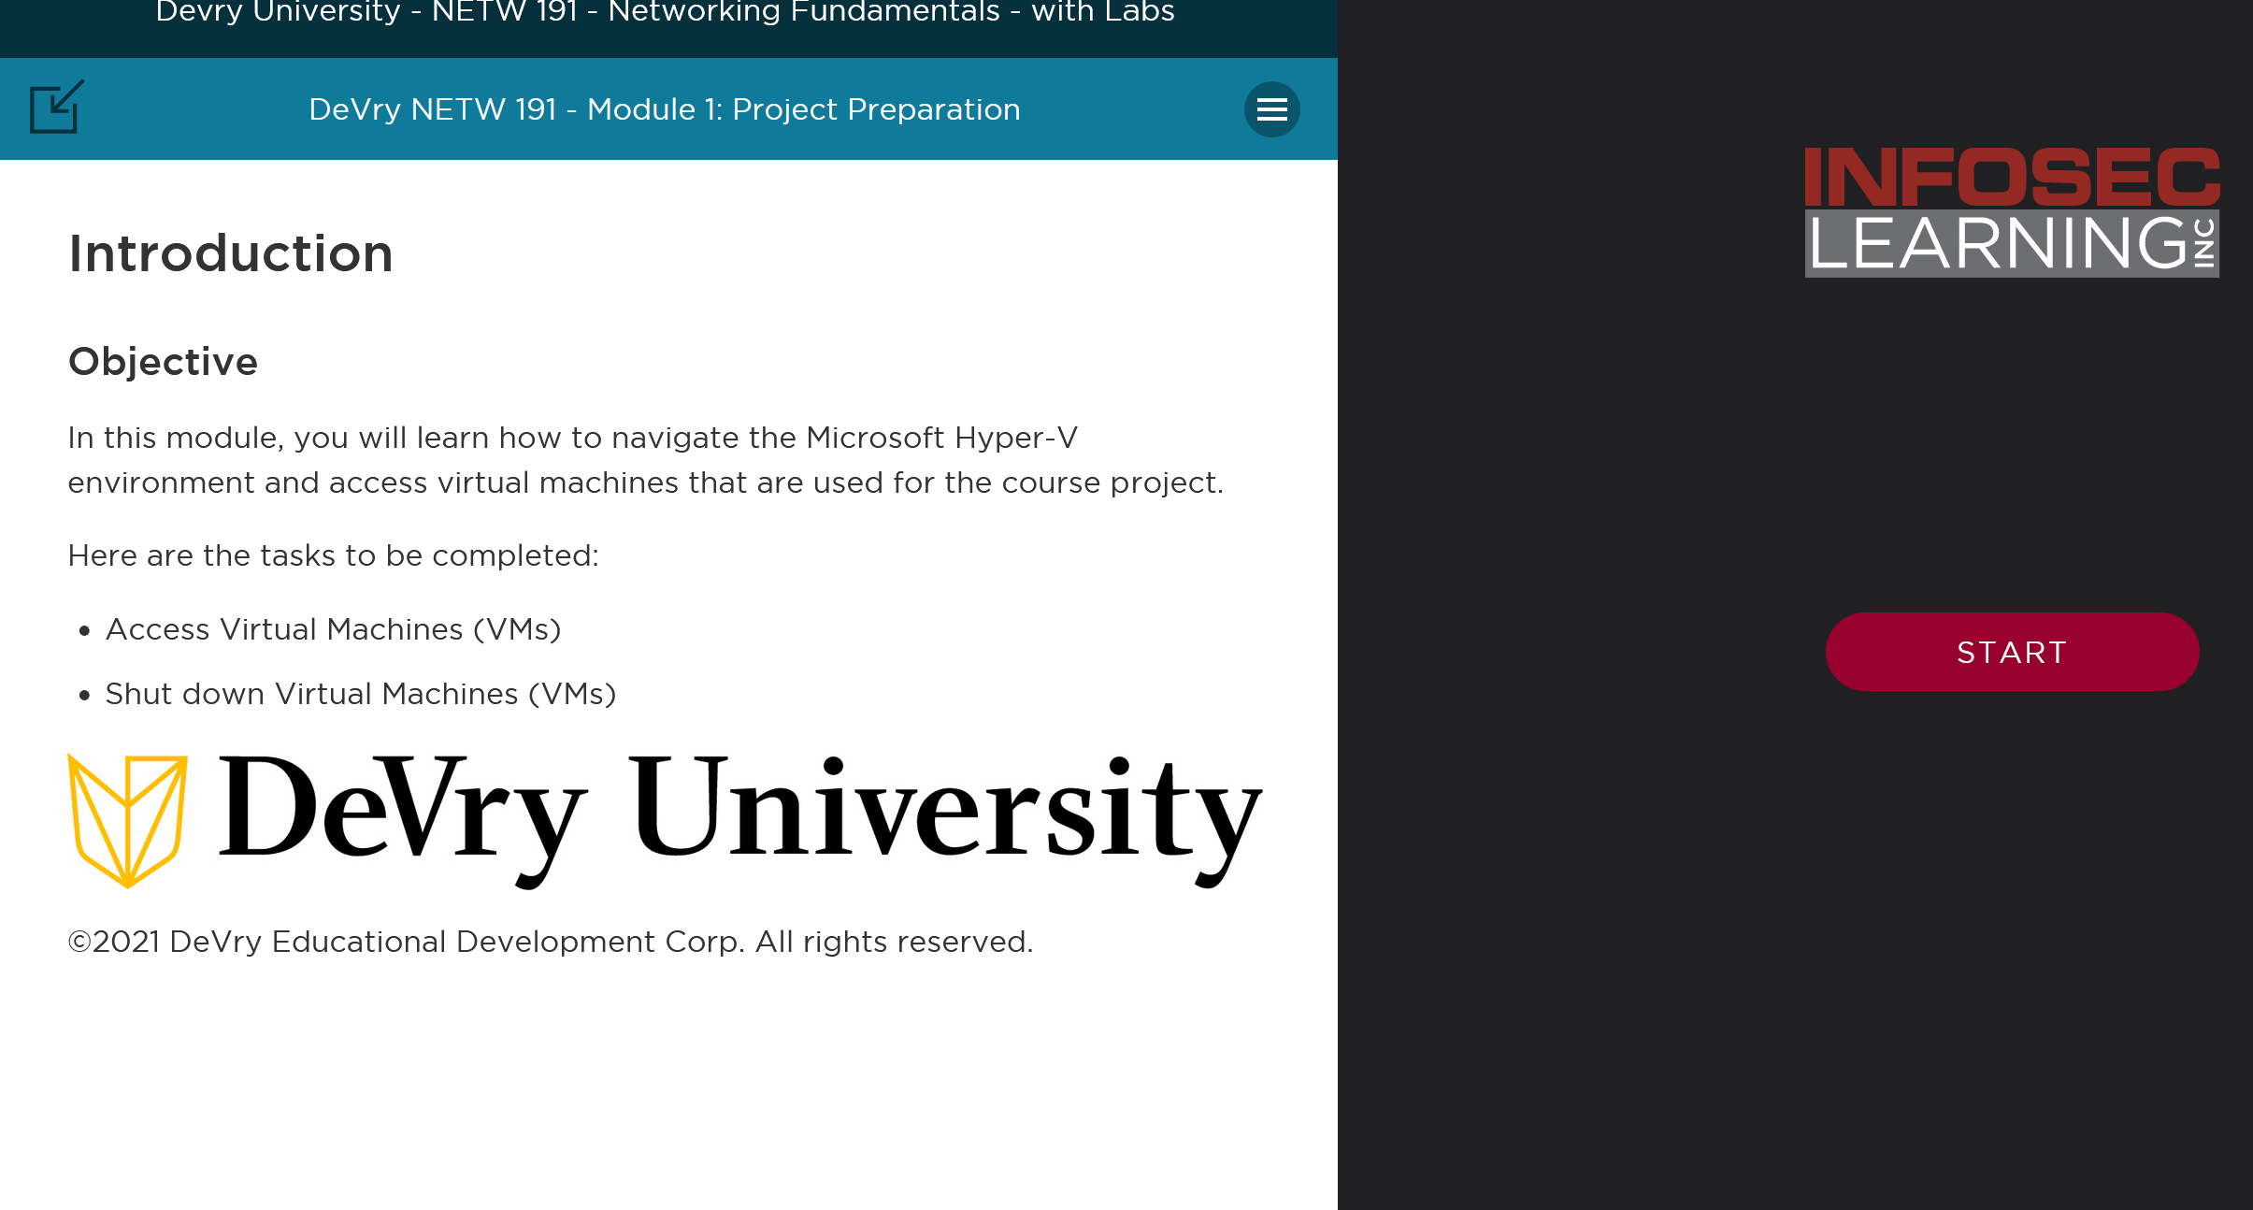
Getting Familiar with Infosec
To begin in order any of the project to have been completed DeVry University uses something called Infosec Learning.
I learned how to use the virtual machines inside of Infosec. The cool thing about infosec and the virtual machines is if you are not familiar virtual machines and infosec there are clear precise instructions on what to do.

Slide 4
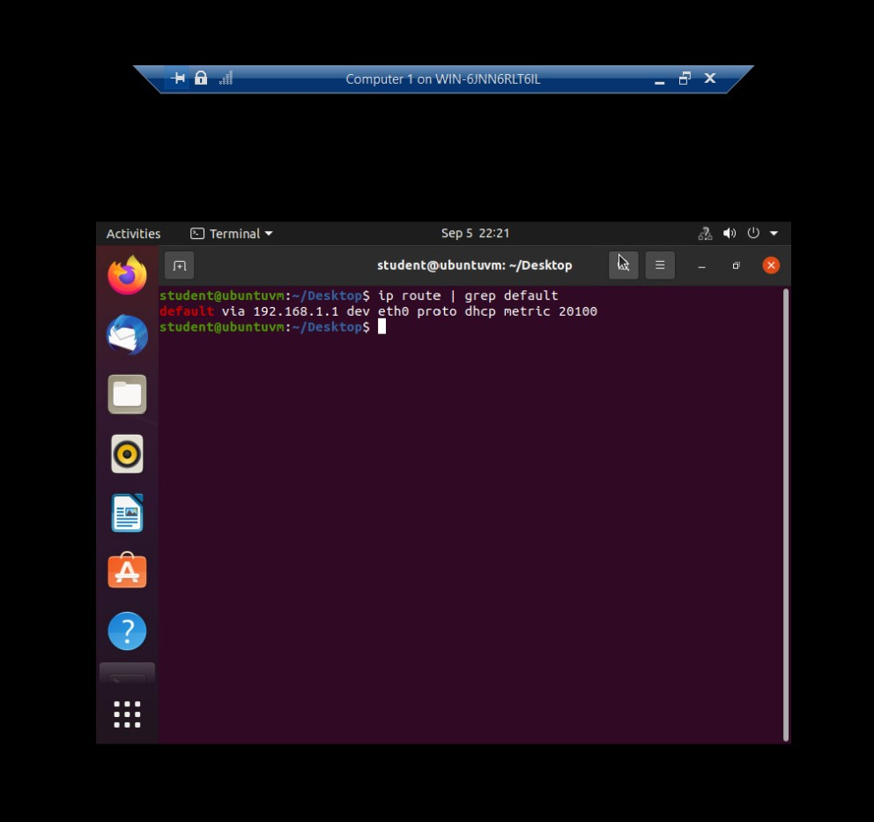
The objective of this module was to implement an IPv4 addressing scheme to support a network.

Slide 5
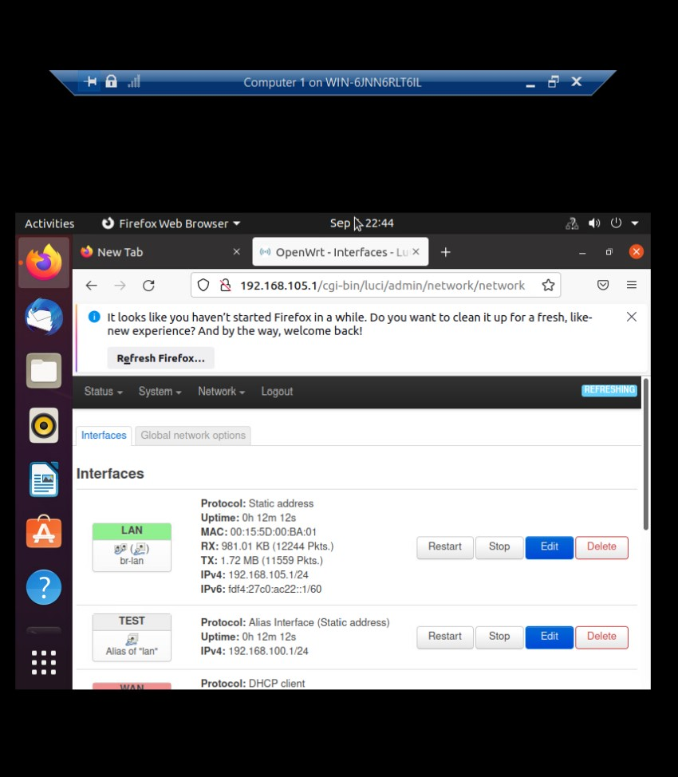
Assigned was an IPv4 address to the SOHO Router virtual machine.

Slide 6
Connectivity Testing W/Infosec
A lot of functionality is built into a SOHO router. It contains a switch that supports multiple interfaces. It has routing functionality that connects your devices to the outside world (e.g., over a cable modem). It automatically performs network address translation between your LAN ports and the WAN port. Many SOHO routers also include wireless access point functionality.
Connectivity was tested among the two computers and SOHO Router.

Slide 7
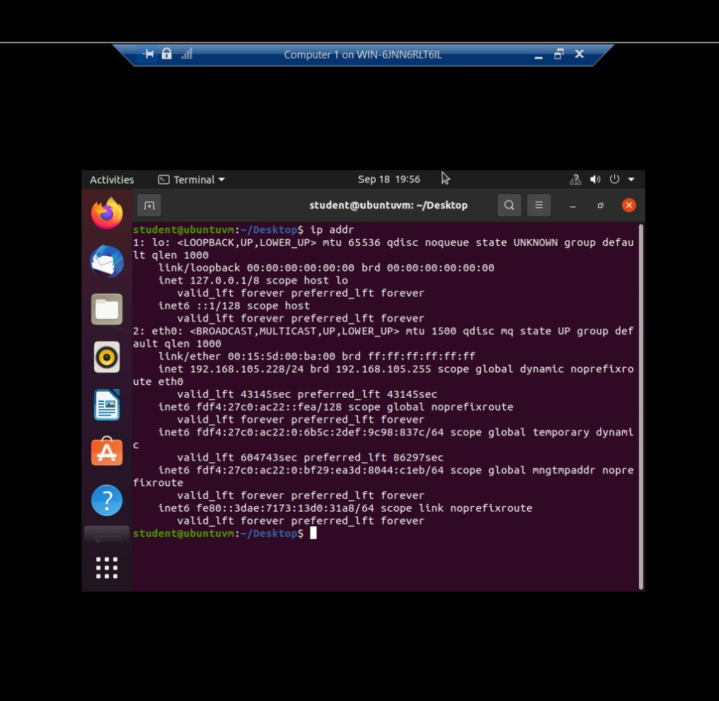
This screenshot shows the IPv4 address of the Computer 1 VM.

Slide 8
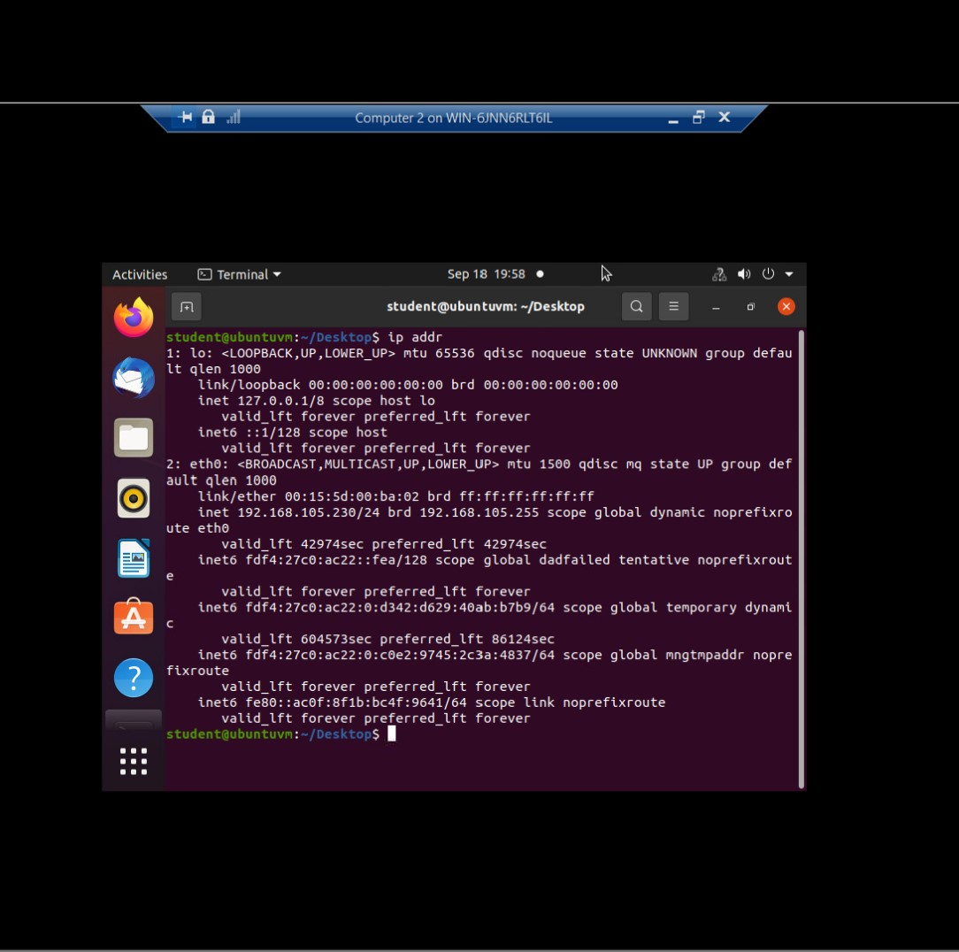
This screenshot shows the IPv4 address of the Computer 2 VM.

Slide 9
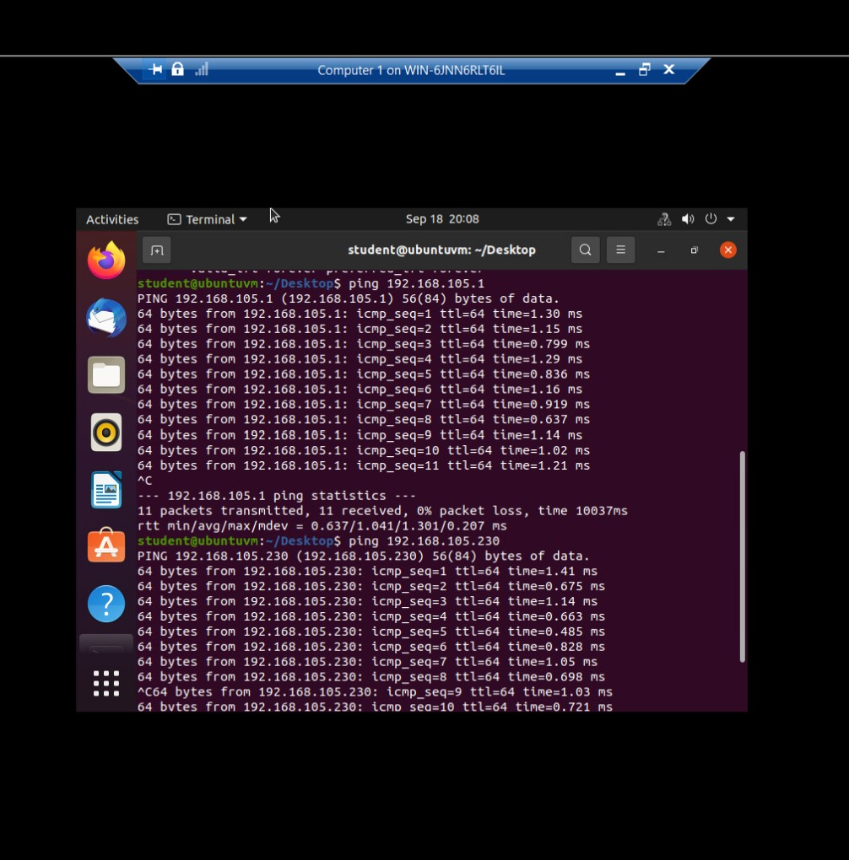
This screenshot shows the connectivity tests between the Computer 1 VM and the other two devices (i.e., the SOHO Router VM and Computer 2 VM).

Slide 10
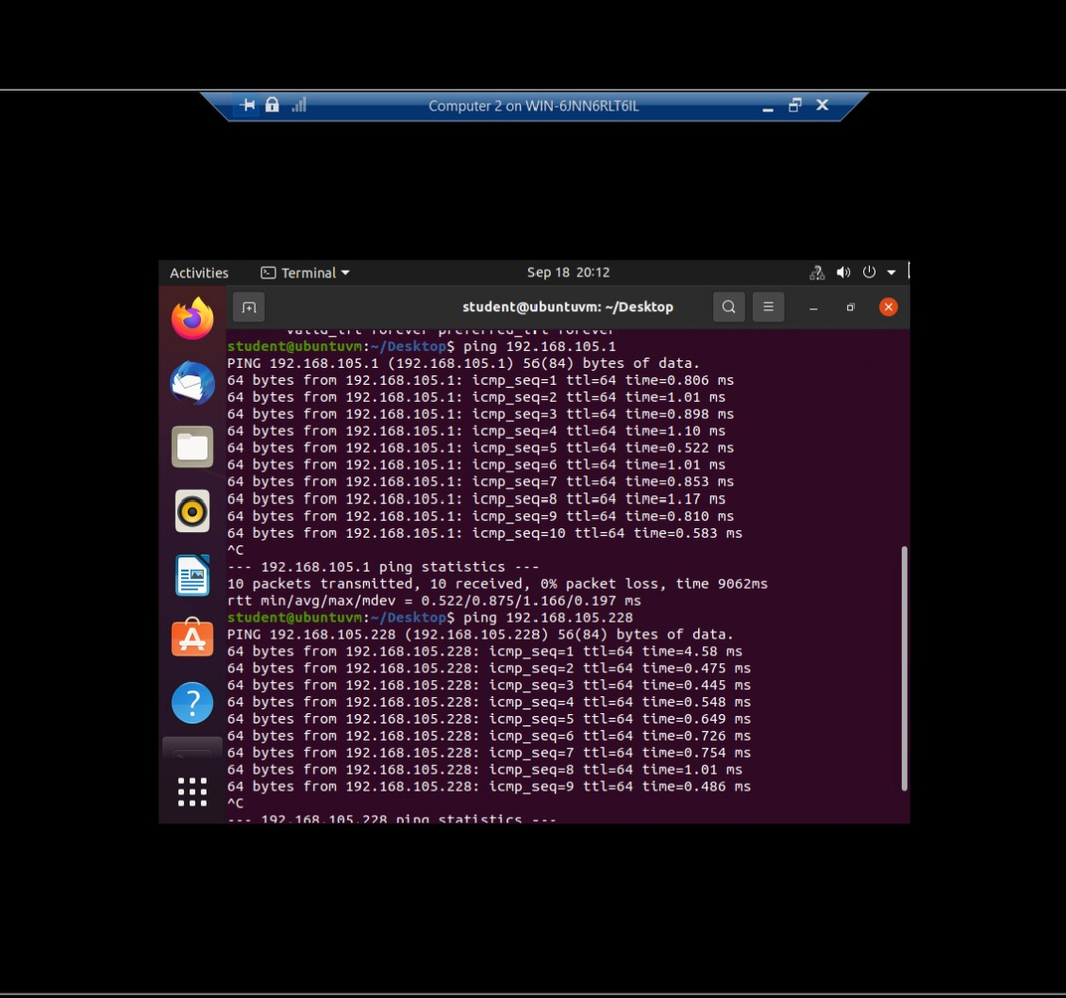
This screenshot shows the connectivity tests between the Computer 2 VM and the other two devices (i.e., the SOHO Router VM and Computer 1 VM).

Slide 11
IP Subnetting & Loopback Interface
I started with a class C network and divided its block of IP addresses into smaller blocks (i.e., subnets). Next, I configured two Loopback interfaces on the SOHO Router, by using IP addresses of newly created subnets, to simulate two LAN segments.

Slide 12
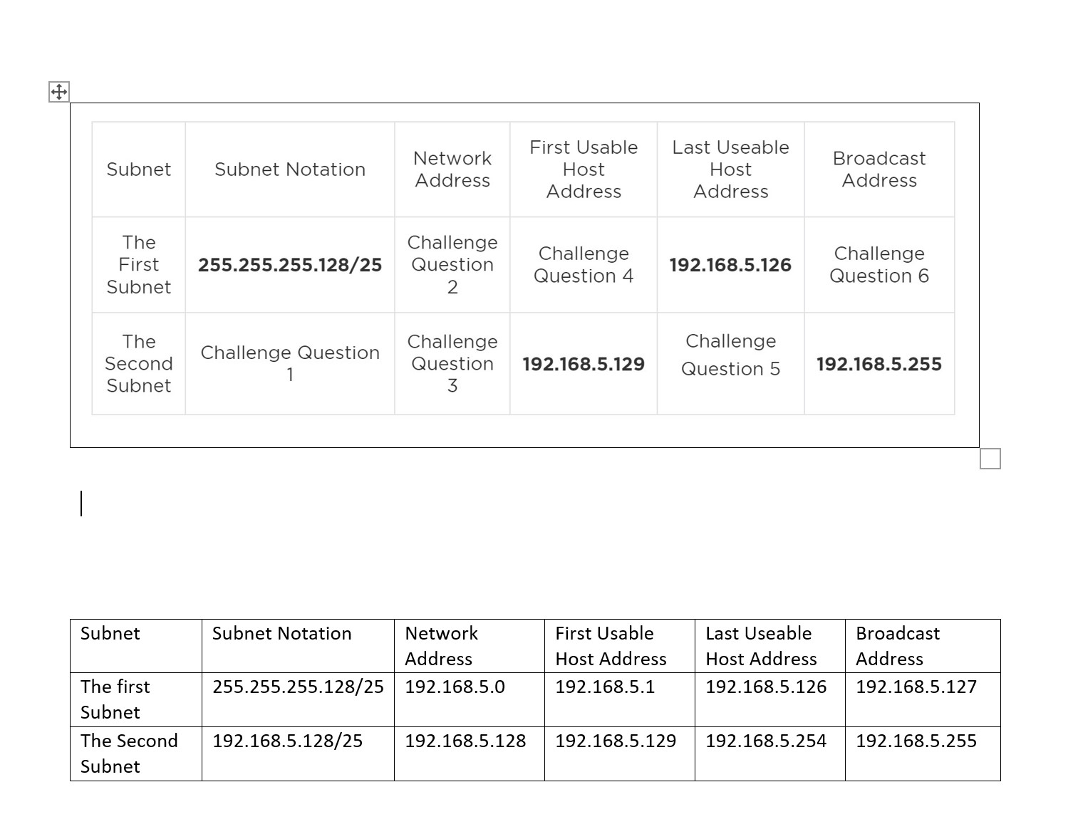
This table includes two /25 subnets, listing the subnet notation, network address, first usable host address, last usable host address, and broadcast address of each subnet.

Slide 13
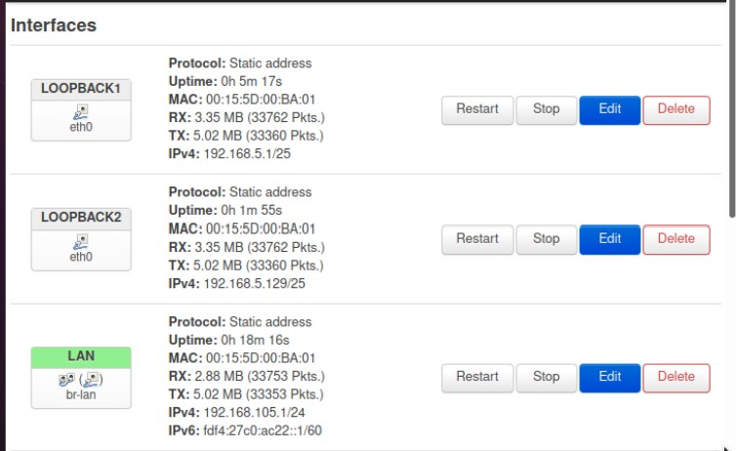
This screenshot shows both Loopback1 and Loopback2 interfaces and their correct IPv4 addresses.

Slide 14
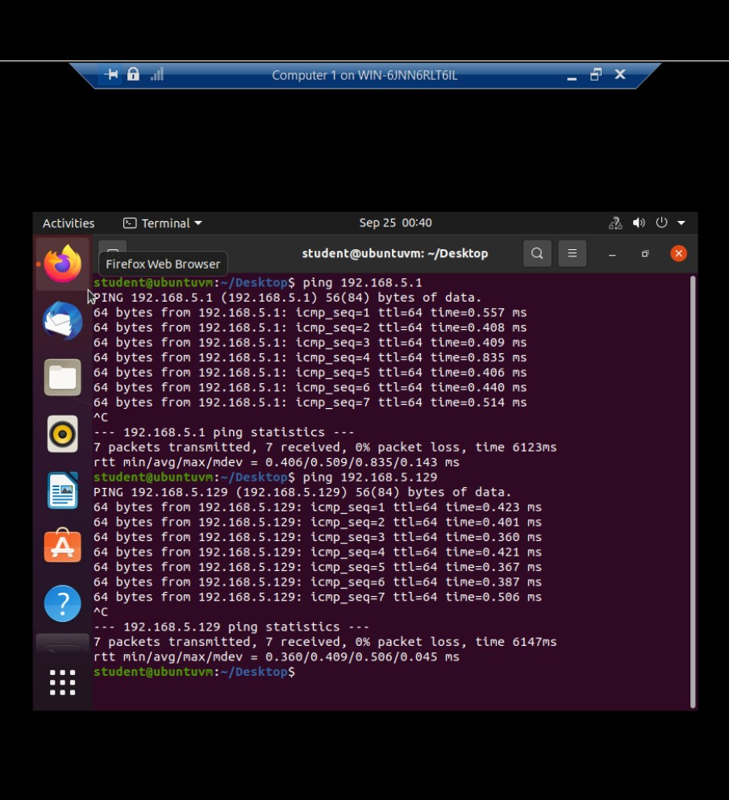
This screenshot shows two successful ping tests from the Computer 1 VM to the Loopback 1 and Loopback 2 interfaces.

Slide 15
Visio Network Diagram
Microsoft Visio was used to create a network diagram that depicts the interconnection of the Computer 1 VM, the Computer 2 VM, and the SOHO Router VM.
What is Microsoft Visio: Microsoft Visio is a diagramming and vector graphics application.
Since this was my first time using Microsoft Visio I did not find it to be to challenging to use but yet easy and fun to use and play around with.

Slide 16
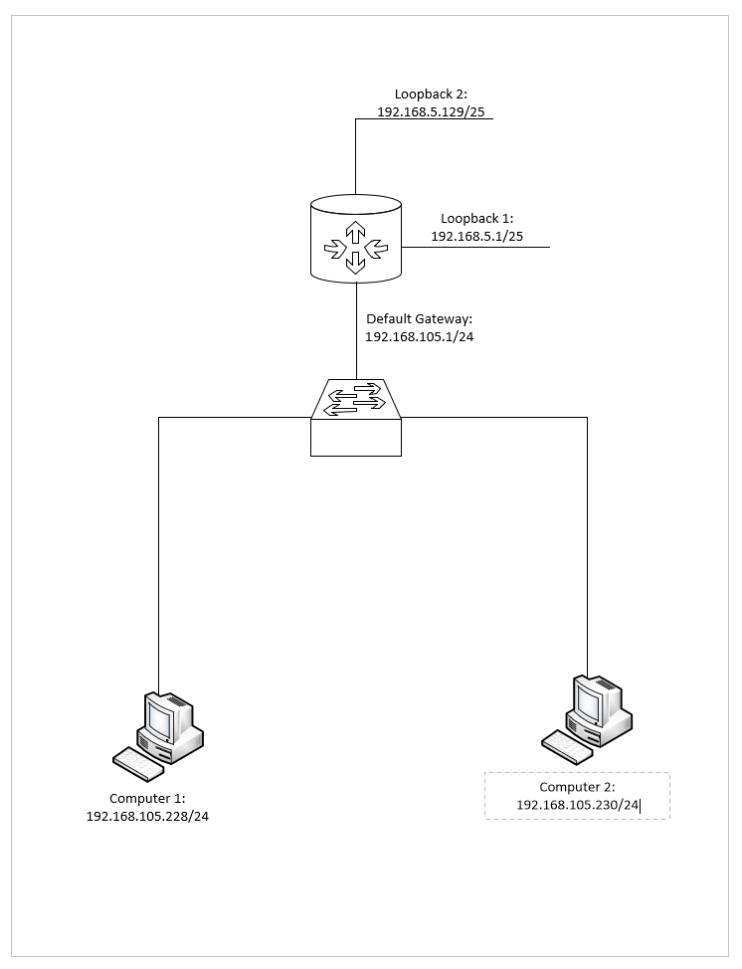
Microsoft Visio Network Diagram shows the interconnection between computer 1 VM, the computer 2 VM, and the SOHO Router.

Slide 17

SOHO Wireless Network and Security
I was able to explore some router configurations that could be used to add protection to a SOHO wireless network.

Slide 18
SOHO Wireless Network Security
1.What are the factory default username and password of a TP-Link router? Why is it important to change the default username and password of a SOHO router?
Answer: The Default username and password is admin. The reason why it is important to change both default password and username is because it makes it vulnerable to hack into to for anyone to gain access.
2. To protect a SOHO wireless network with a small number of devices, which address management method provides more control, configuring the device IP addresses manually (static IP) or using a DHCP server (dynamic IP)? Why? Answer: To protect a SOHO wireless network it is best to use a static IP because it is secure than using a DHCP Server. New IP configuration management will require admin to redo the addressing process with a DHCP it is easier for the IP configuration management, it is more flexible which can leave addresses with some of them being unused meaning this can make things easier to get hacked into.

Slide 19
MAC Filtering
3. What does MAC filtering do? If needed, when would you use deny filtering rules and when would you use allow filtering rules? What happens to devices that want to connect, if the “Allow the stations specified by any enabled entries in the list to access” function is enabled but there are no entries in the list?
Answer:
1. MAC filtering improves security by limiting the devices that can join a network.
2. You would use deny filtering rules when you do not want access to be gained to the AP.
3. You would allow access to filtering when access is allowed to be gained to the AP.
4. If there are no enabled functions available on the list then there will be no wireless access to the AP.

Slide 20
SOHO Wireless Network Security
What wireless security settings are displayed on the Wireless Security page? Which one is recommended by the vendor? Why?
Answer: Disable Wireless Security - The wireless security function can be enabled or disabled. If disabled, the wireless stations will be able to connect the device without encryption. It is recommended strongly that you choose one of following options to enable security. WPA/WPA2 - Personal - Select WPA based on pre-shared passphrase. WPA/WPA2 - Enterprise - Select WPA based on Radius Server. WEP - Select 802.11 WEP security. It is strongly recommended to enable wireless security and select WPA2-PSK AES encryption. Longer key lengths makes the wireless security system a bit more difficult to crack and figure out.
2. Among the configurations you explored in this module, which one is a true security function? Why?
Answer: Wireless security settings using authentication and encryption protocols (RADIUS, 802.1x, PSK, TKIP, WPA2, WPA) protects the wireless access password. Change the default admin username and the password non-mandatory PW Policy. MAC Filtering- Validity of MAC Address- MAC address spoofing. Static & DHCP- IP address configuration.
3. What would you do to protect your wireless network at home? Why?
Answer: Some ways to protect your wireless network at home are:
Encrypting your network which makes it harder for anyone to figure out and get ahold of your personal information, Change router preset passwords (Wi-Fi Network & router admin) to something more secure and harder for anyone else to figure out, set up a separate login for guest, remember to log out as administrator on your devices.

Slide 21
References
1. TP-Link Emulators | TP-Link
2. TP-LINK router login | TP-LINK Default Router Password & Username (routerpasswords.com)
3. DHCP vs Static IP: What's the Difference? | FS Community
4. MAC Filtering in Computer Network – GeeksforGeeks
5. How To Secure Your Home Wi-Fi Network | Consumer Advice (ftc.gov)
…

Slide 22

Challenges
The only challenge that I have faced while doing this class was basically getting the gist of figuring out IP addresses fully. I am sure overtime that it is something that will come to me with practice.

Slide 23

Career Skills
Some career skills that I have learned are:
Better critical thinking
Understanding
Troubleshooting and problem solving

Slide 24
Conclusion
I hope you have enjoyed my presentation
This class has taught me the basics of networking using and doing the following:
IPV4 addressing.
SOHO Router.
Connectivity Testing.
IP Subnetting & Loop playback.
Visio Network Diagram.
SOHO Wireless Network Security.
This class was exciting and yet challenging as I have learned a lot and will continue to learn and go more in-depth when it comes to networking in my further classes.

