Slide 1
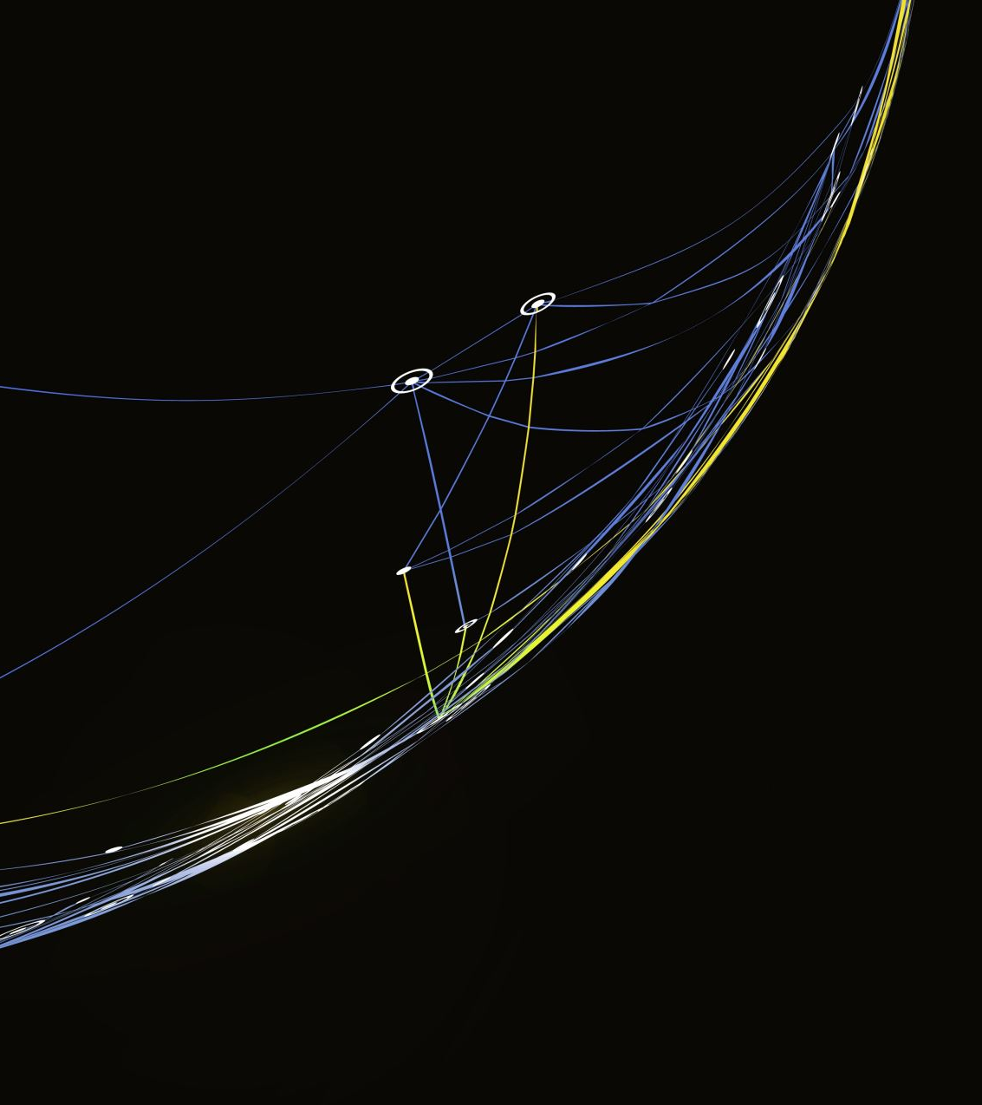
Luella Tracy Henderson
Final Project Week 8
8/26/2023

Slide 2
Introduction
In this project I will be presenting of how I developed a stock
Using Spyder IDE as well as GUI for results.
I will go over each Slide and what it entails on the build up leading to the final presentation

Slide 3
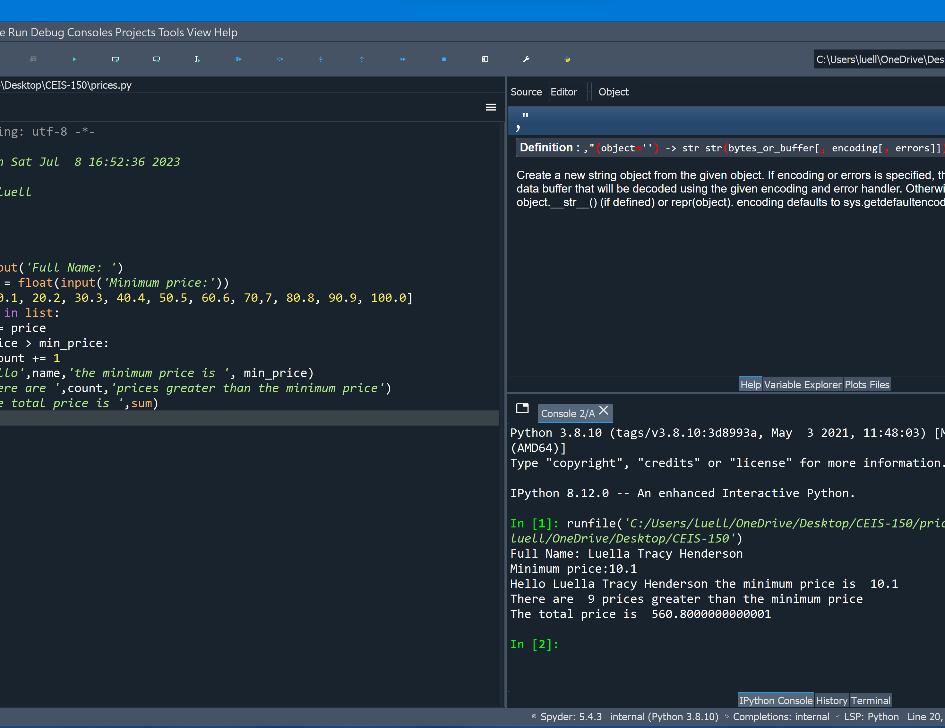
Program
Screen shot of Python program running successfully.

Slide 4
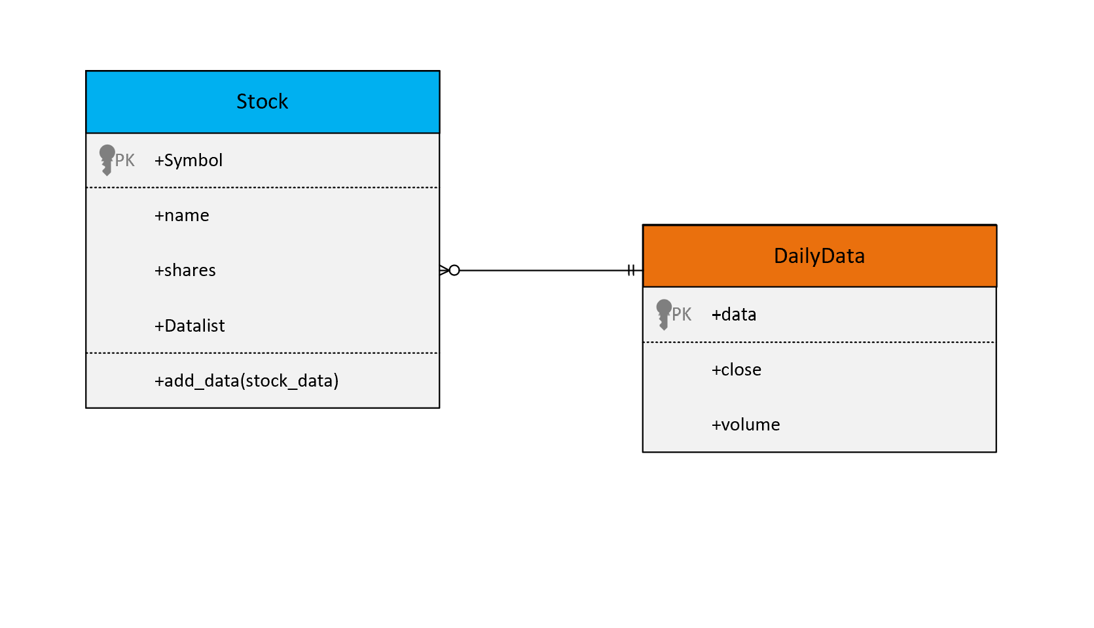
Class Diagram
Paste your Visio Class Diagram

Slide 5
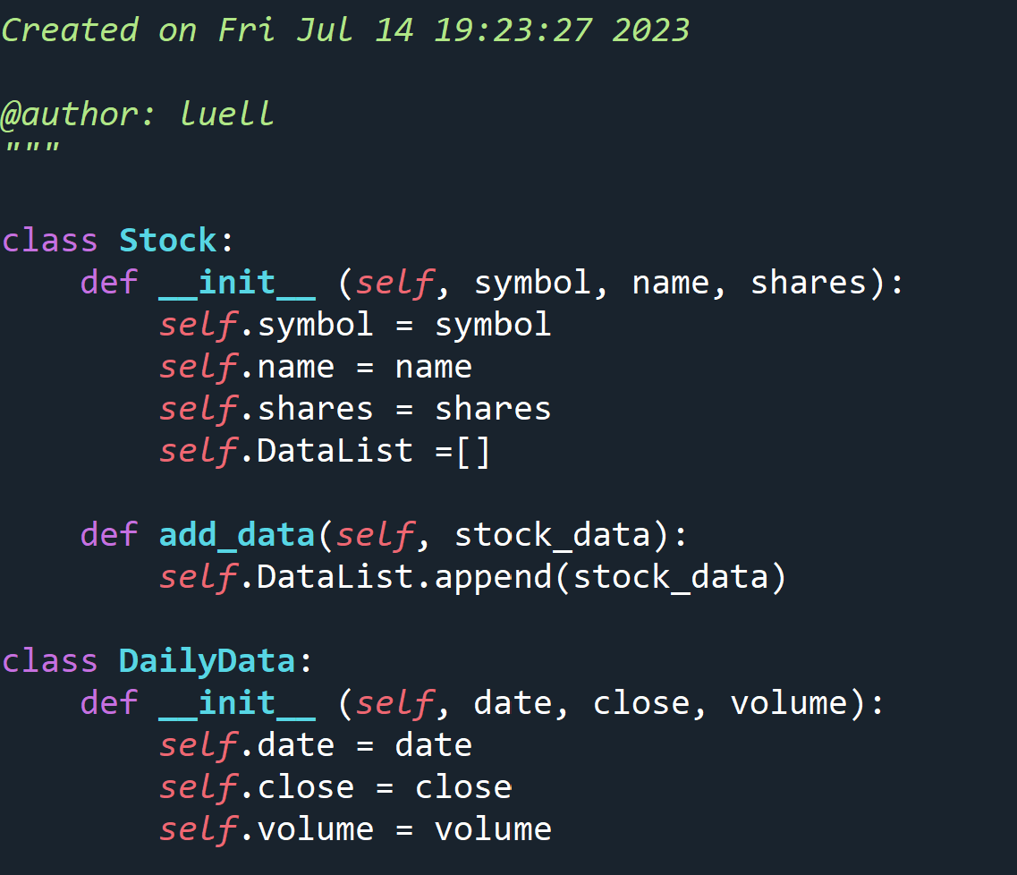
Class Code
Screen Shot of your stock_class.py file.

Slide 6
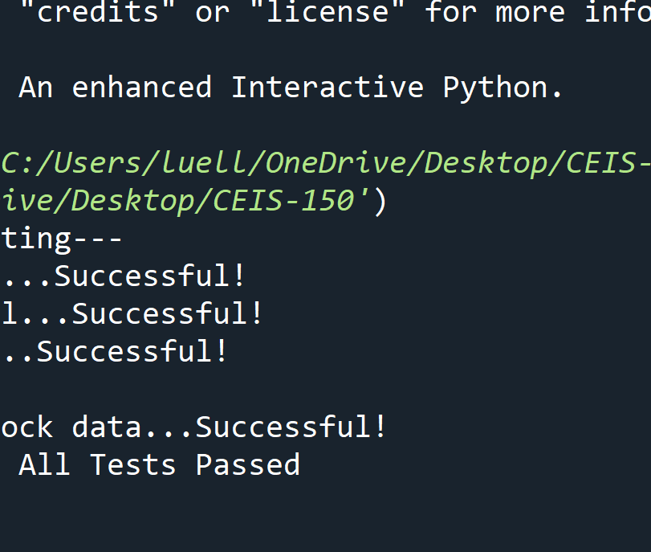
Unit Test
Screen Shot of your successful unit test.

Slide 7
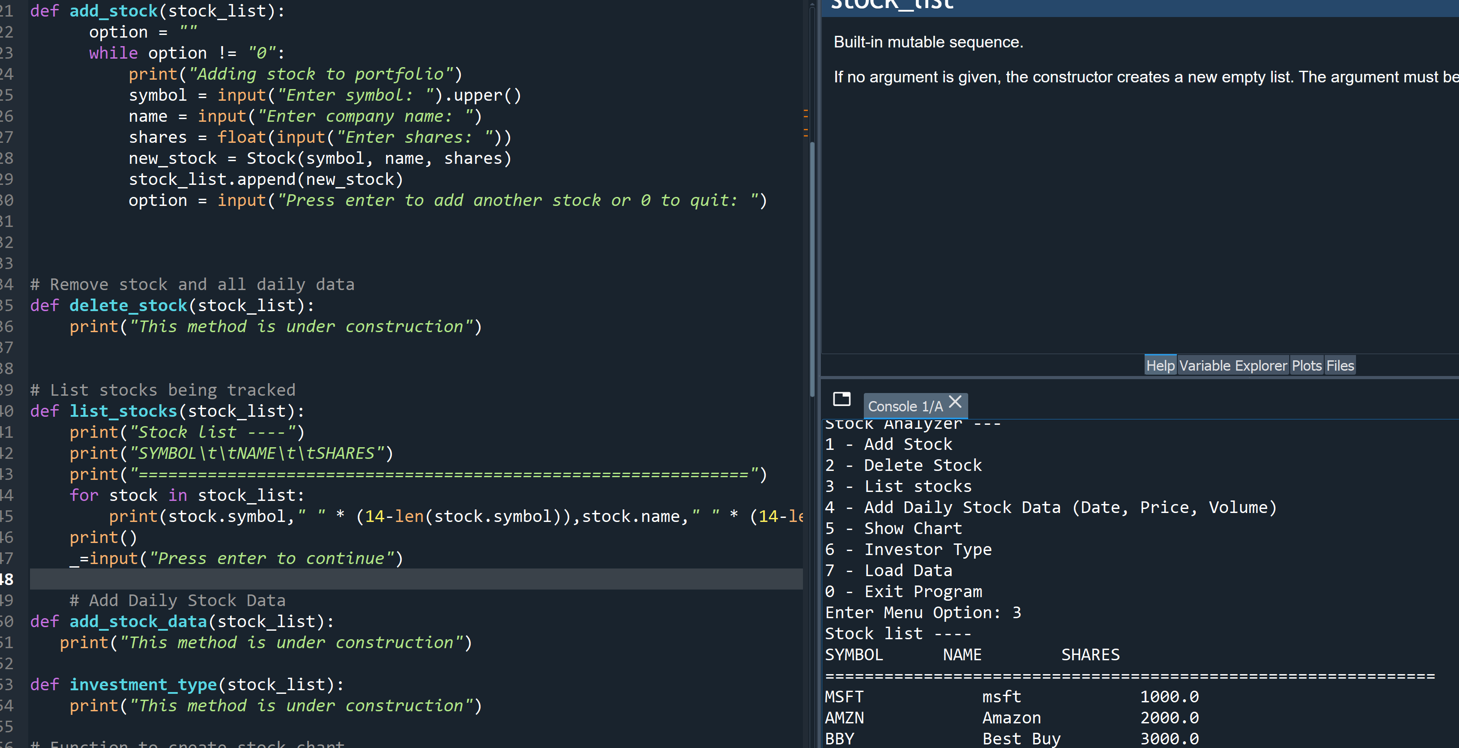
Adding a Stock
Paste a screen shot of your working Stock program.

Slide 8
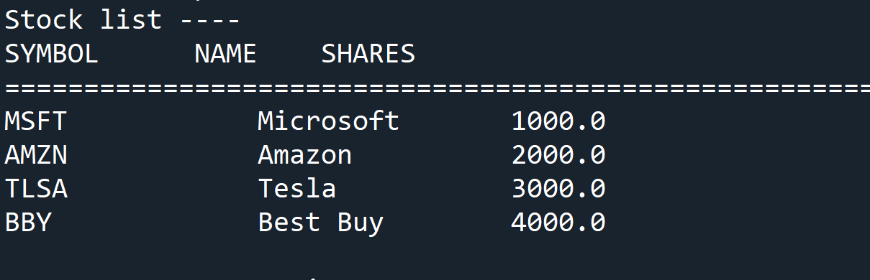
Listing 3 Stocks
Paste a screen shot of your working Stock program.

Slide 9
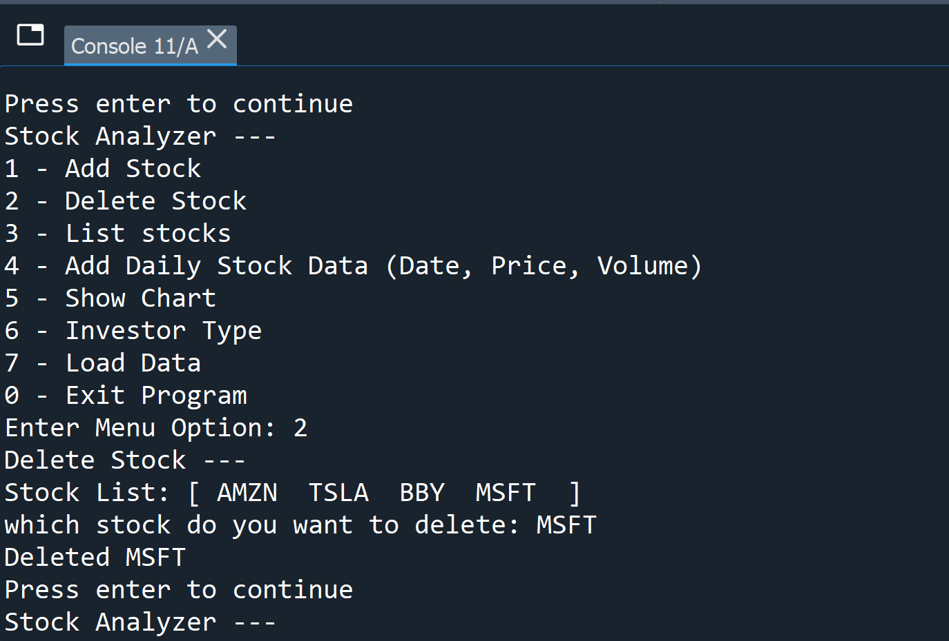
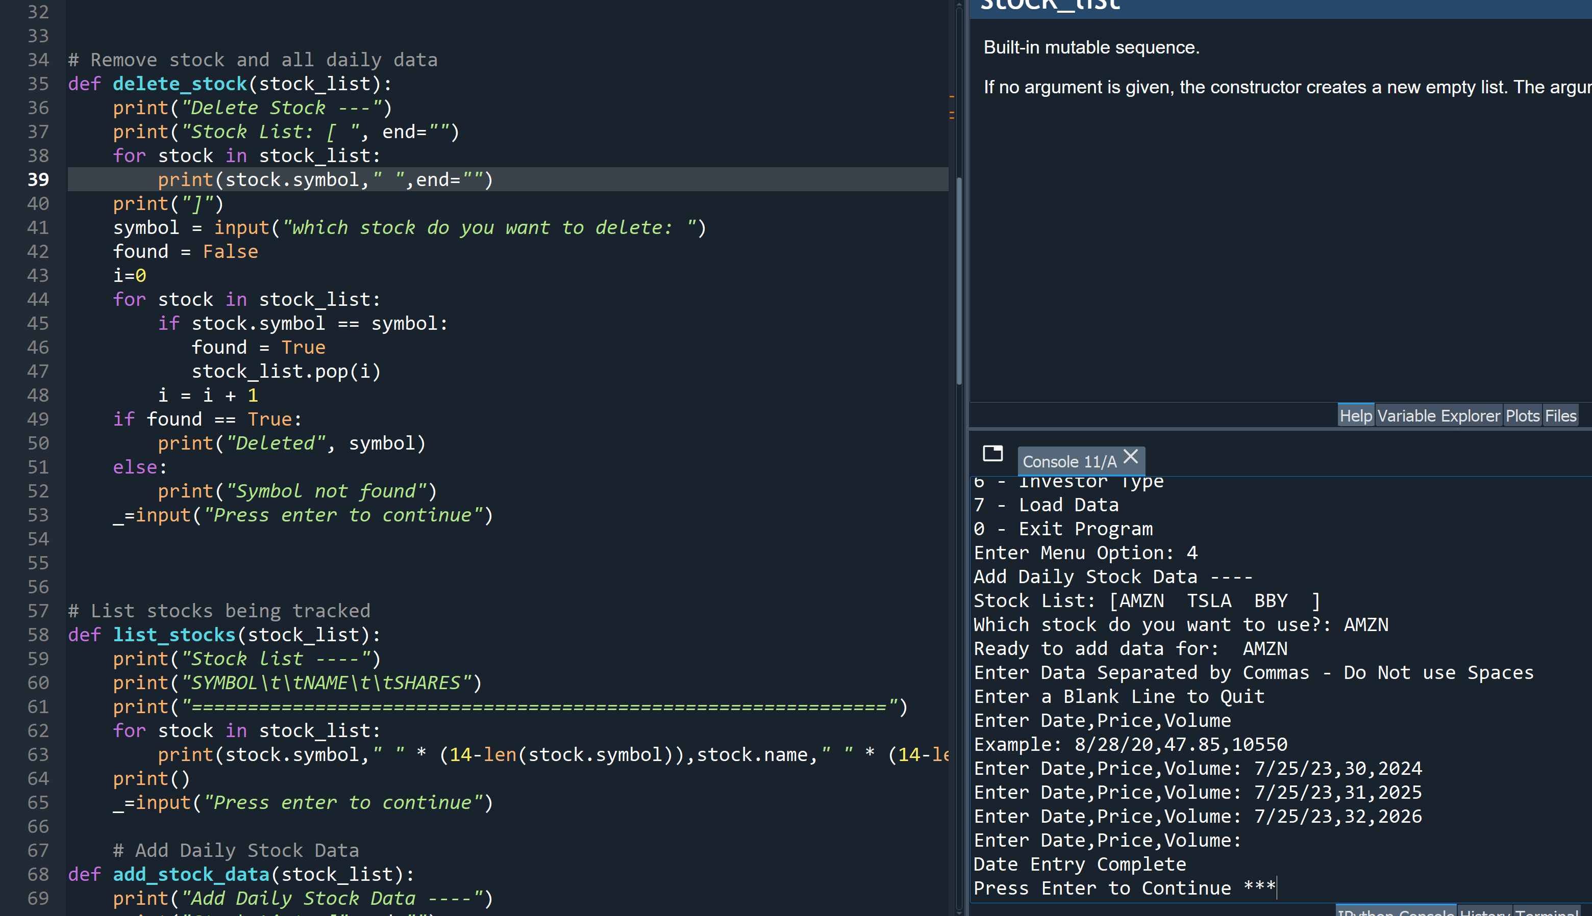
Daily Data
Paste a screen shot of your working Stock program.

Slide 10
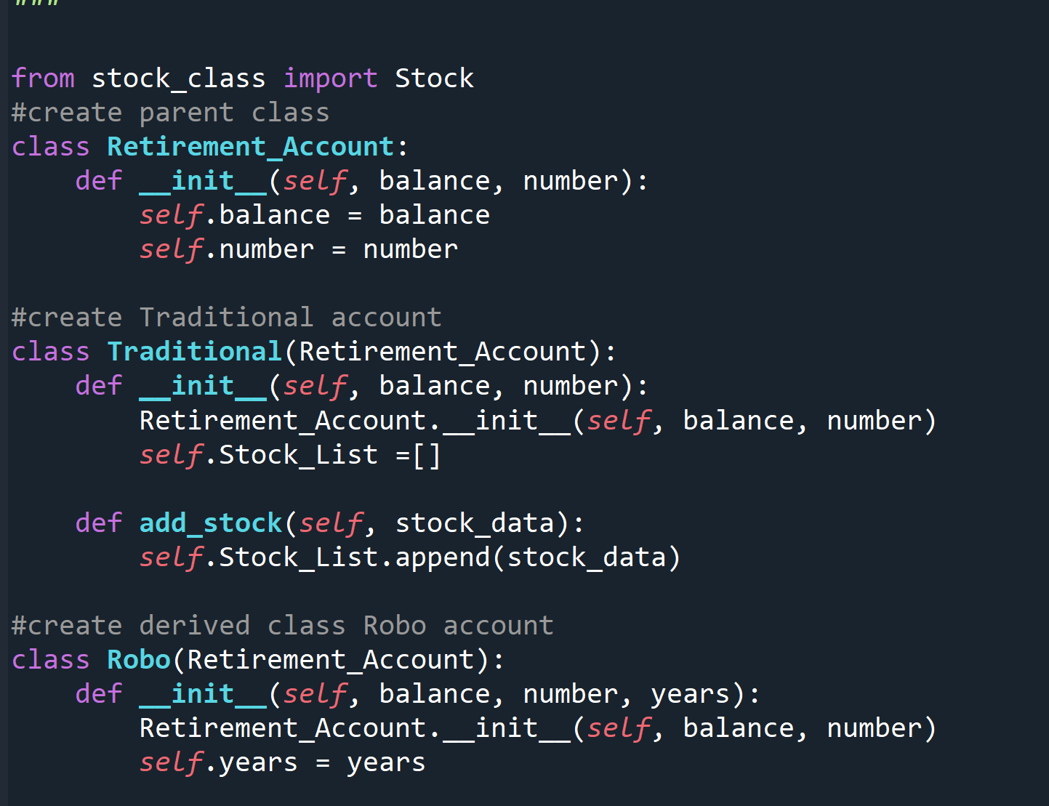
Inherited classes
Paste a screen shot of your classes

Slide 11
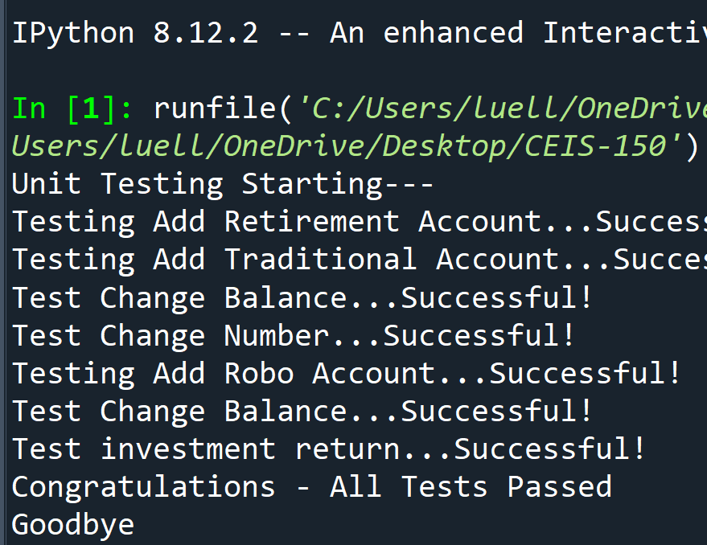
Unit Tests
Paste a screen shot of your unit tests successfully completed

Slide 12
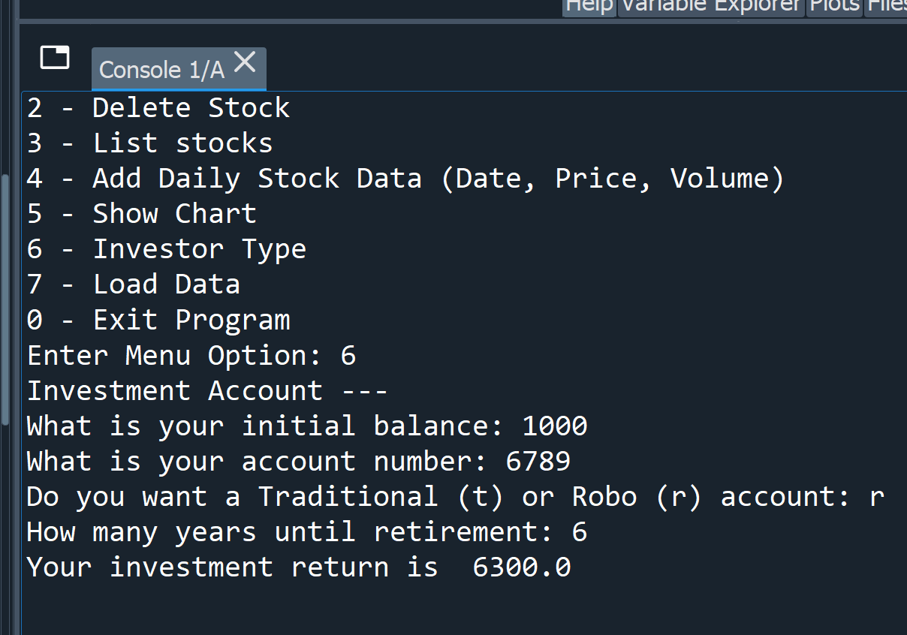
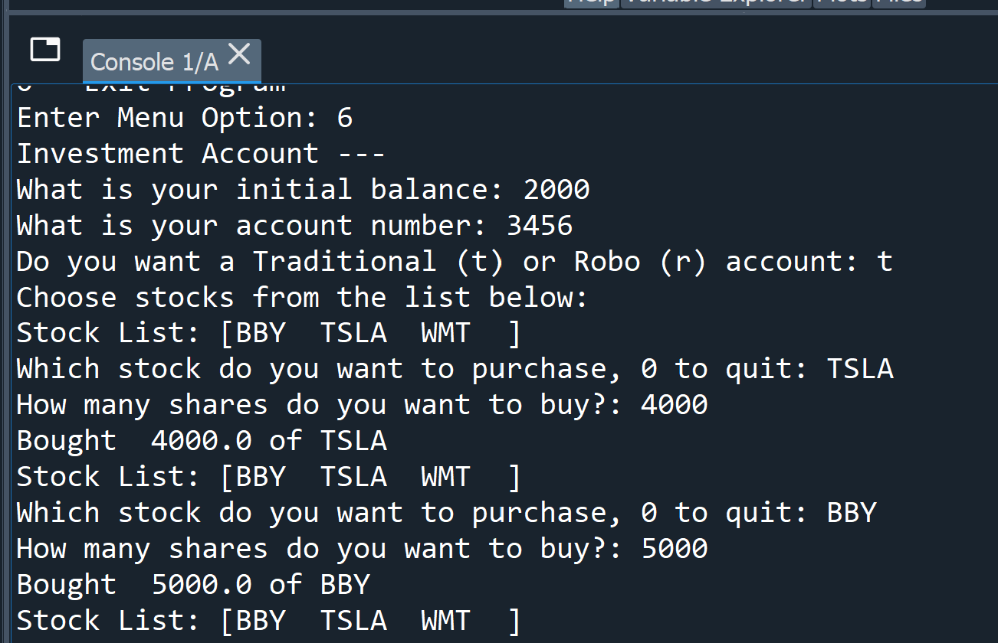
Stock menu program
Paste a screen shot of your classes in the main program

Slide 13
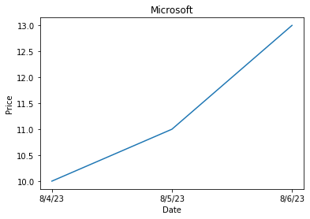
Chart
Paste a screen shot of your stock chart.

Slide 14
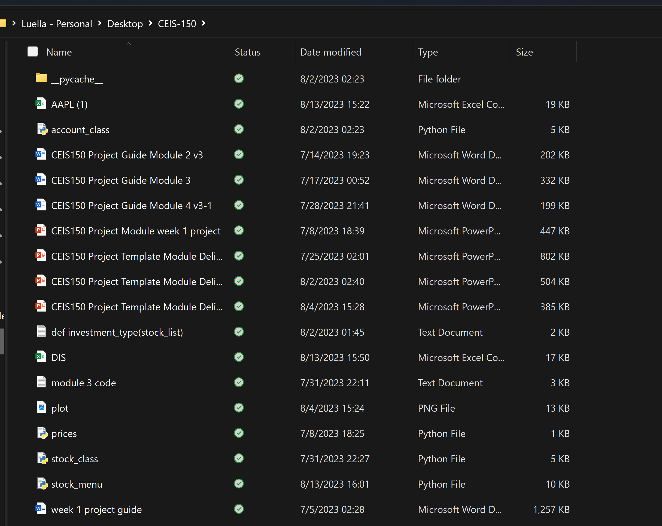
File
Paste a screen shot of the file downloaded from Yahoo finance

Slide 15
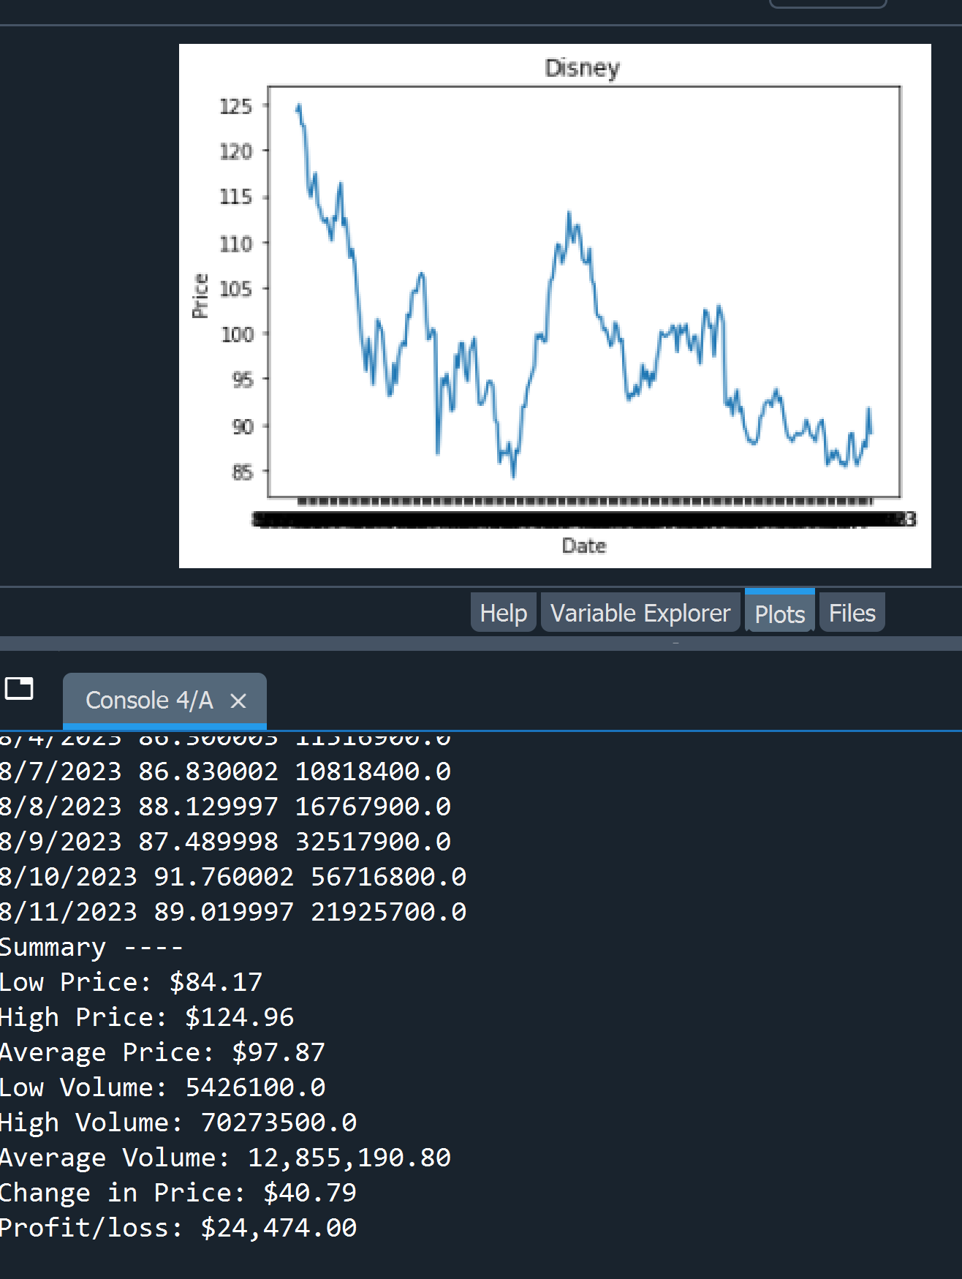
Importing data
Screenshot of the historical data import

Slide 16
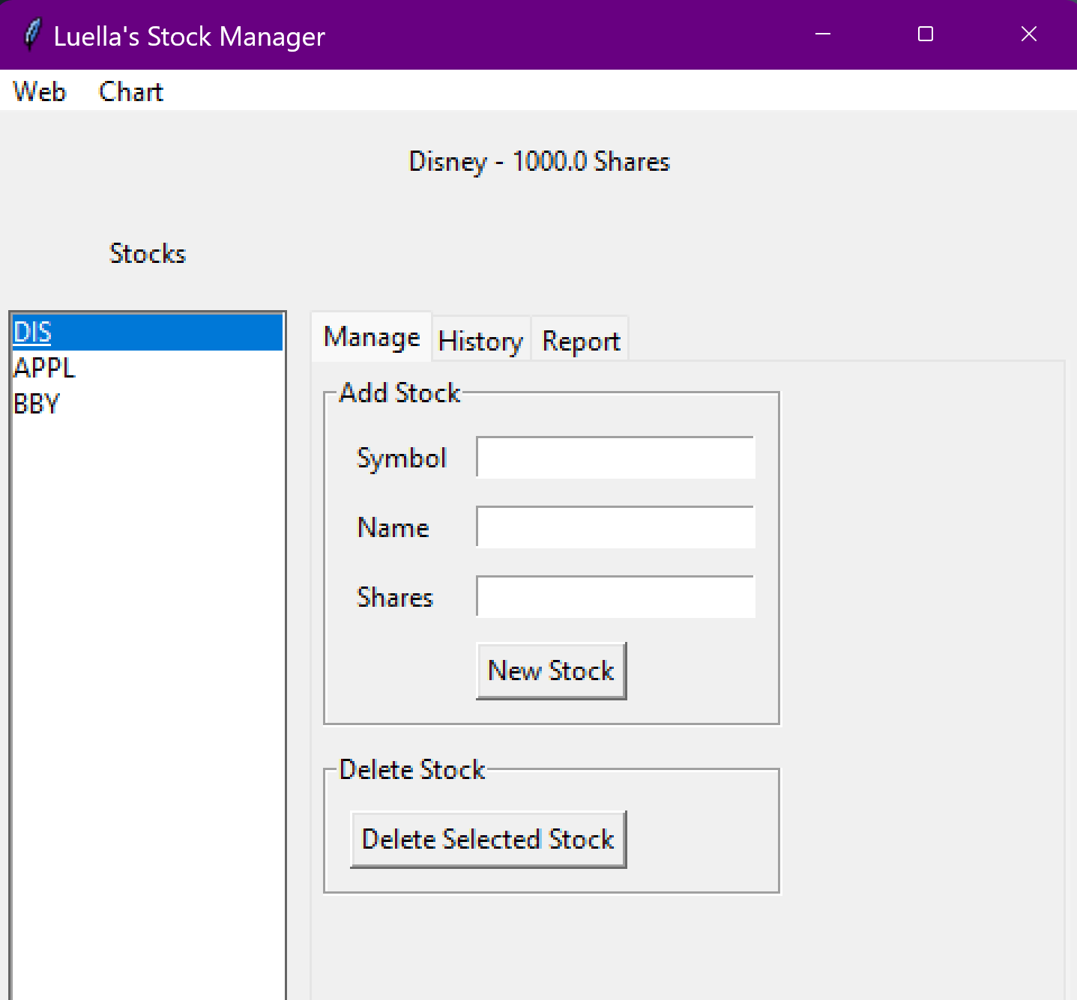
Stocks in GUI
Paste a screen shot of your GUI working

Slide 17
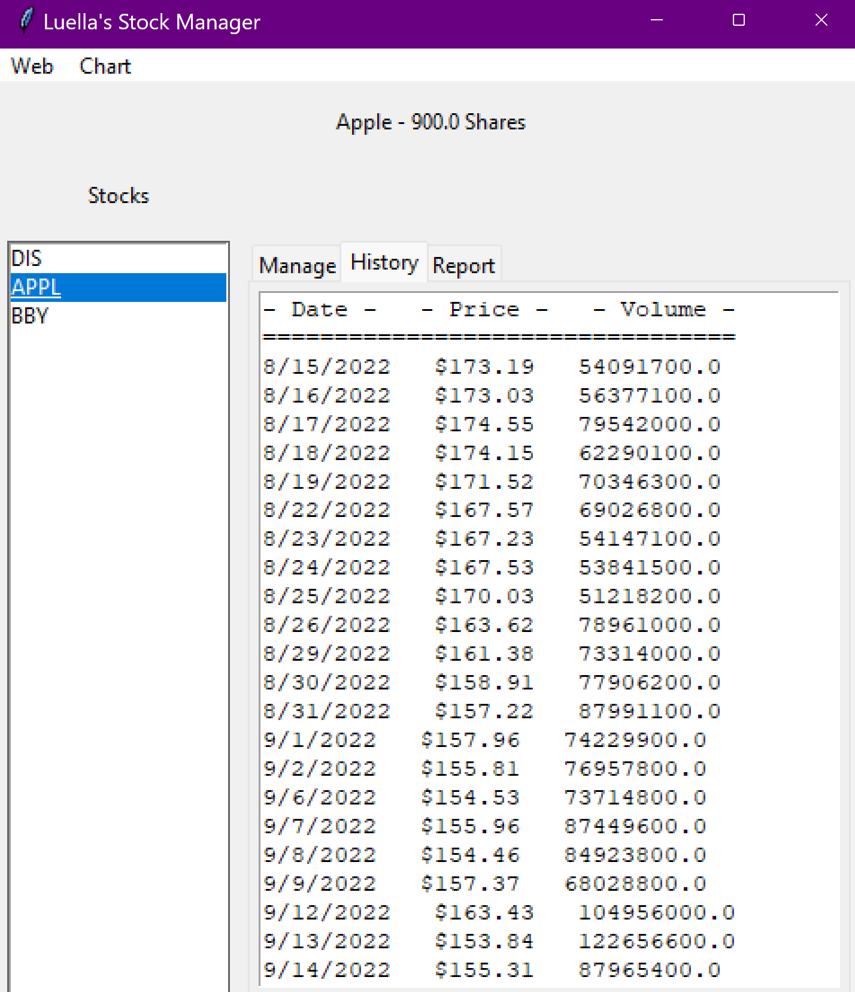
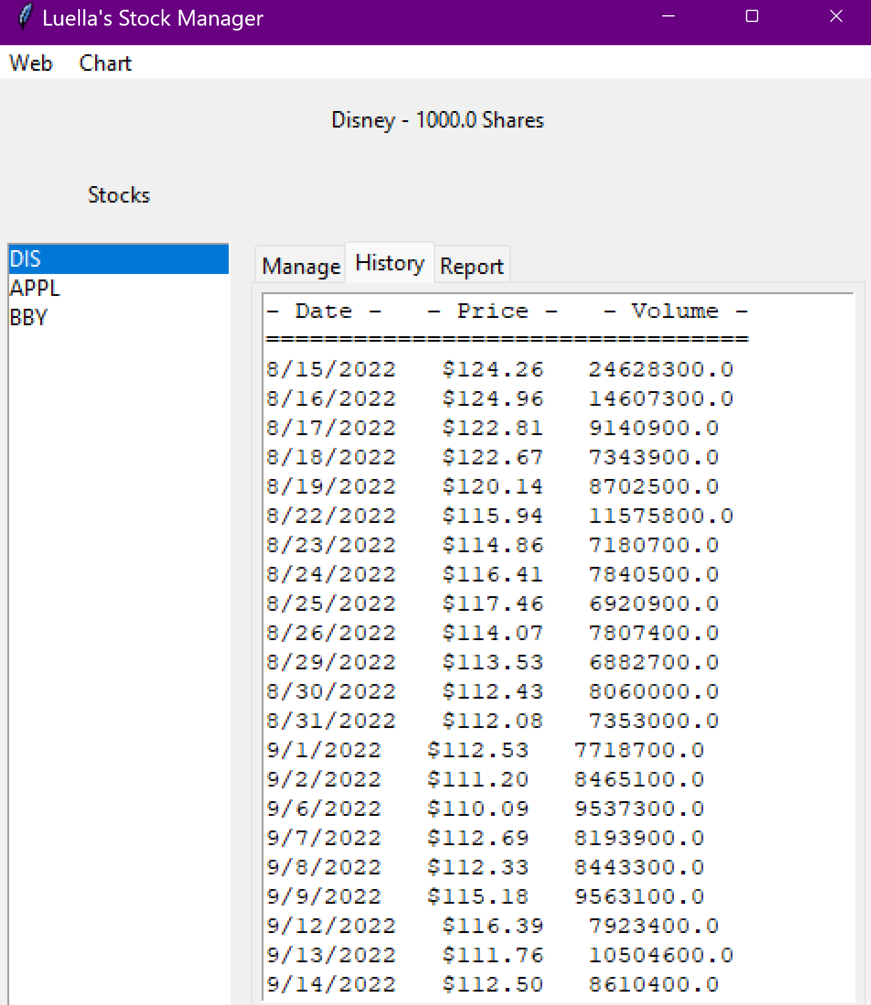
History Tab
Paste a screen shot of your History tab with import working.

Slide 18
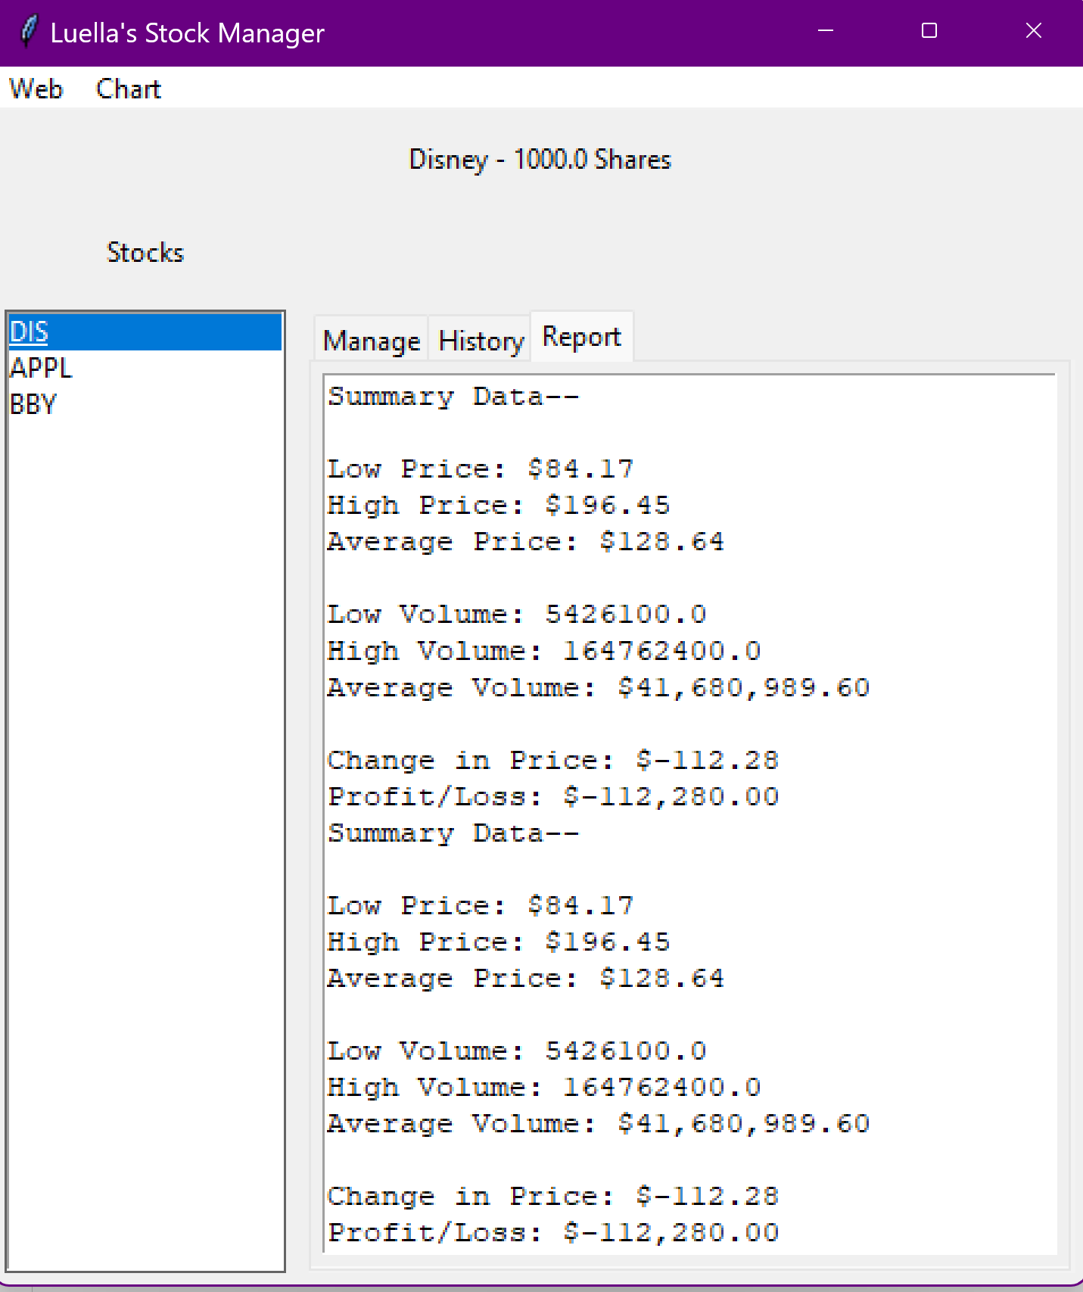
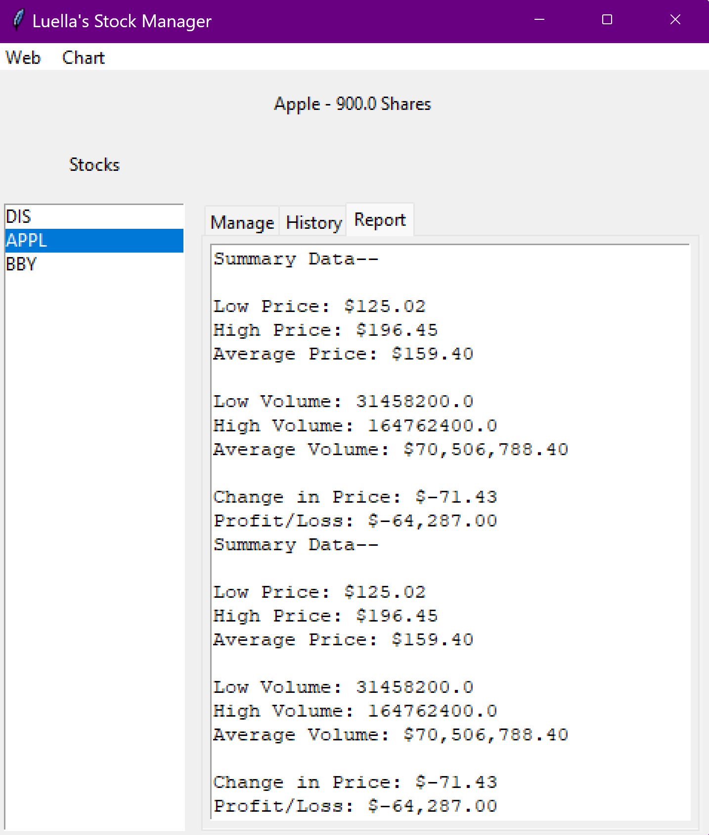
Report Complete
Paste a screen shot of your Report tab

Slide 19
What I learned
From this class I learned that new features while learning how to use Python since I was not 100% used to programming except having a little experience in a previous class.
I also learned problem solving skills when running into issues during certain parts of this project.
I learned patience considering some of the projects took a lot of time and patience.

Slide 20

Career Skills
I learned:
Patience
Hard-work
Problem solving skills

Slide 21

Conclusion
In conclusion, I enjoyed this class and learning a bit more about programming with Python.
The project from beginning to end was fun, exciting, and challenging.

