Slide 1

Luella Tracy Henderson
12/17/2022
Sec 285
Professor Okrah

Slide 2

Introduction
In this presentation, I will go over everything I have learned in Sec285.
Throughout the PowerPoint, I will go over the preparation, Security, and Threats, Cryptography, Network attacks & Defenses, Wireless network & Device Security, Identity and access management, & Risk Management.

Slide 3

Preparation-week 1
When preparing for this project, some of the needed is to ensure you have accessed the ITPRO TV code to complete the modules throughout the eight weeks.
The next thing we used was Infosec Learning, a virtual learning system that entails a series of various machines we used throughout the eight weeks.
The virtual machines we used were Kali, Ubuntu, & Linux Server.

Slide 4

Cryptography

Slide 5
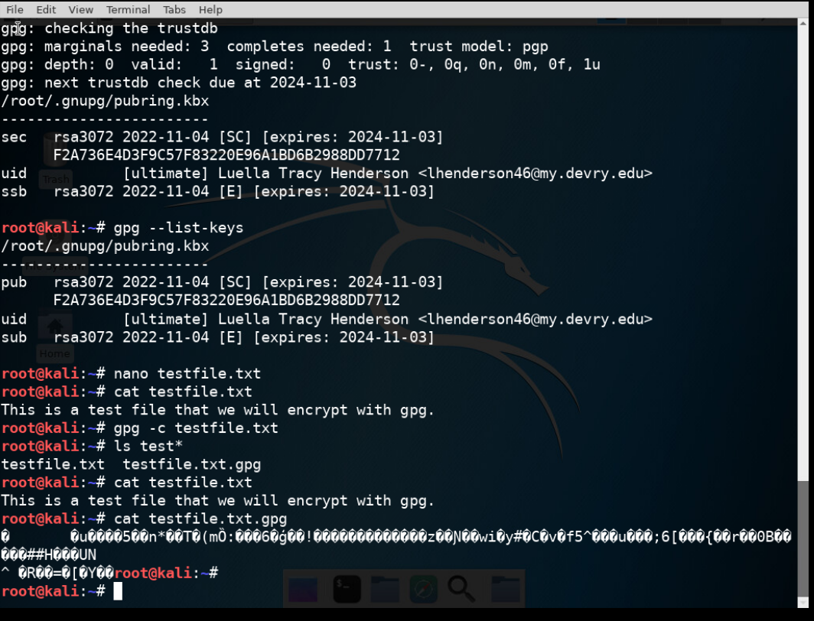
File Encryption
This screenshot shows the following.
Content of the plaintext file
Content of the encrypted file

Slide 6
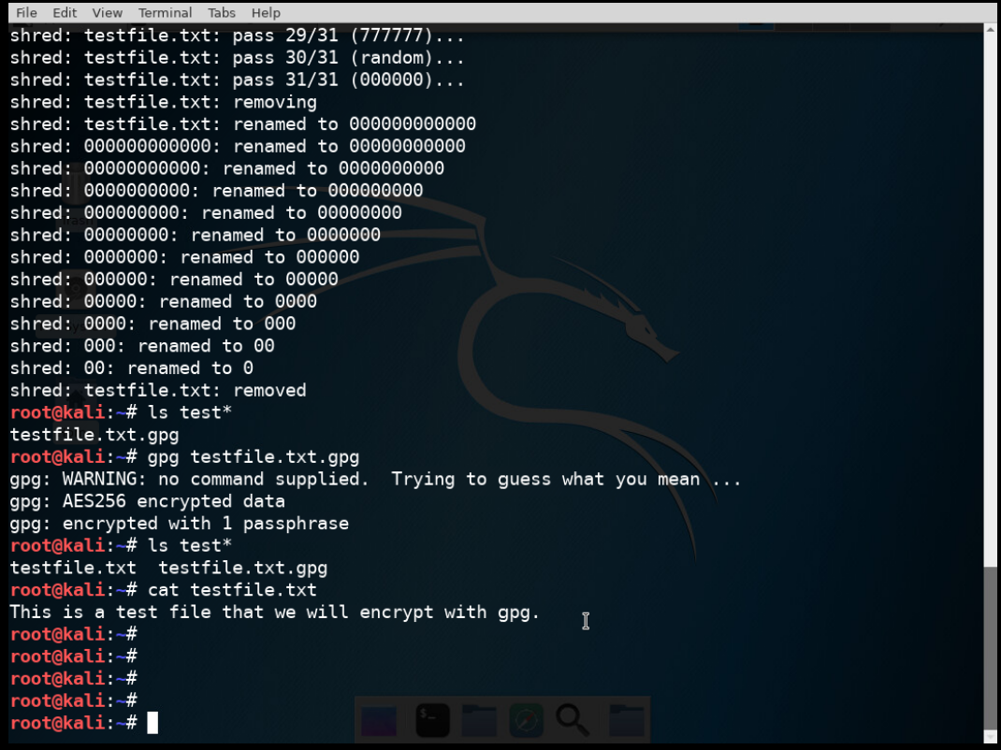
File Decryption
This screenshot shows the following.
The encrypted file is listed by itself
The decrypting process
Both the encrypted file and the original plaintext file are listed

Slide 7
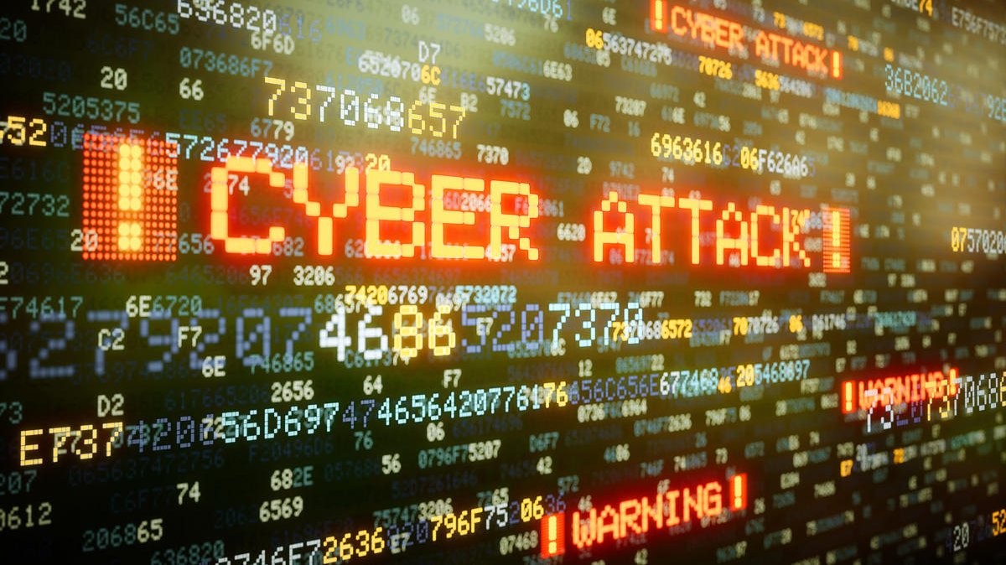
Network Attacks and Defenses
This Photo by Unknown Author is licensed under CC BY-SA-NC

Slide 8

Question
What effect does the sudo iptables --policy INPUT DROP command have on the access to computing resources?
Answer here: The effect of the sudo iptables is that it gives room for the system administrator to deal with incoming and outgoing traffic.
Alternative Answer: The policy INPUT DROP blocked incoming traffic to the network so that Nmap could not tell whether the ports were open or closed. This allows System Administrators to control incoming traffic. Before the sudo iptables – policy INPUT DROP was implemented, there were 977 closed ports and 23 open ports on the Linux server. But after the INPUT DROP command was run, the firewall blocked all incoming traffic resulting in all 1000 ports closed.
References: https://www.hostinger.com/tutorials/iptables-tutorial

Slide 9
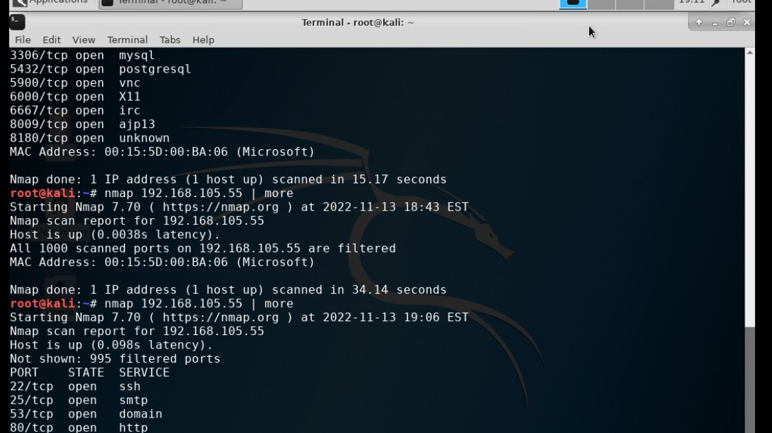
Nmap Scan
This screenshot shows the Nmap scan result of the Linux Server VM.

Slide 10

Bring Your Own Device (BYOD)

Slide 11

1. Overview:
Technology is rapidly evolving, and implementing policies and procedures will help with the security and safety of many devices used today. This policy provides information and a solid foundation as a guideline for employee use of personally owned electronic devices for work-related purposes. Some threats associated with BYOD are compromised data, unsecured wi-fi access, lost or stolen devices, and many more challenges associated with BYOD.
2. Purpose:
The main goal of IT security policy is to protect data’s confidentiality, integrity, and availability (CIA). Such timely discovery to safeguard devices from This policy defines the standards, procedures, and restrictions for end users with legitimate business requirements to access corporate data using their devices. This policy goes over ways to properly use your device to keep it from getting compromised, keeping yourself and ABC Network Corporation safe.

Slide 12

3. Scope:
Cell phones, tablets, and laptops are all part of BYOD. When using your own BYOD, all wi-fi connections must be registered with the IT Department before your device can be used. If your device becomes lost or stolen, MDM software (Mobile Device Management) must be installed on all devices removing sensitive data that may have been on your device. All devices must meet security requirements: using a VPN (Virtual Private Network), using secure passwords on each device, and using the latest antivirus software, which prevents and decreases malware exposure on the devices. If ABC Employer is to be terminated, all data dealing with ABC Corporation Network will be erased for company protection and privacy.
4. Policy:
All BYOD are subject to security assessment before ABC Corporation’s Network; by being accepted into ABC Corporation’s Network, all devices must run on the newest software updates released, and all devices must be updated with the latest anti-virus software and firewall. All employees must sign a contract giving ABC Corporations Network control over how their device is used within the company. Any device that is not updated to the newest version of the software and antivirus risk vulnerability to your device. To prevent harm to your devices, please regularly check for any updates necessary to keep your devices safe.
Regarding remediation for BYOD, all devices with network security issues will be remediated through the IT Department to be corrected. If any problems arise when using your devices, such as network issues, any employee should contact IT through email or phone during business days to help resolve the issue. When sending emails to IT, please CC management in all emails regarding your IT issues.

Slide 13

5. Policy Compliance:
All ABC Corporation employees agree upon signing a contract to have their BYOD centrally managed and partially controlled through IT to keep themselves and the company safe from risk. Intrusion detection tools will be installed automatically on all devices and only to be used upon suspicion if your BYOD is being used outside of work purposes. All internal and external audits must be handled accordingly through the IT and Legal Departments at any time.
Any employee not following security policy and procedure will result in a two-step disciplinary action, one written warning, and termination from the company due to breach of contract, with the possibility of legal action being taken against them. IT will erase any work-related information about the employer’s BYOD and wipe clean remotely.
6. Related Standards, Policies, and Processes:
In the case of working in environments such as medical or psychiatric facilities, ABC Corporation will implement HIPPA policies, procedures, and standards due to patient and hospital confidentiality. PCI-DSS policies, standards, and procedures will secure all patients’ credit information for secure safety measures.

Slide 14
7. Definitions and Terms:
Think of terms such as BYOD, mobile devices, and CIA. Define them here
BYOD- The ability to bring one’s device to and from work for work-related purposes only.
CIA- Confidentiality, Integrity, & Availability.
Mobile Devices- Portable electronic equipment used to connect to internet services; a mobile device is considered a cell phone, tablet, or laptop used to carry around anywhere you go.
8. Revision History:
Date of change | Responsible | Summary of change
August,2019 | ABC Corp. Network | Updated and converted to new format
November,2022 | Luella Tracy Henderson | Created new policy to be put into place of current one

Slide 15
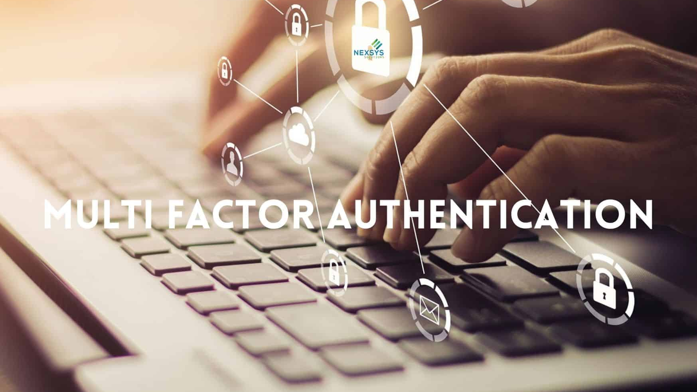
Multifactor authentication (MFA)

Slide 16
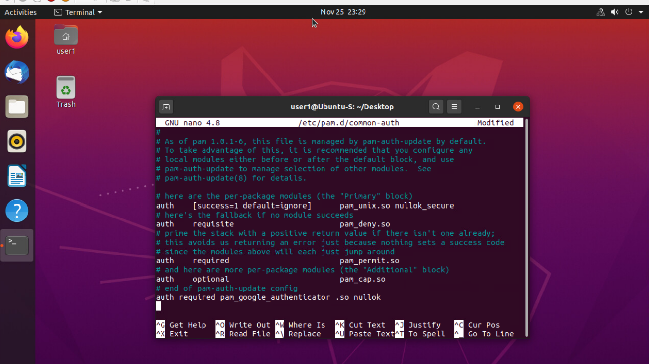
Common-auth Configuration File
This screenshot shows the entry that indicates the use of the Google Authenticator module.

Slide 17
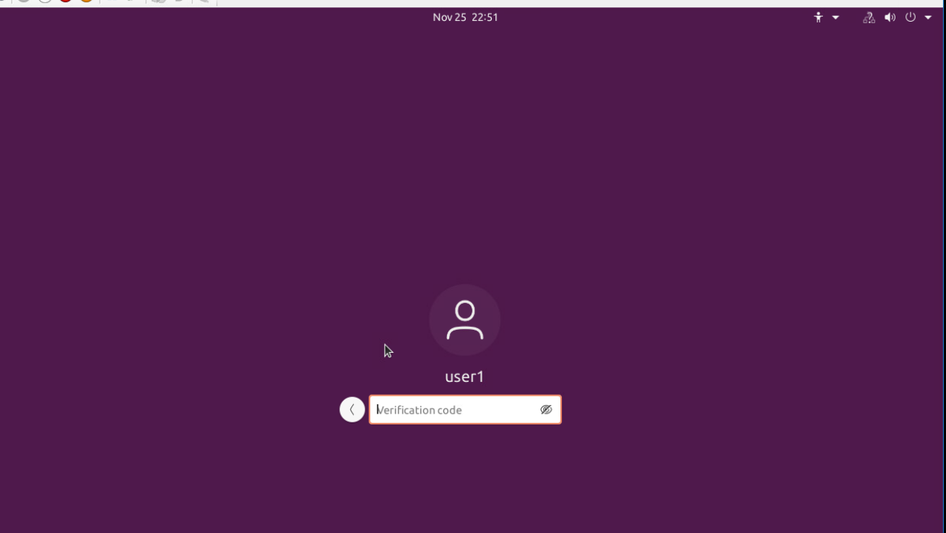
MFA Logon Screen
This screenshot shows the login screen where a verification code is required.

Slide 18
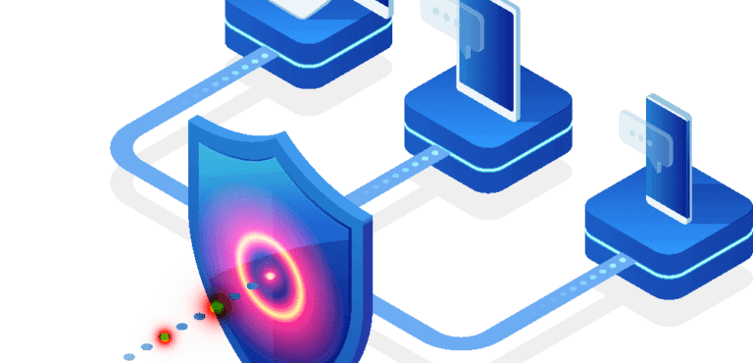

Vulnerability Assessment
This Photo by Unknown Author is licensed under CC BY-ND

Slide 19
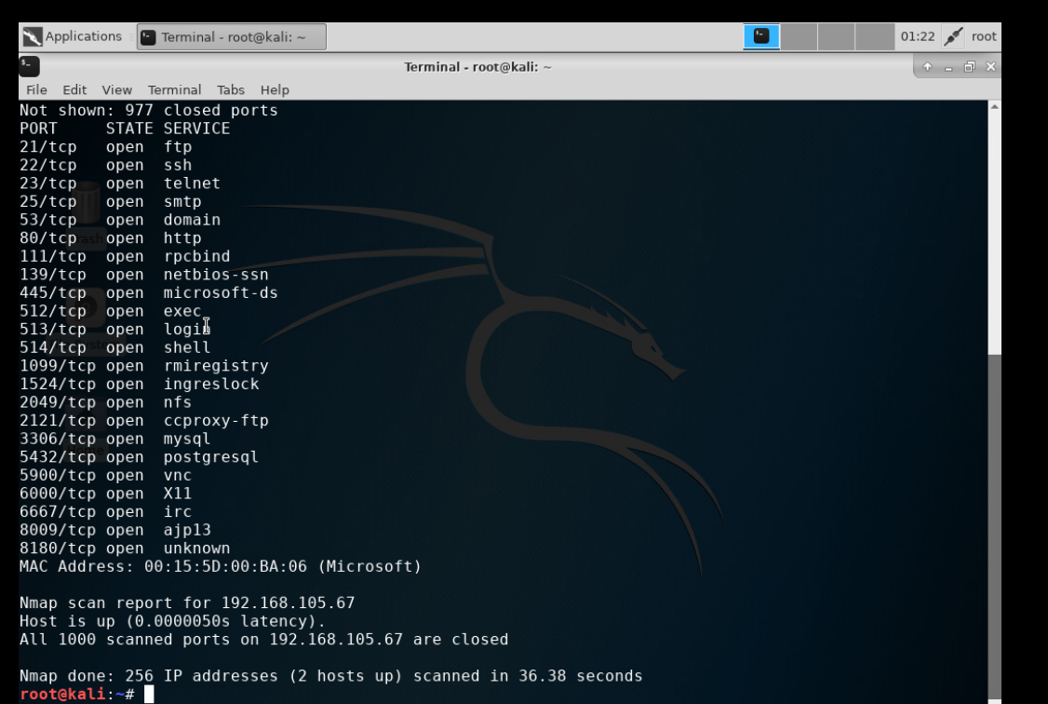
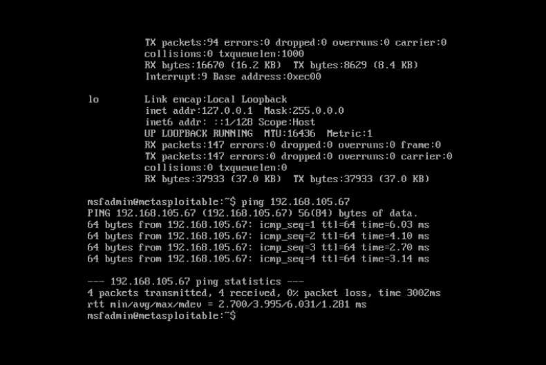
Nmap
This screenshot includes the scan result showing both the Kali and Linux Server VMs.

Slide 20
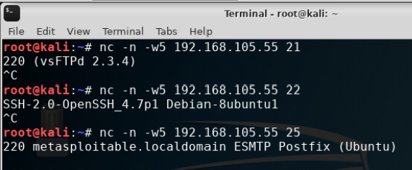
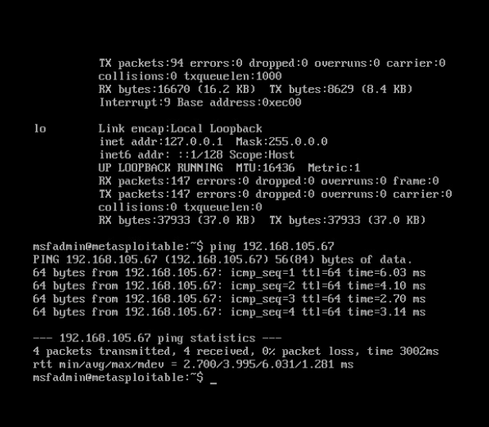
Net Cat
This screenshot includes the scan result showing both the Kali and Linux Server VMs.

Slide 21
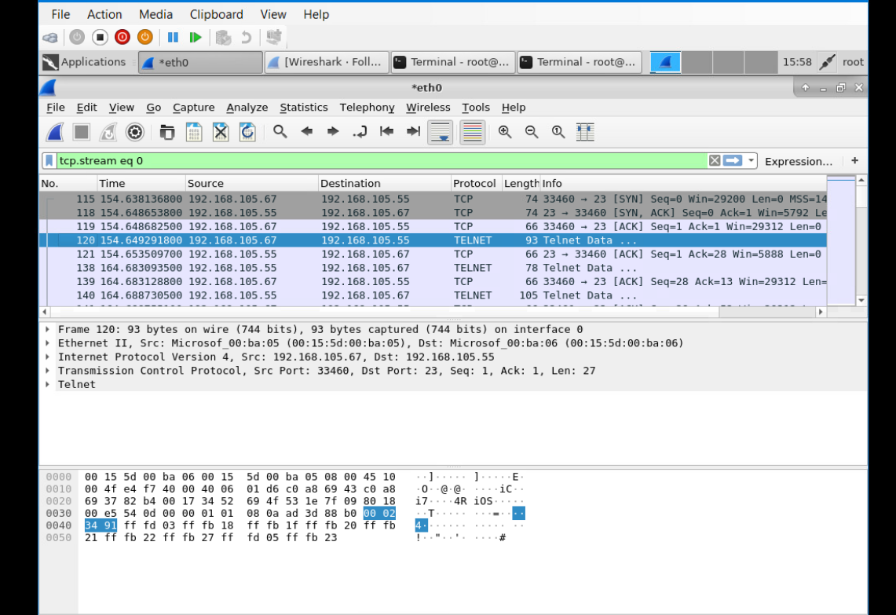
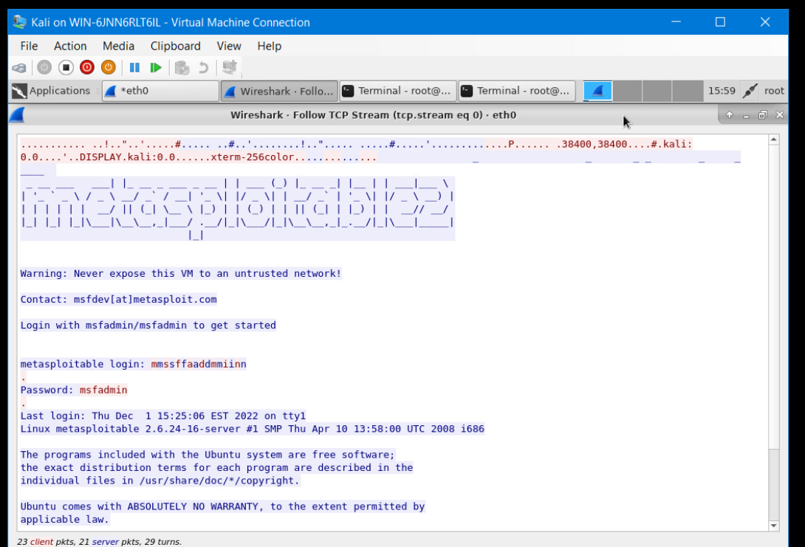
Wireshark
This screenshot includes the Wireshark—Following the TCP Steam window showing the Telnet username and password.

Slide 22
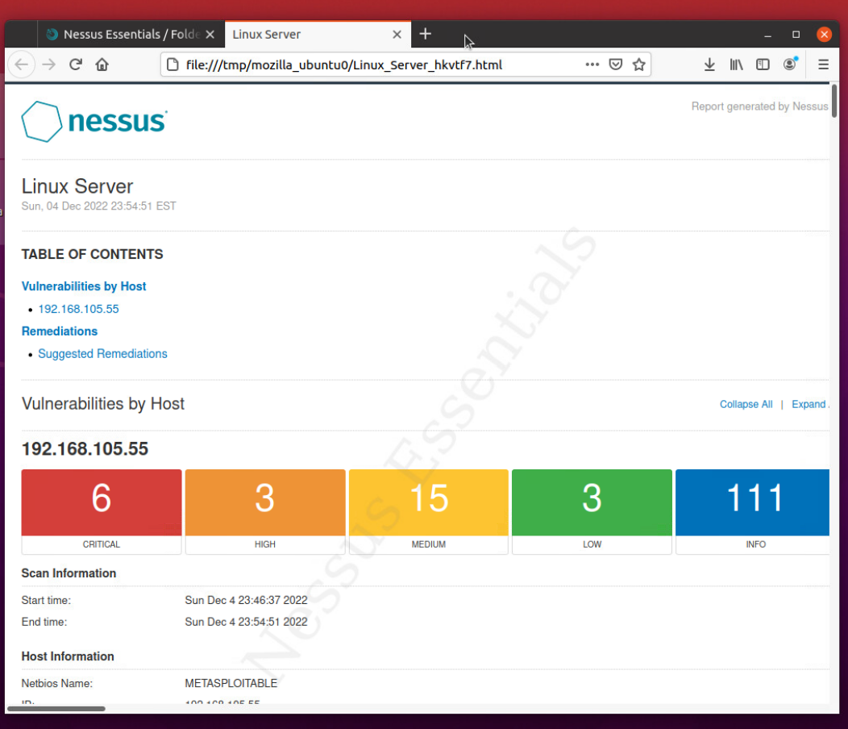
Nessus
This screenshot includes the high-level view of the Nessus vulnerability scan report which shows categories of vulnerability in different colors.

Slide 23

Challenges
Some challenges I have faced in this class are mainly using Infosec with one of the virtual machines not working correctly for me, so I had to reach out to IT to help resolve the issue.
Another challenge I faced was responding to peers in our weekly discussions only because I am still new to the tech field and have yet to work in it; I find it hard to relate to things and talk about them effectively without doing the research or lessons.

Slide 24

Career Skills
Better Critical thinking
Understanding
Troubleshooting and problem solving
Patience

Slide 25

References used
I did not use a ton of references when working on this project.
https://www.hostinger.com/tutorials/iptables-tutorial
This Photo by Unknown Author is licensed under CC BY-SA

Slide 26

Conclusion
I hope you enjoyed my presentation:
I learned about Security & threats, Cryptography, Network attacks & Defenses, Wireless network & Device Security, Identity and access management, & Risk Management. The class was interesting and entailed a lot of exciting things.

