Slide 1
CEIS-110
Programming Data with Python
Luella Tracy Henderson
10/12/2022
DeVry University
Professor Wang

Slide 2
Introduction
Hello & Welcome this presentation will demonstrate the work I have done in CEIS-110.
For this class Python (Spyder) was used for all the projects that I will be talking about throughout the slides.
I will also be discussing flow charts
The use of noaa-sdk
Weather data and cleansing data
Querying with SQL
Graphs and analysis
My challenges and how I plan to overcome those challenges
My career skills
Lastly my conclusion ☺

Slide 3
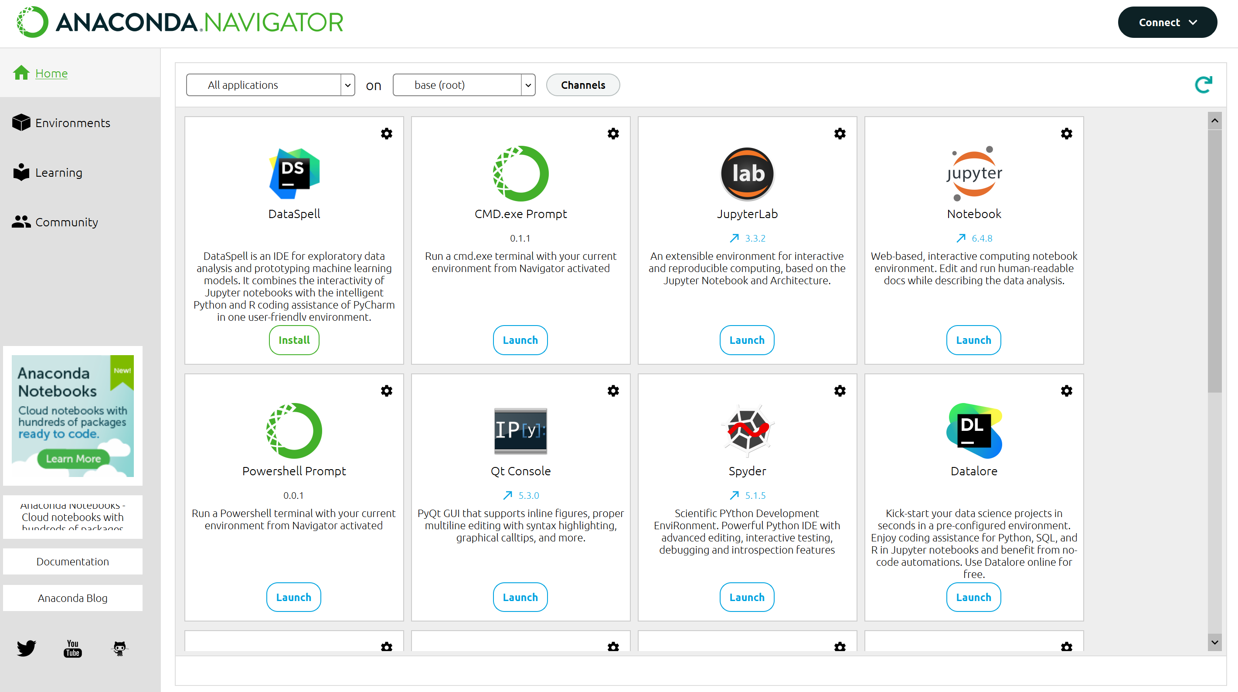
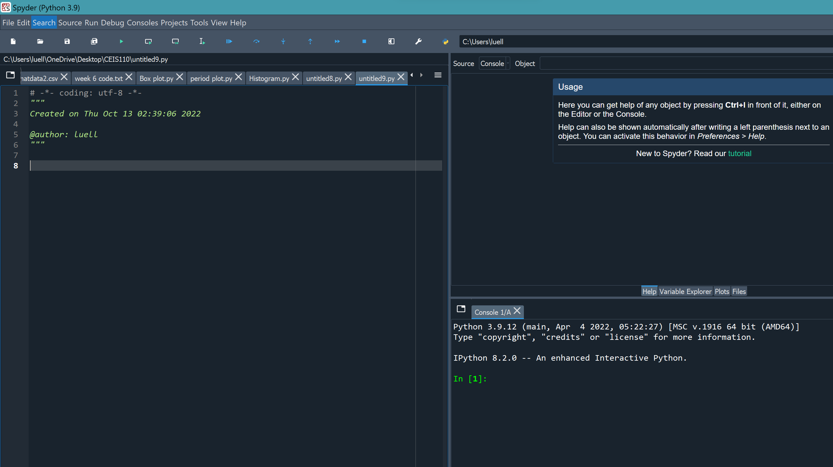
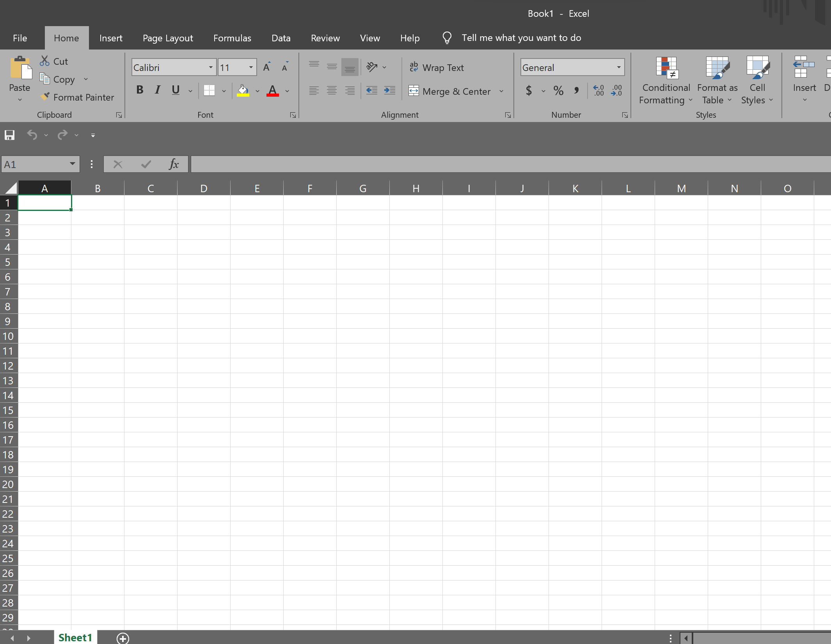
Software Inventory
The software that was used for the project was Anaconda Navigator with Python IDE (Spyder) and Excel.

Slide 4

Planning & Design
After downloading the Anaconda Software that was going to be used throughout the class, we then prepared for the data project.
A Flow chart was created in the process of helping to plan for all future steps.
Planning out any project thoroughly gives a better understanding on how things will turn out in the future.

Slide 5
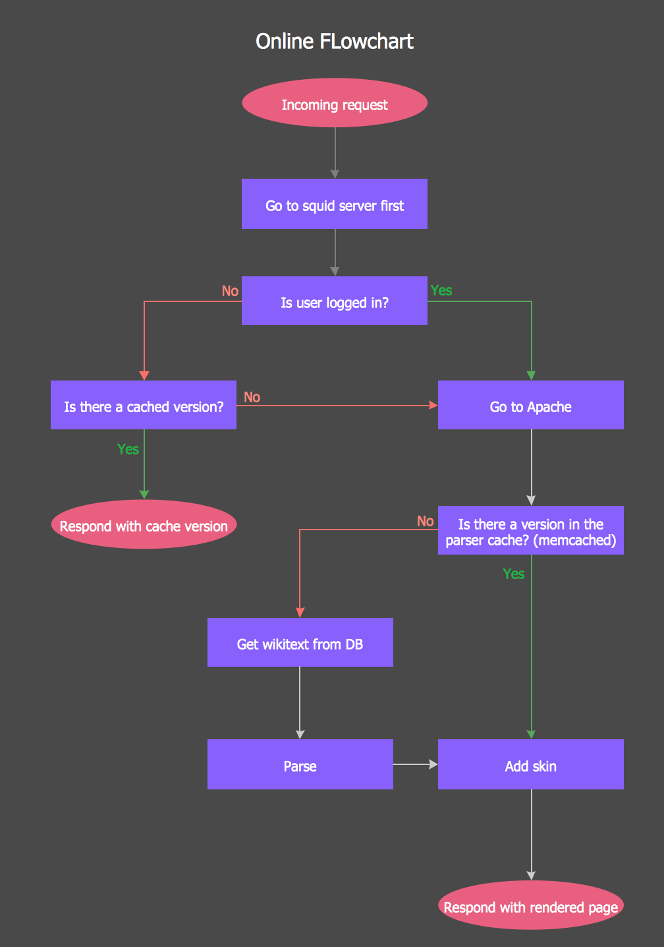
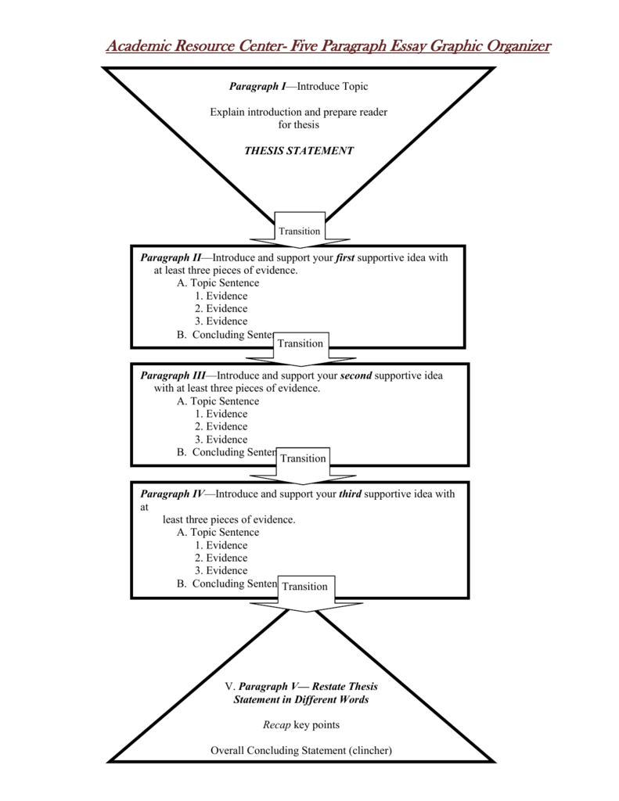
What is a flow chart
A flow chart is a diagram that represents a workflow or process. It can also be defined as a step-by-step approach to solving task.
Flow Charts are used by many companies and organizations.
Flow charts can help you get your ideas out there and organized in a way that helps you better understand how you will tackle the project given to you.
A flow chart can also be seen as sort of a writing organizational chart for people that need to have their ideas better organized.

Slide 6
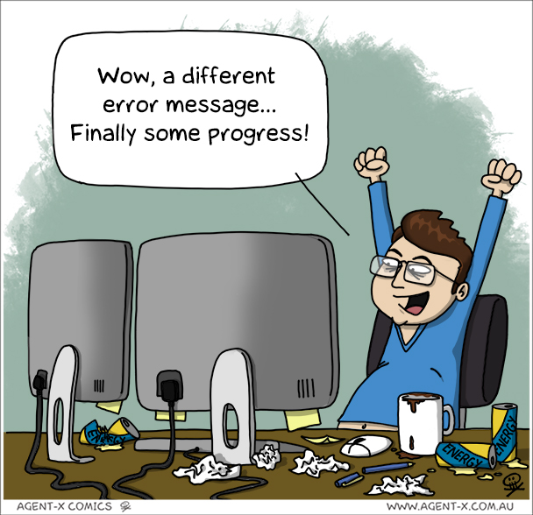
Start
Flow Chart
Install Python Modules
Download Weather data to data base
Extract Weather data from database into a CSV File
Cleanse weather data
Use python data analytics modules to develop graphical models
Use Excel to manipulate data
End

Slide 7
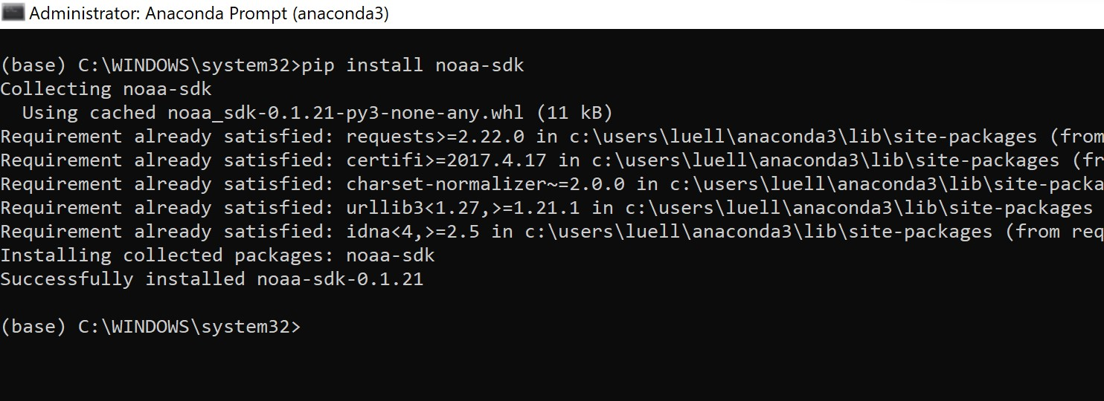
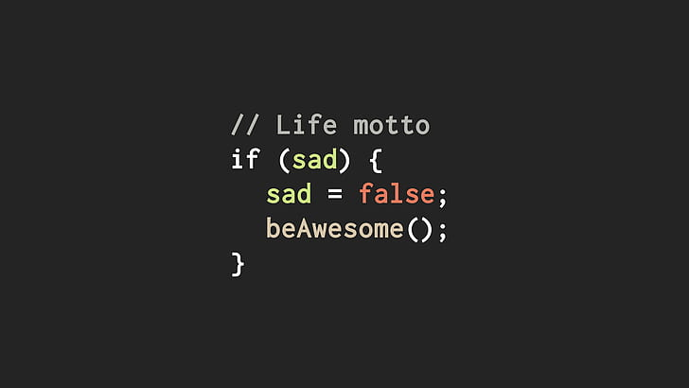

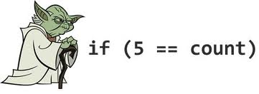
I installed noaa-sdk that was used in gathering the information throughout the project.
NOAA-SDK stands for National Oceanic & Atmospheric Administration it is a weather data service that uses a cloud based program interface.
The Screenshot provided is of the installed noaa-sdk for Python.

Slide 8
Temperature and Humidity
After having installed noaa-sdk & running anaconda; using the Spyder application the information was stored and saved for later use.
This created weather observations to be downloaded causing this data to be stored and later used.

Slide 9
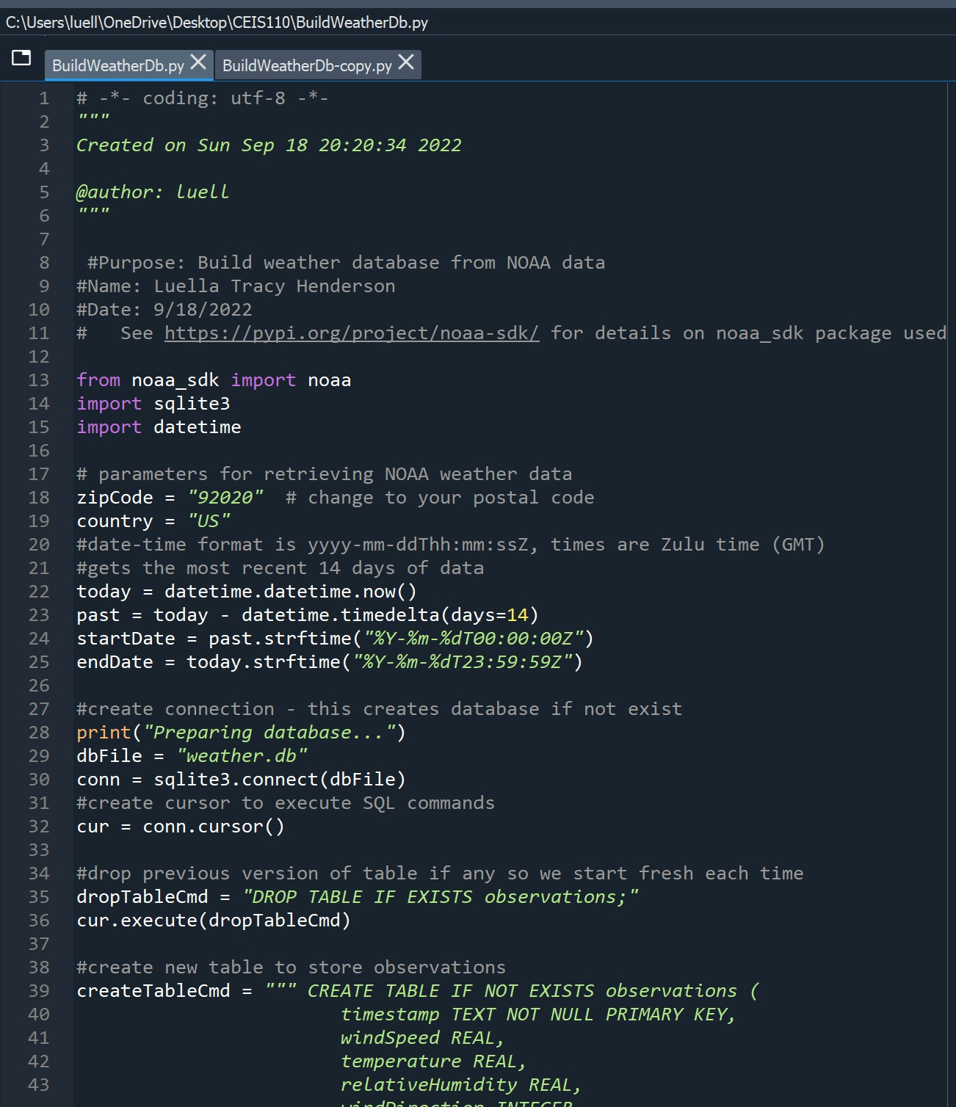
BuildWeatherDb.py Code

Slide 10
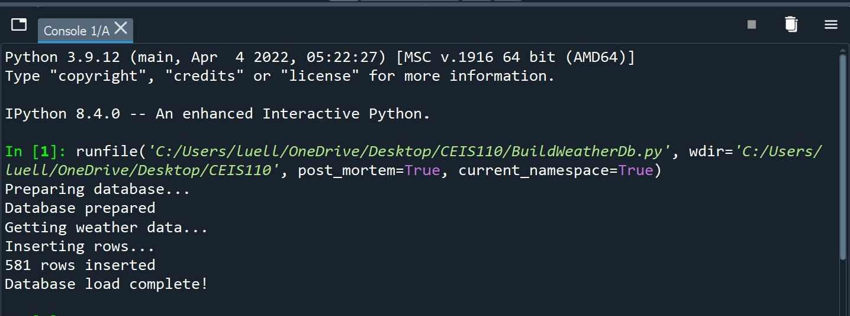
Python Console

Slide 11
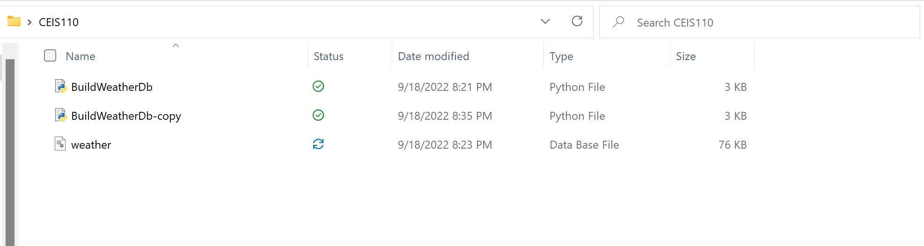
Weather. dB File:
All files were saved and stored throughout using Python

Slide 12
Querying Database with SQL
What is SQL? It is Structured Query Language that is used for working w/databases.
SQL was used to query the database from noaa-sdk in order to gain results.

Slide 13
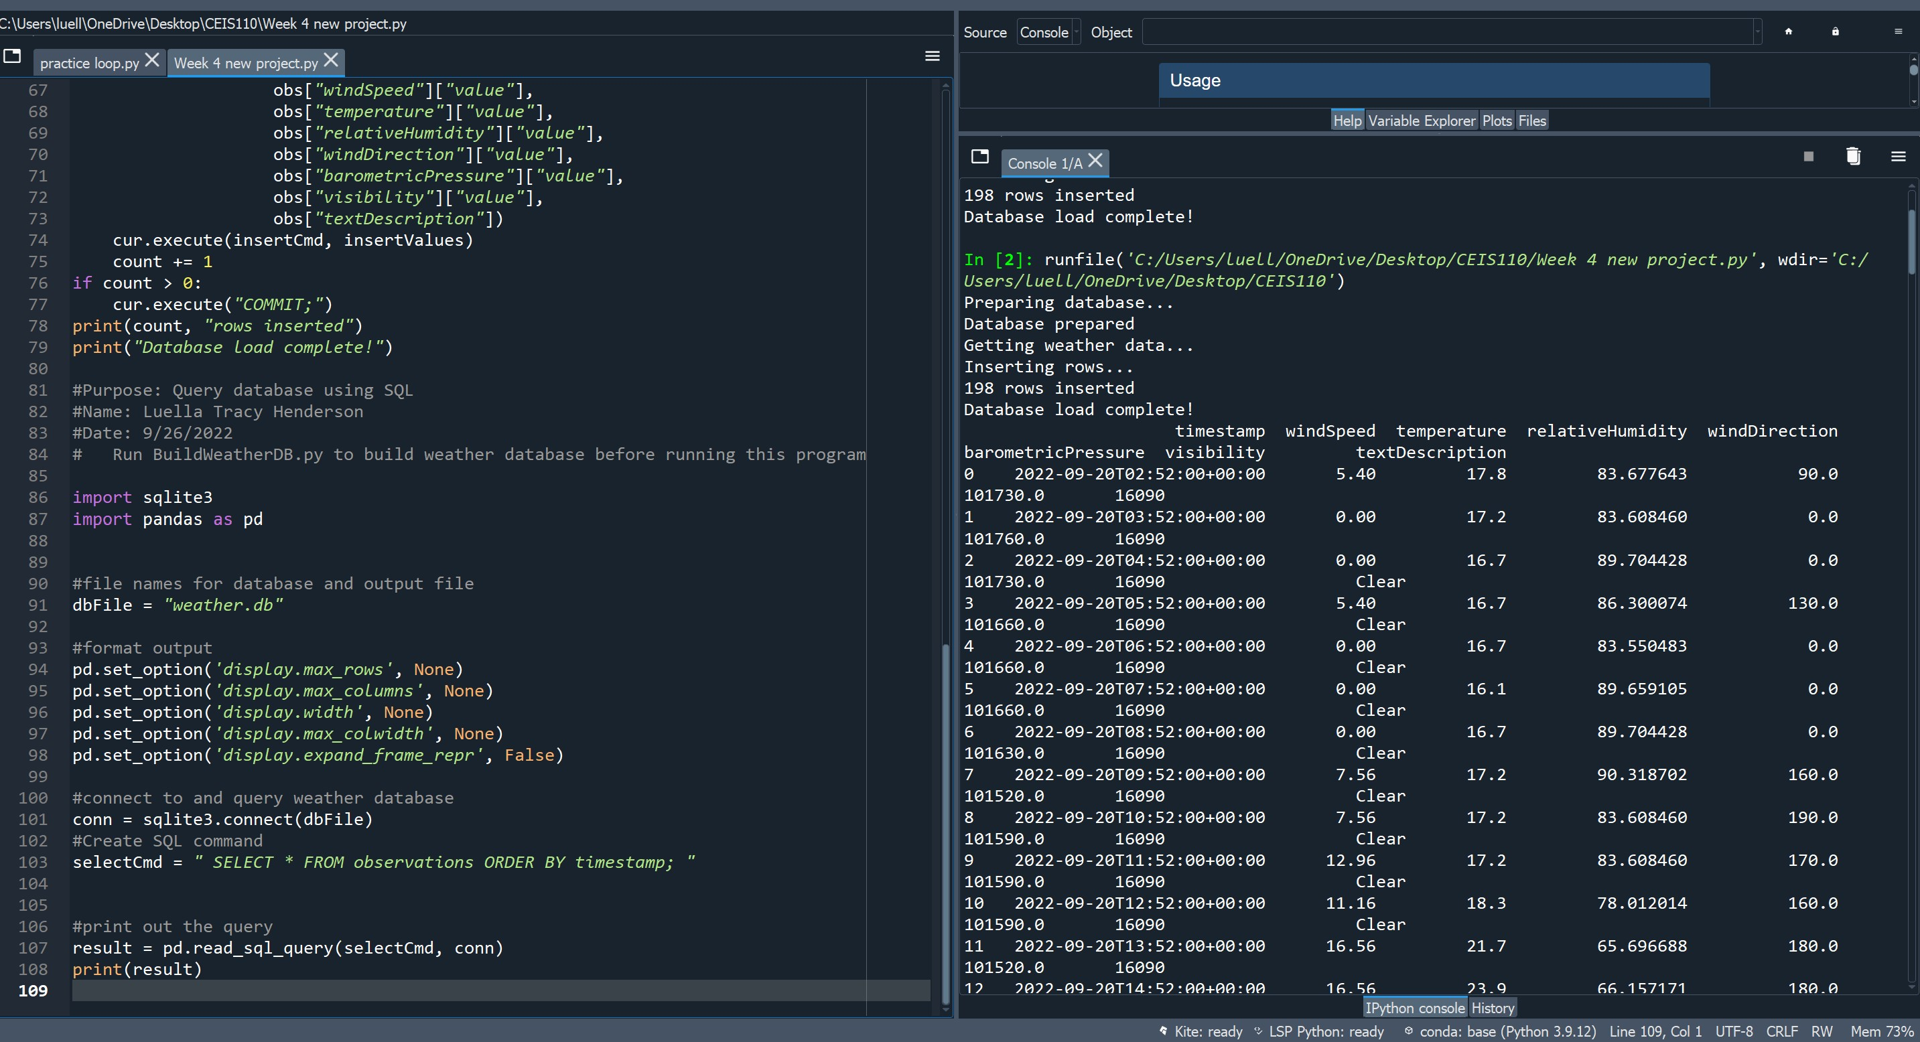
Query to retrieve all columns and all rows

Slide 14
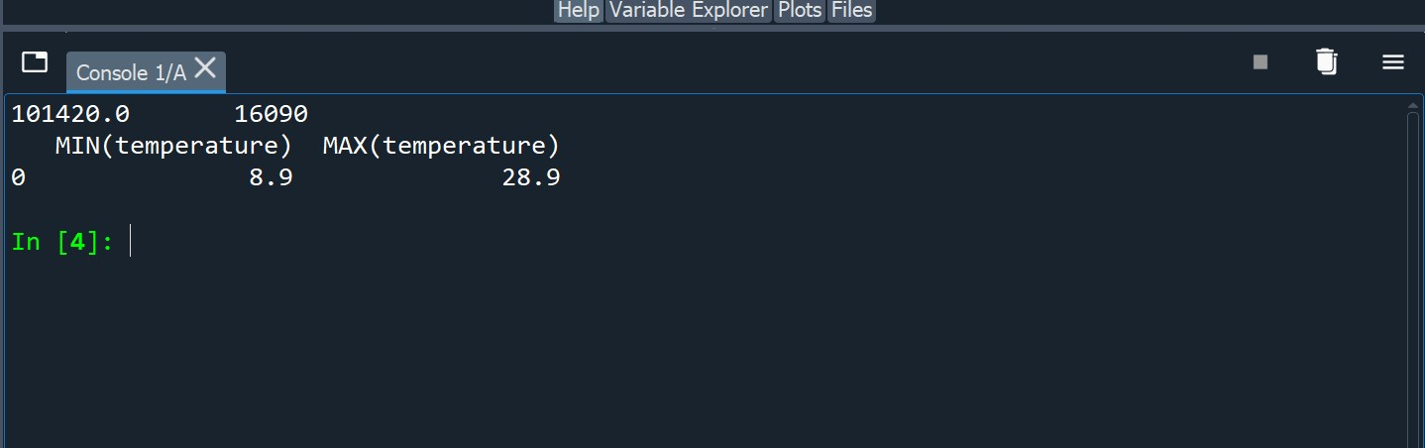
Query to retrieve lowest and highest temperatures

Slide 15
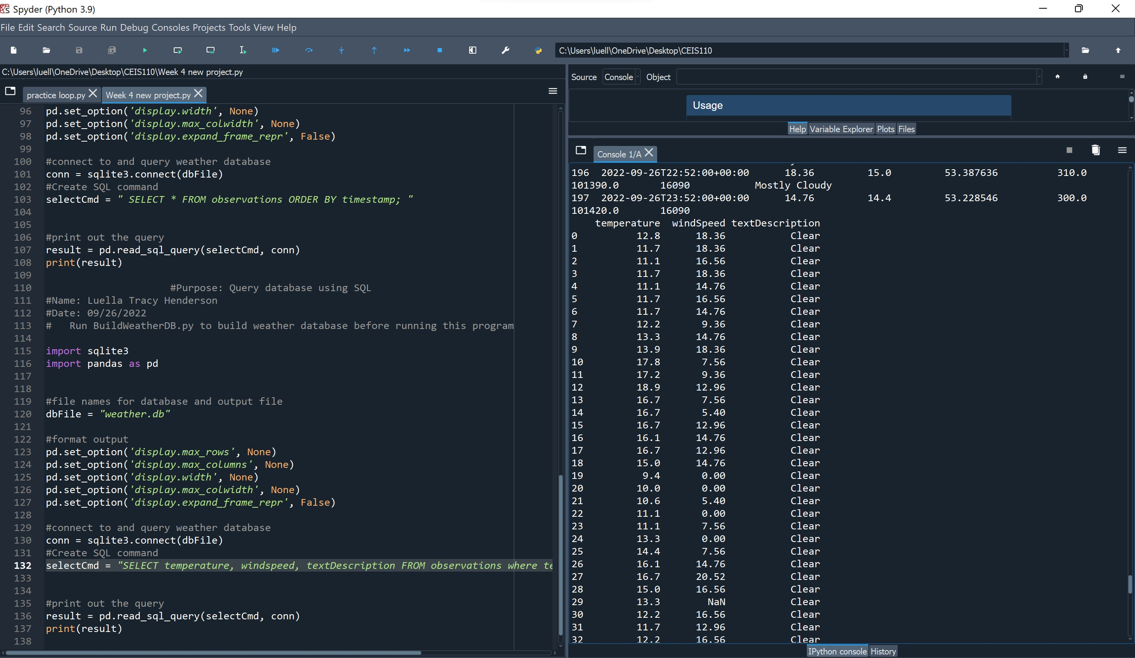
Query to retrieve all clear days

Slide 16
Data Cleansing
Data cleansing or cleaning is the process for detecting and correcting data information that is inaccurate or corrupt. This is usually in the form of a record set, table, or database.
Python would read the data that was output by the python program. From there a CSV File would be saved and turned into an Excel spreadsheet.
Within the Excel spreadsheet I would go in and correct the mistakes for missing values.

Slide 17
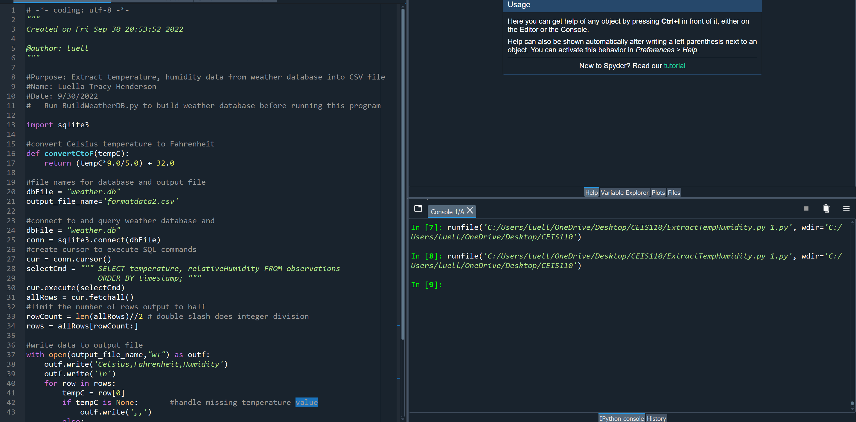
Python code

Slide 18
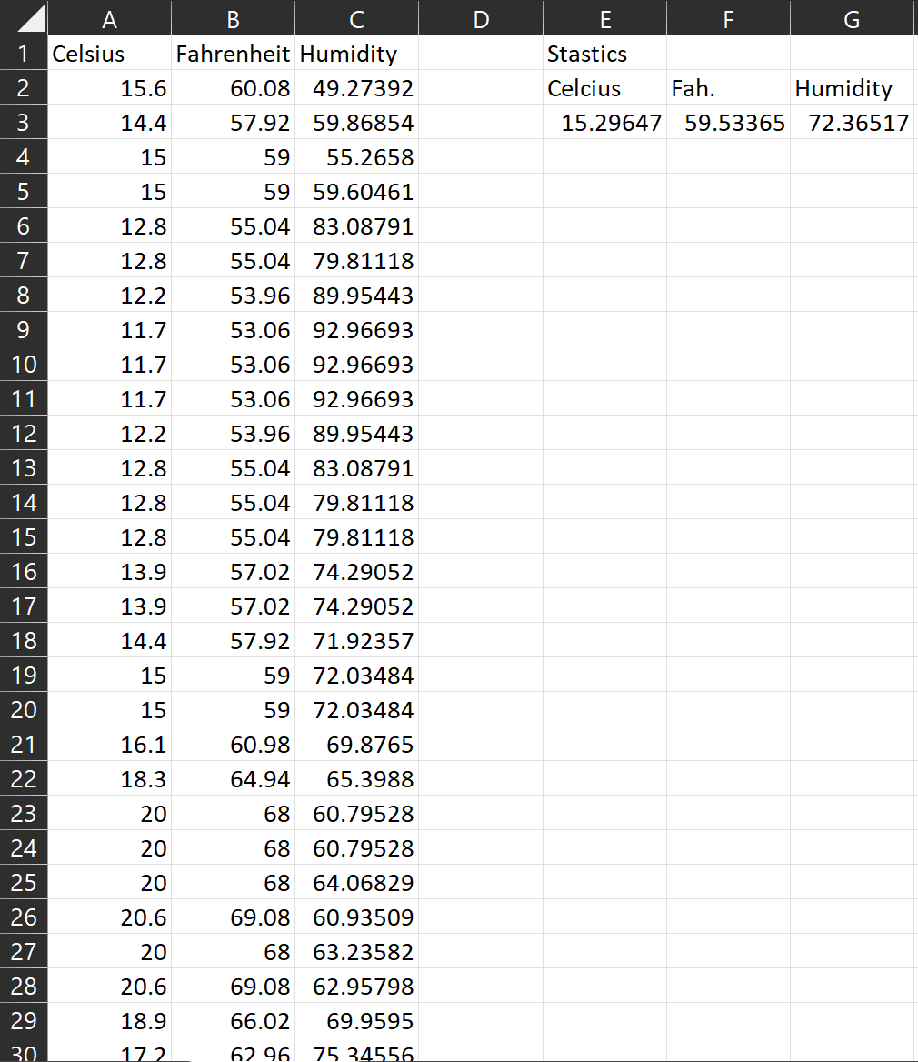
Retrieve and Convert Data to CSV Format

Slide 19
Temperature and Humidity Chart:
Chart displays various temp. and humidity.

Slide 20
Data Analytics
The python data analytics modules was created using various charts and graphics to represent the data.
Data sets can be manipulated and saved into tabular format.
The graphs shown are available in Anaconda
Multiple charts were created with my data.
Predictions were made from my findings

Slide 21
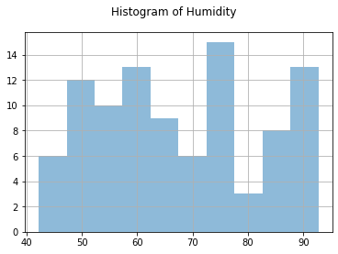
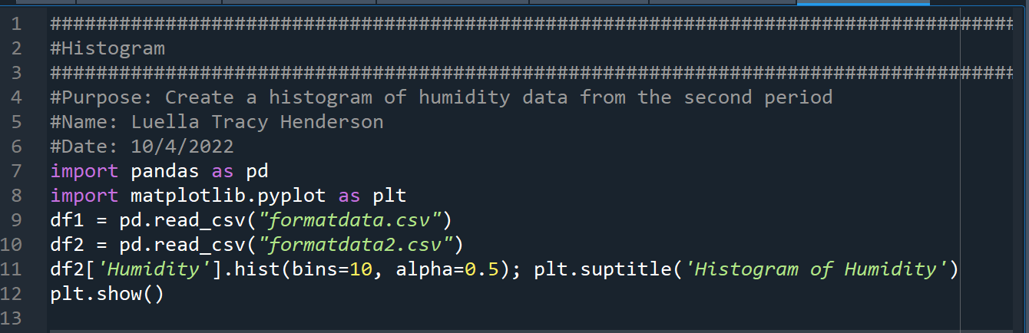
Histogram Graph

Slide 22
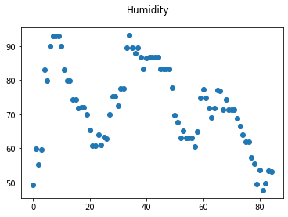
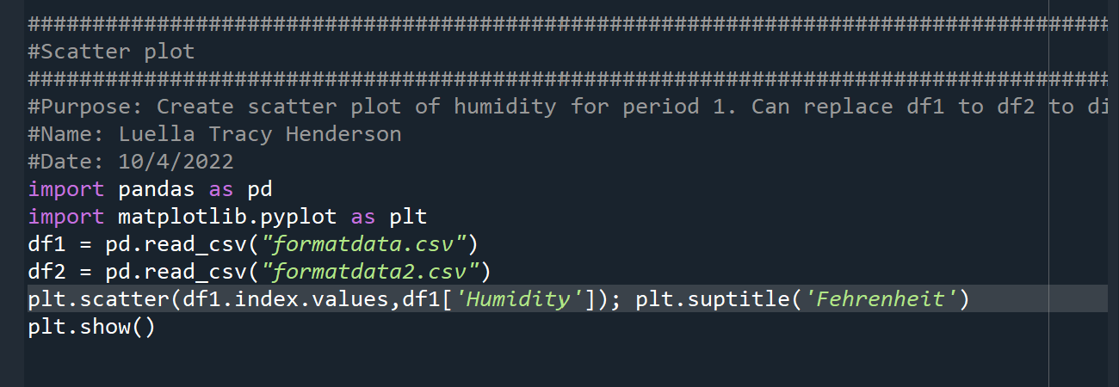
Scatter Plot Graph

Slide 23
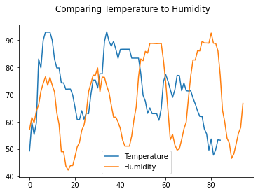
Analysis
Think of your own question and create a chart/graph to answer it
Your own question:
As the temperature increases does the humidity increases?
Answer supported by Chart:
When comparing the data that I have you can see an increase in temperature as well as mid-humidity with the increase in the temperature. You can also see that when the temperature decreases you can see a decrease in humidity. Overtime from looking at this graph you see a good balance of increase and decrease depending on the temperature.

Slide 24
Prediction
Develop a prediction based on the data. What variations in temperature and humidity do you expect over the next few hours or days? How would humidity change if temperature goes up or down?
Within the next few days/hours from my analysis I can predict that the as the temperature decreases overtime the humidity will also decrease, but if the temperature starts to increase then we will see an increase with humidity since the higher the temperature is the more humidity there will be.

Slide 25
Challenges
Some Challenges that I faced while working on this project and throughout the class was and still currently challenging me are:
Trying to make time to learn more about programming and python
In Module 4 I had to re-do my project because I had some hiccups with having clear data show up.

Slide 26

Over Coming Challenges
To work on the challenges that I have mentioned I could simply:
I would have to make time to practice and use python more if I want to better understand it than what I do now.
With my Module 4 challenge to work on that and solve that problem I had to use a different zip code other than my own in order to get a different set of results from my previous ones.

Slide 27


Career Skills
Some Career skills that I learned from this class are:
Patience
Understanding
Better Critical thinking skills
Understanding charts and data concepts
Python and programming
Data cleansing
Troubleshooting and problem solving
How to save files when writing code

Slide 28
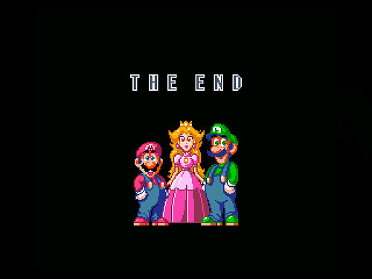
Conclusion
I hope you have enjoyed my final project In this class.
I learned the basics of programming using data.
My understanding on how to program and use python has been vastly expanding and I know I will continuously learn more throughout the rest of my time at DeVry.

