Slide 1


NETW 411
Luella Tracy Henderson
06/20/2024
Prof. Karadsheh

Slide 2


Introduction
The topics I will be discussing are:
How to access an Android Emulator and navigate its user interface.
How to use the Android Debug Bridge (ADB) to gain root access to the Android Emulator device.
explore the Android Developer Tools (ADT) and the Eclipse development environment to create a simple app to be deployed in your Android phone.
reverse engineer an Android App to its source code
explore the use of a proxy server to analyze the traffic between your Android phone and a public Web site.

Slide 3
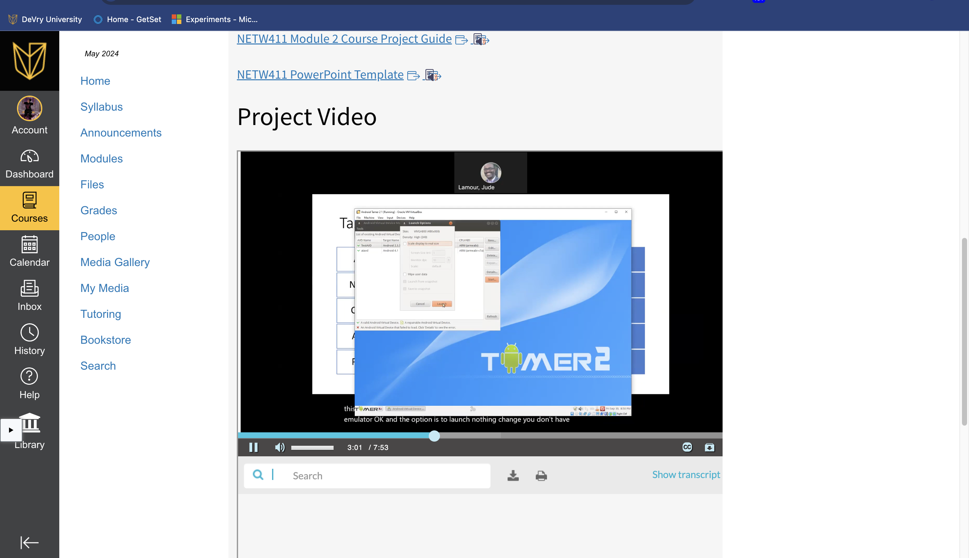
This screenshot should show the Android emulator phone screen with its apps.
Accessing the Android Emulator
Notes:
Screenshot of recorded video of the android emulator.

Slide 4


What is Android SDK? What is it used for?
Answer:
Android SDK is a software development kit that can develop applications on an android platform. Things within the SDK include:
Debugging, libraries, handset emulator, documentation, sample code, tutorials, & relevant documentation for the android program interface (APIs)
Android SDK is used to run, debug, build and test android applications.
References:
1. https://www.edureka.co/blog/android-sdk-tutorial/#:~:text=The%20Android%20SDK%20(Software%20Development,goes%20as%20smoothly%20as%20possible.
2. https://www.youtube.com/watch?v=676FMfkYxOk

Slide 5

What does the com.android.phone process represent?
Answer: It means that you can not use the application because of various issues such as bugs. This process represents the functionality of the phone.
References:
1. https://www.aiseesoft.com/solution/unfortunately-the-process-com-android-phone-has-stopped.html
2. https://www.youtube.com/watch?v=Rsf1LO7BL2Y

Slide 6
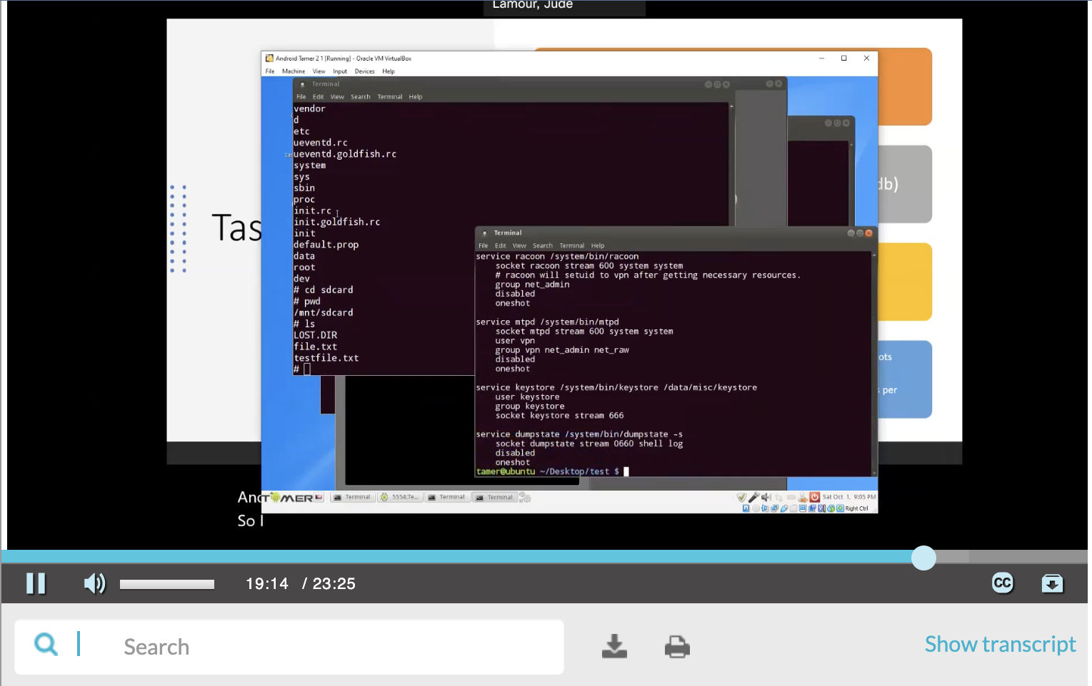
This screenshot should show that the file.txt file is present in the target directory.
Using Mobile Remote Shell

Slide 7
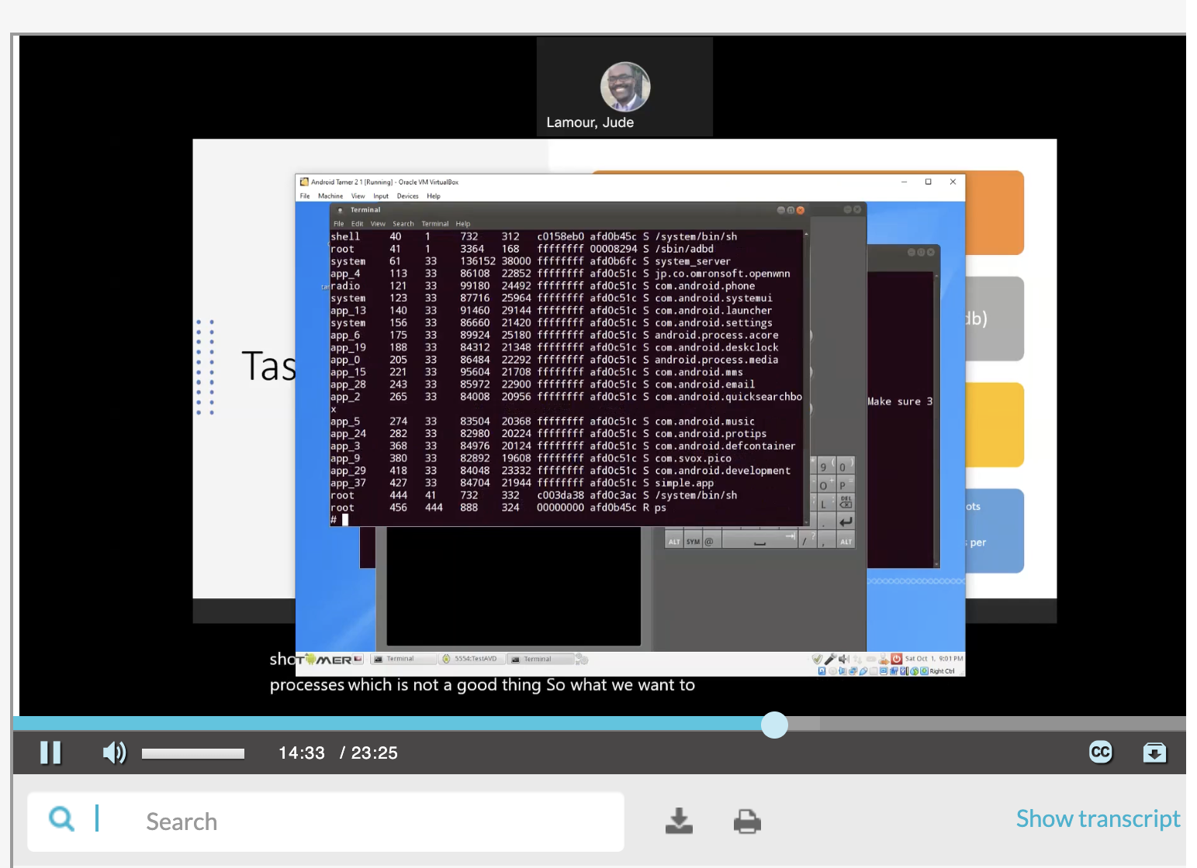
This screenshot should show 1) the abd pull command and 2) the copied over file in the target directory.
Using Mobile Remote Shell

Slide 8

Examine the content of init.rc file on local machine by using the nano init.rc command. Explain the purpose of the file.
Answer: The init file is a key component that deals with the booting process of android systems. It’s job is to initialize instructions.
References:
https://community.nxp.com/t5/i-MX-Processors-Knowledge-Base/What-is-inside-the-init-rc-and-what-is-it-used-for/ta-p/1106360
2. https://www.youtube.com/watch?v=m1Ag4eGlWbU&t=21s

Slide 9
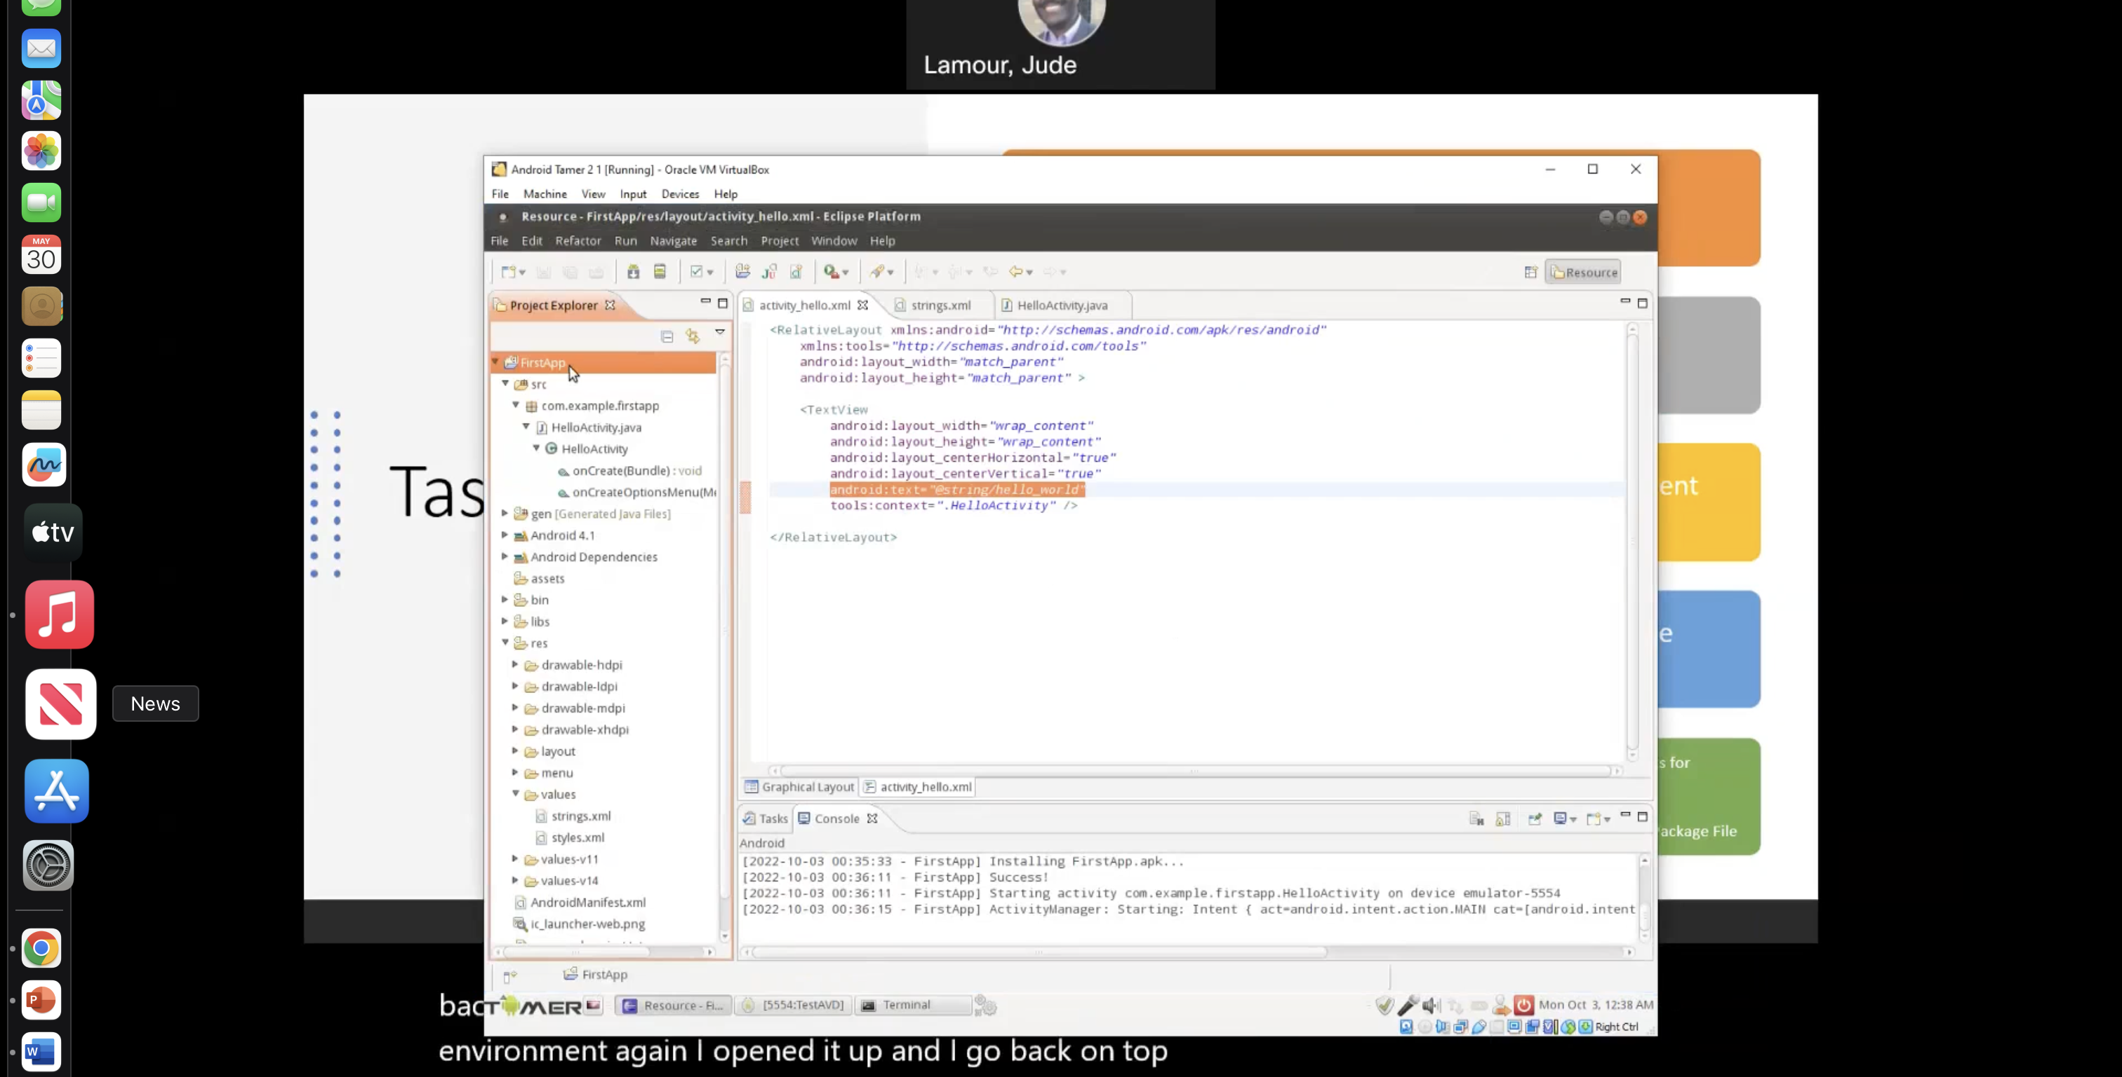
Using the Eclipse IDE
This screenshot should show the phone screen with the “Hello world!” message.
Make sure that the screenshot captures the date/time info in the bottom right corner of your computer screen!

Slide 10
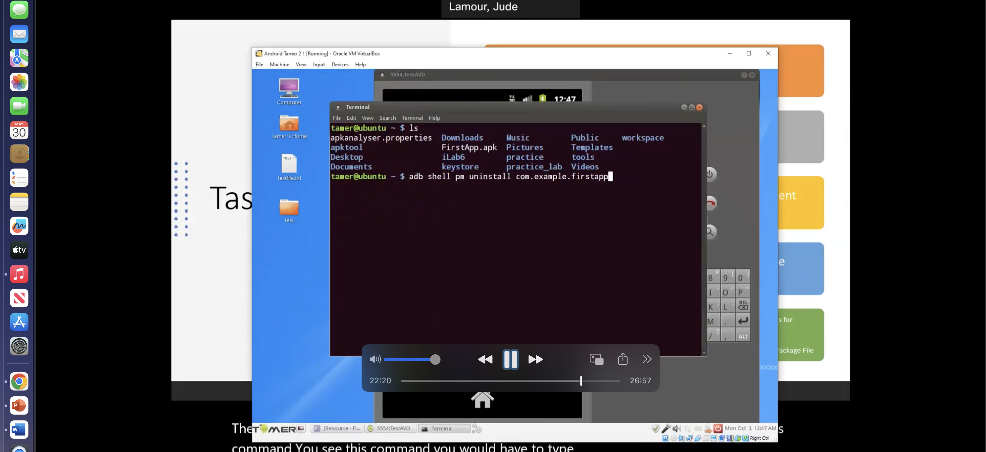
This screenshot should show the phone screen with the new FirstApp app installed.
Creating Android Package File

Slide 11
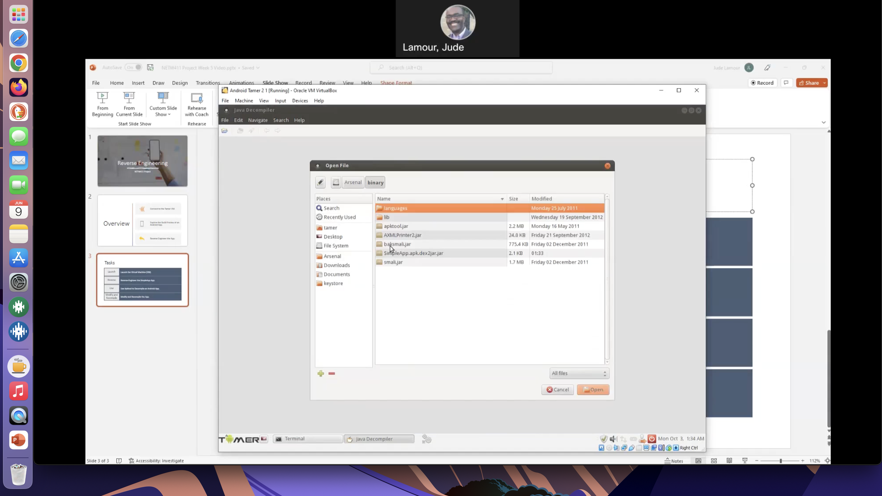
Reverse Engineering the SimpleApp App
This screenshot should show the Java Decompile tool window with SimpleApp source code.

Slide 12
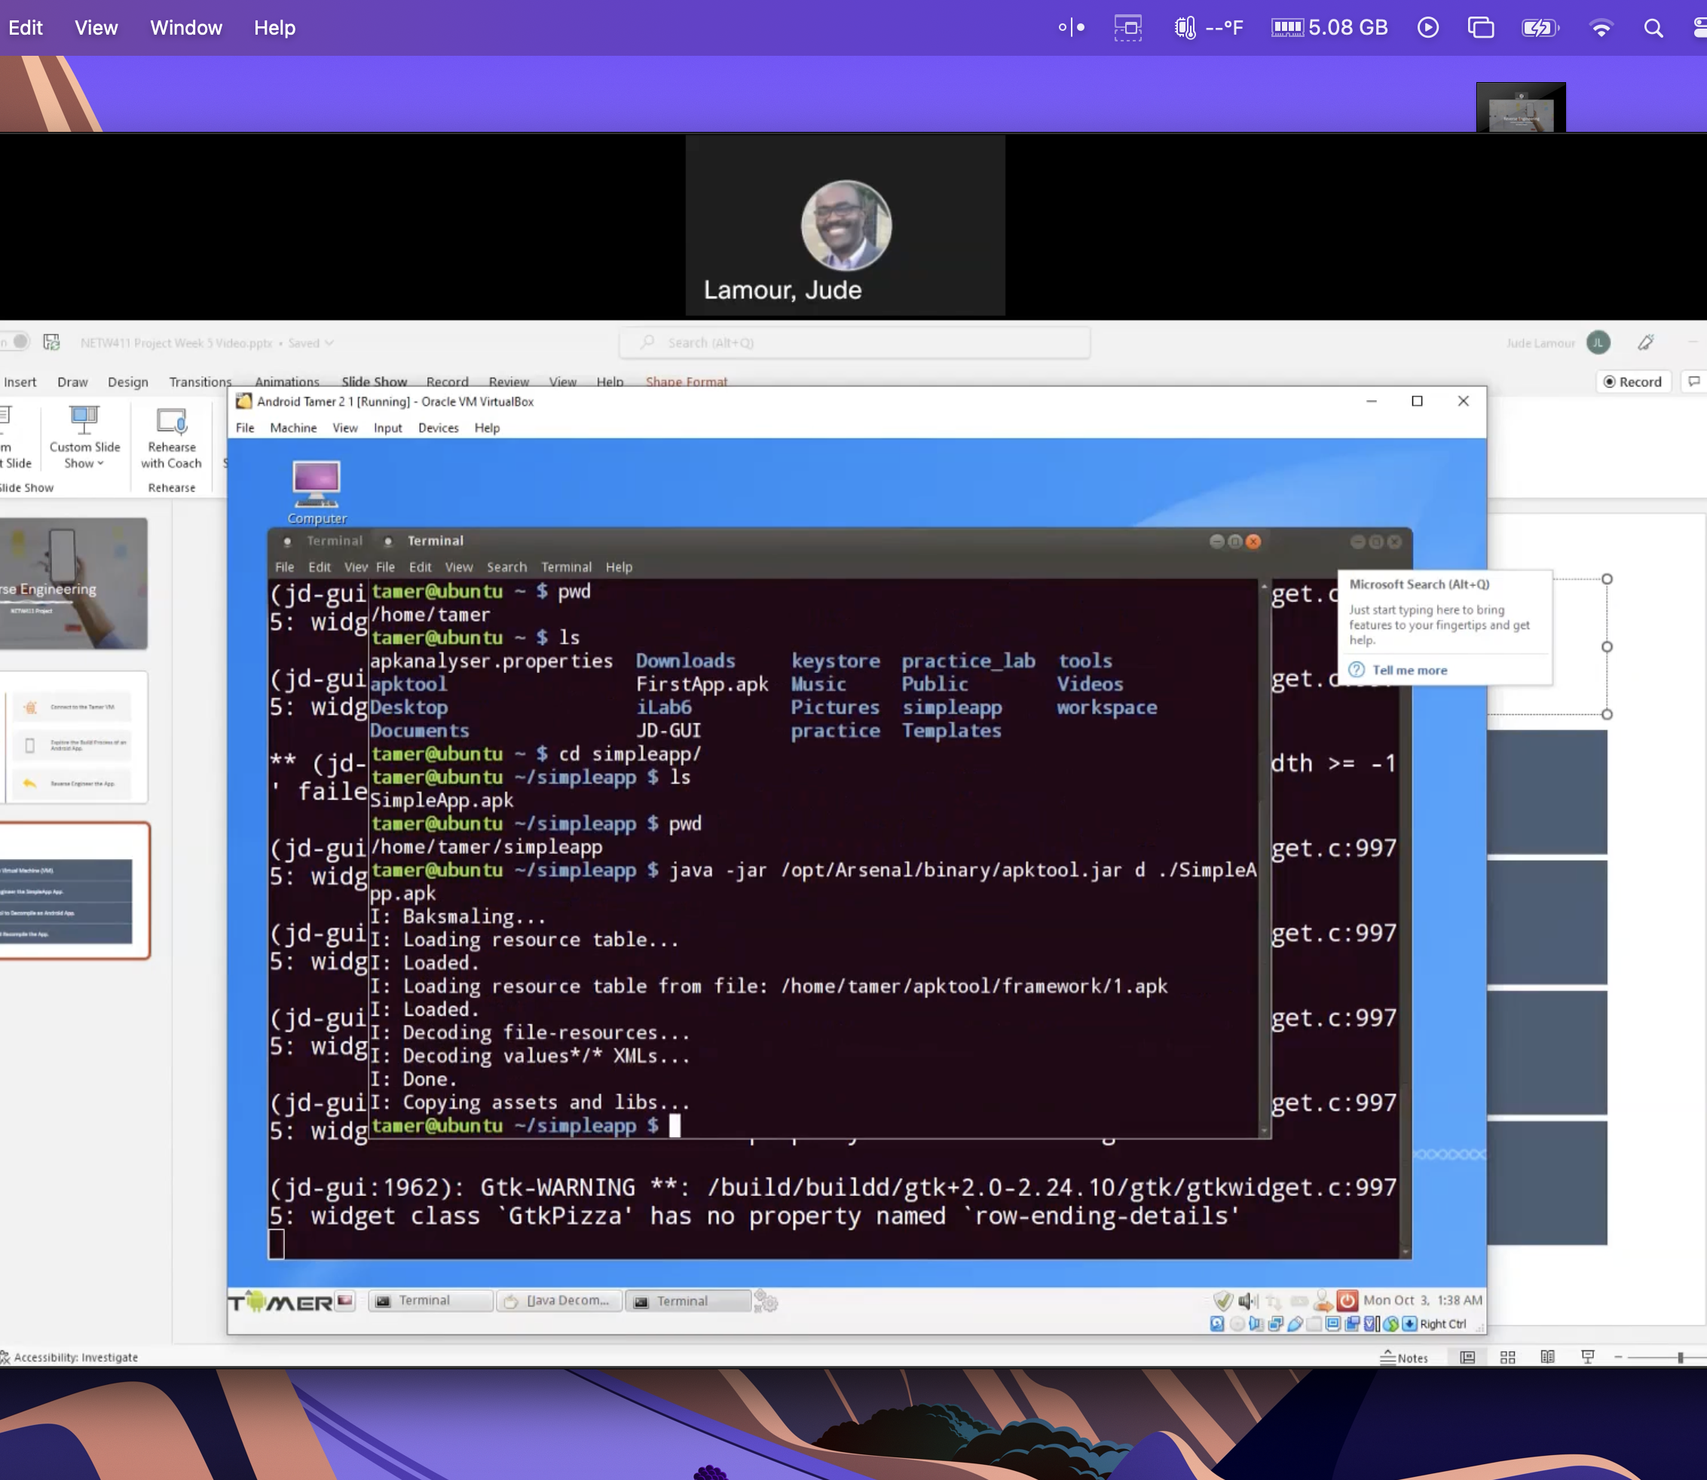
This screenshot should show the content of the AndroidManifest.xml file.
Reverse Engineering the SimpleApp App

Slide 13
Reverse Engineering the SimpleApp App
This screenshot should show the recompiling process using apktool.

Slide 14
Research Burp Suite online.
In the screenshot shown in Step 3, what does it mean when you select “Yes” to confirm the “Are you sure that you want to listen on all interfaces” message?
Answer: You allow a program or device access to listen on all available network interfaces on your system. Allowing other programs to communicate with other devices creates better reach and access between devices and services on the network interfaces.
References:
1. https://www.vaadata.com/blog/introduction-to-burp-suite-the-tool-dedicated-to-web-application-security/
2. https://www.scaler.com/topics/cyber-security/burp-suite/

Slide 15
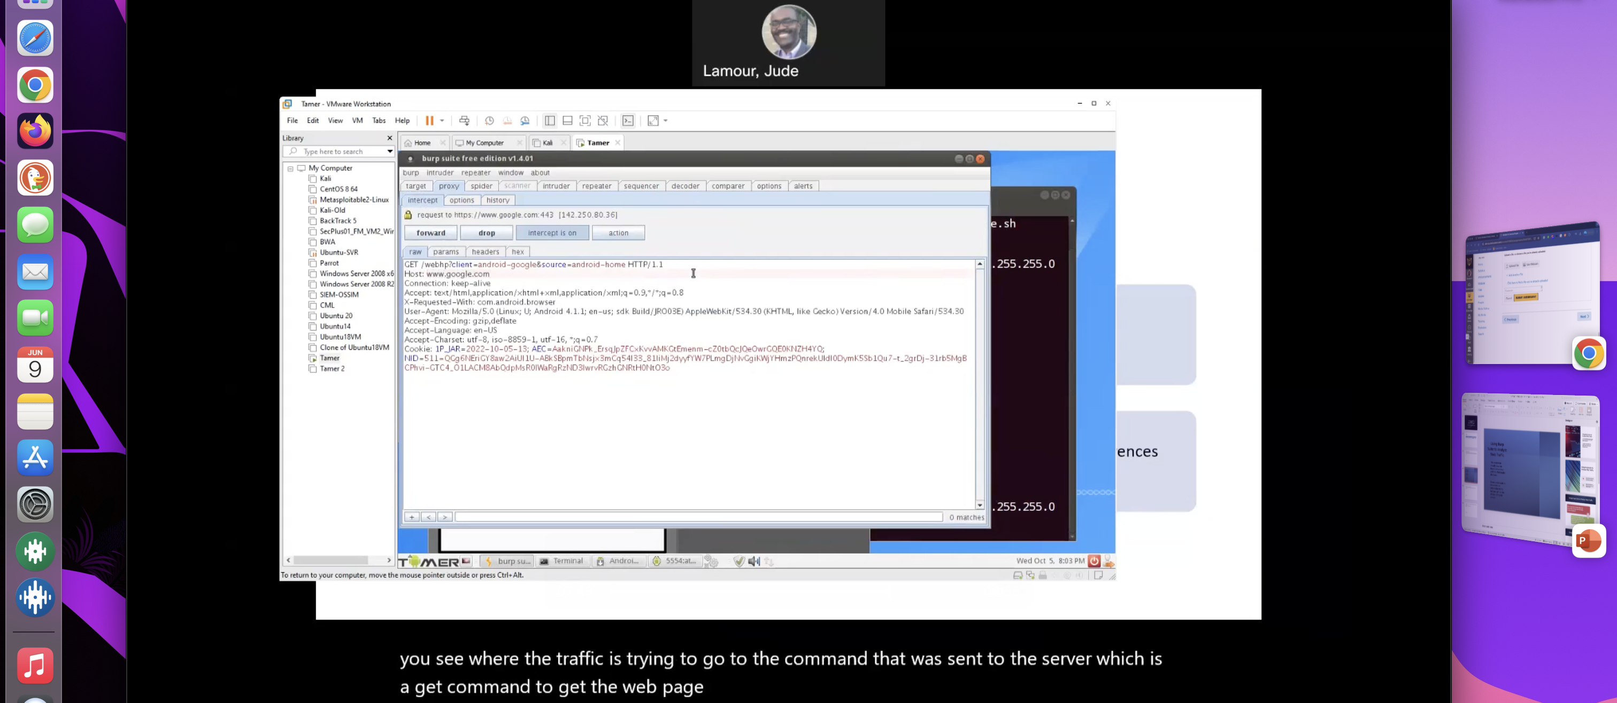
Using Burp Suite to Analyze Web Traffic
This screenshot should show the Burp Suite window with the Web header displayed.
.

Slide 16

Research the concept of “Web Headers.”
What is the role played by Web headers in a hacker’s attempt to mount a cyber attack?
Answer: Security headers are directives used by web applications to configure security defenses in web browsers. Based on these directives, browsers can make it harder to exploit client-side vulnerabilities such as Cross-Site Scripting or Clickjacking. Headers can also be used to configure the browser to only allow valid TLS communication and enforce valid certificates, or even enforce using a specific server certificate.
References:
https://help.deepsecurity.trendmicro.com/aws/http-security-headers.html#:~:text=Security%20headers%20are%20directives%20used,Cross%2DSite%20Scripting%20or%20Clickjacking.
2. https://www.youtube.com/watch?v=a8ekABWZ_-Q

Slide 17

Research the proxy software available for actual Android devices (not just an emulator).
Describe what it is and how it works.
Answer: There are various types of proxy software available for android devices here are a few that named top for this year in 2024 such as Oxylabs, Control D, Nord VPN these are just to name a few. Proxy servers enable the connection between client requests and resource providers through an intermediary server that manages and performs the network transaction. Some of the software that I mentioned do exactly that, but each product may do more than the other, this also goes into how much you want to spend on such software for protection.
References:
https://sourceforge.net/software/proxy-servers/android/
2. https://www.javatpoint.com/proxy-browser-apps-for-android

Slide 18

Challenges
The only issue I really had with the projects is not being able to do them. Since I own a MacBook I was not able to download the software needed to do the android emulator. The only solution was for me to watch the videos full on through for credit purposes.

Slide 19

Career Skills
Critical thinking skills
Understanding
Deeper knowledge
Trouble shooting and problem solving

Slide 20

I hope you have enjoyed this slide show presentation.
The things learned in this presentation is a hands-on experience that I got a chance to see how it was done. I Definity learned a lot even though I could not fully engage the way I wanted to the example videos were very helpful and useful when learning the following:
How to access an Android Emulator and navigate its user interface.
How to use the Android Debug Bridge (ADB) to gain root access to the Android Emulator device.
explore the Android Developer Tools (ADT) and the Eclipse development environment to create a simple app to be deployed in your Android phone.
reverse engineer an Android App to its source code
explore the use of a proxy server to analyze the traffic between your Android phone and a public Web site.

